Slide 1
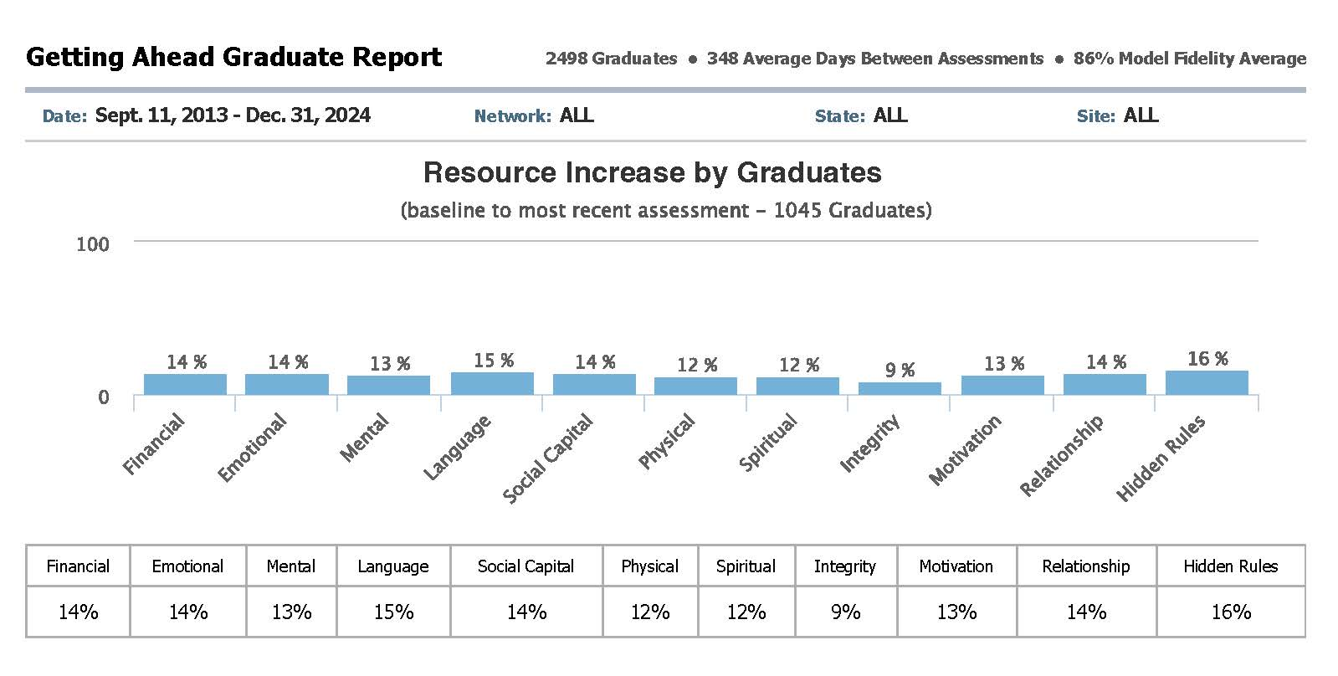
Getting Ahead Graduation Report December 31, 2024
Copyright 2025 by aha! Process, Inc. Report portal funded by aha! Process, Inc. in partnership with Simon Solutions (Developers of Charity Tracker)

Slide 2
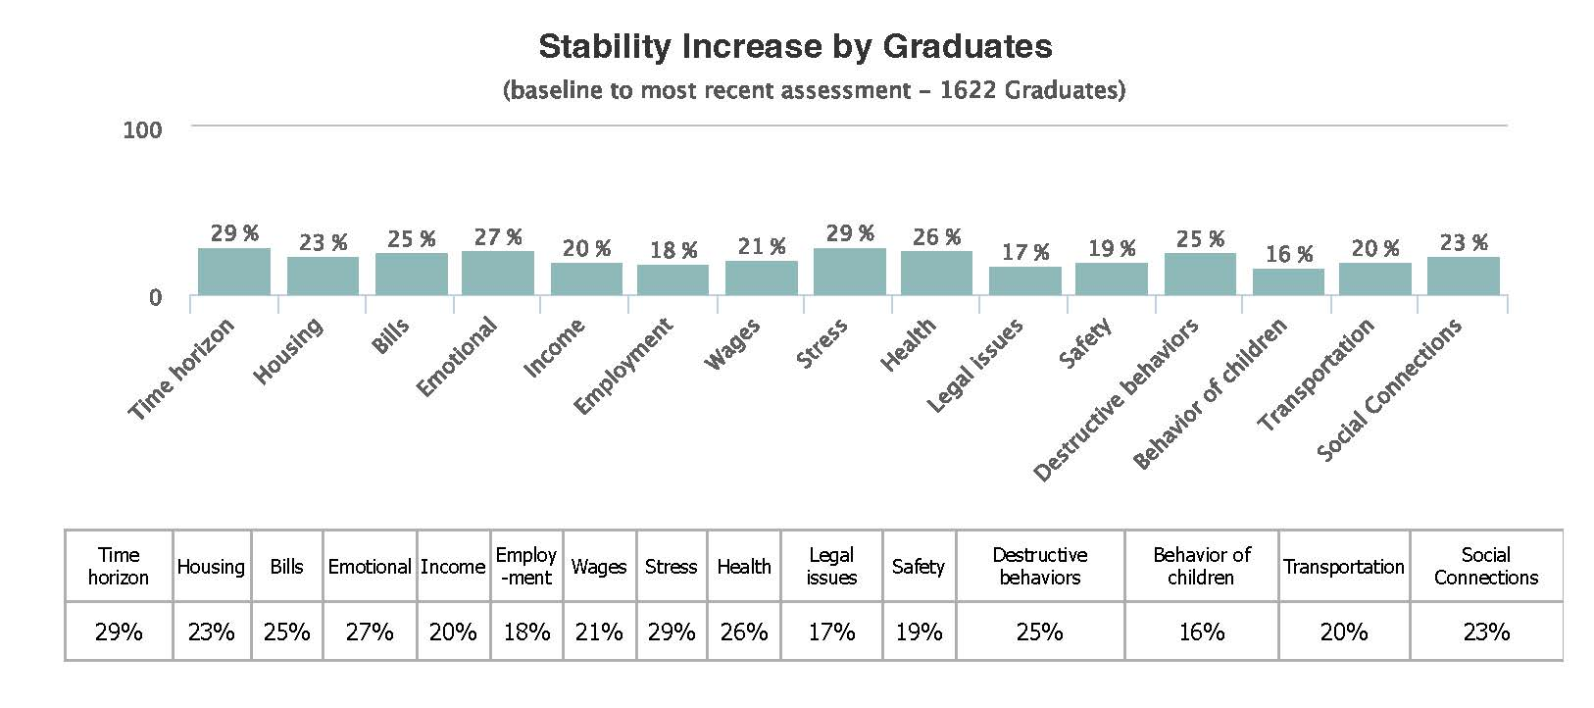
Getting Ahead Graduate Report (continued)
Copyright 2025 by aha! Process, Inc. Report portal funded by aha! Process, Inc. in partnership with Simon Solutions (Developers of Charity Tracker)

Slide 3
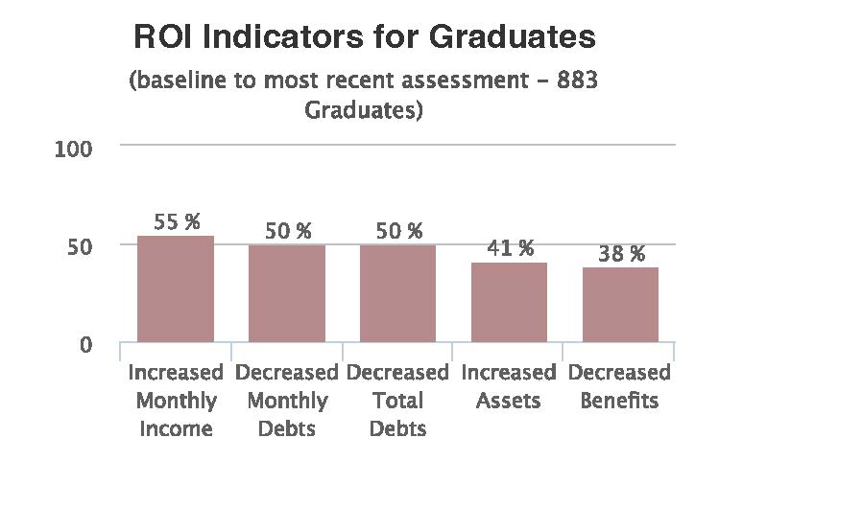
Getting Ahead Graduate Report (continued)
Copyright 2025 by aha! Process, Inc. Report portal funded by aha! Process, Inc. in partnership with Simon Solutions (Developers of Charity Tracker)

