Slide 1
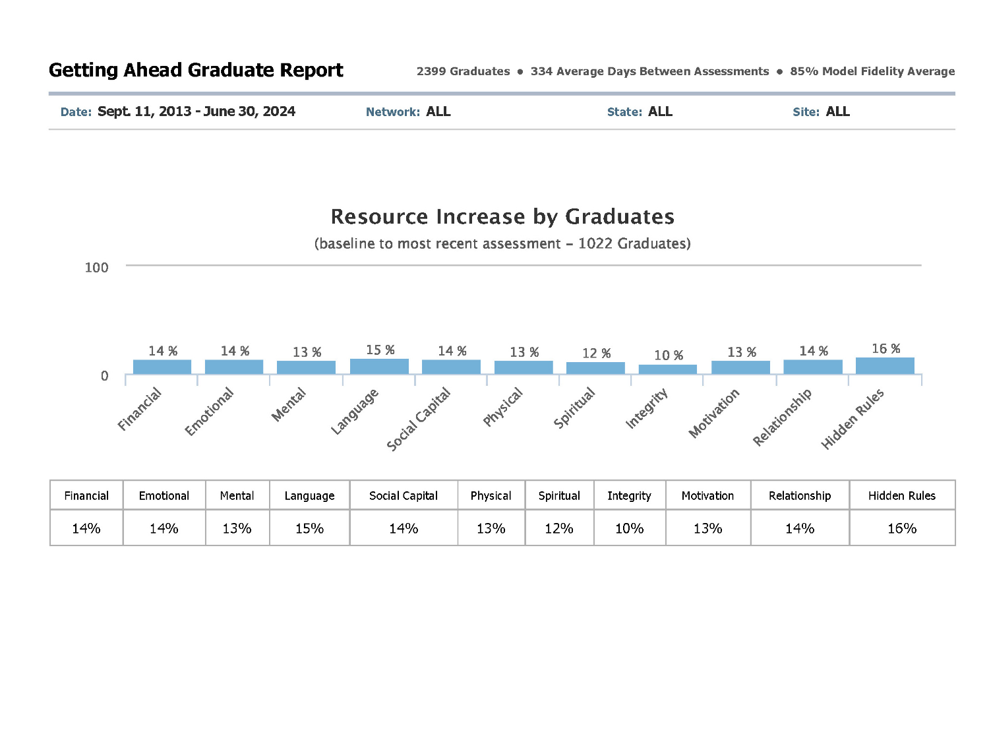
Getting Ahead Graduation Report June 30, 2024
Copyright 2024 by aha! Process, Inc. Report portal funded by aha! Process, Inc. in partnership with Simon Solutions (Developers of Charity Tracker) p 1

Slide 2
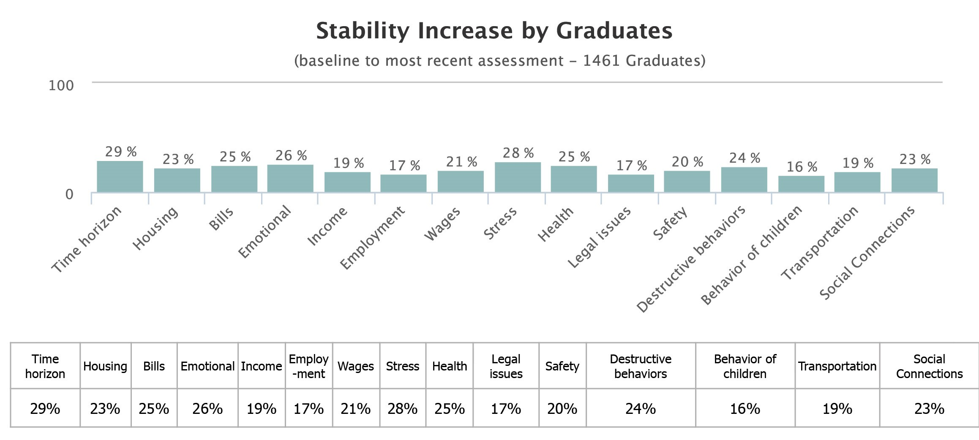
Getting Ahead Graduate Report (continued)
Copyright 2024 by aha! Process, Inc. Report portal funded by aha! Process, Inc. in partnership with Simon Solutions (Developers of Charity Tracker) p 2

Slide 3
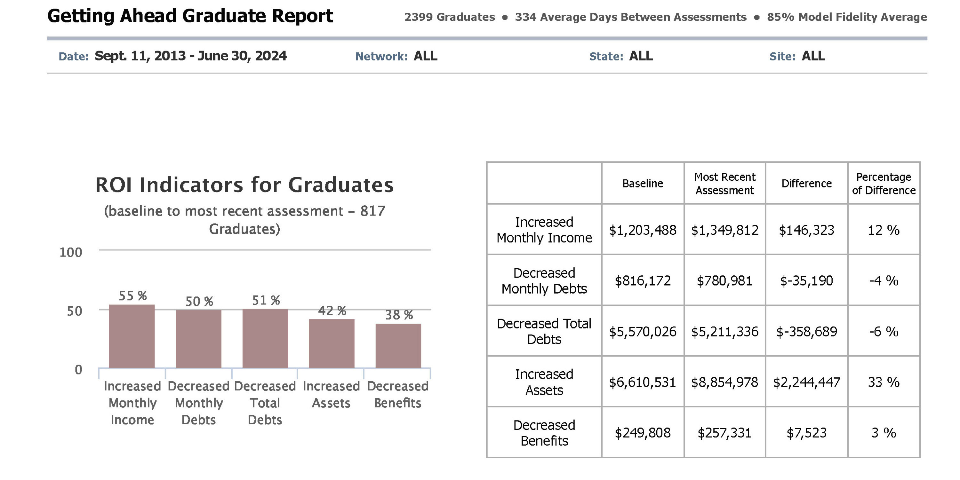
Getting Ahead Graduate Report (continued)
Copyright 2024 by aha! Process, Inc. Report portal funded by aha! Process, Inc. in partnership with Simon Solutions (Developers of Charity Tracker) p 3

