Slide 1
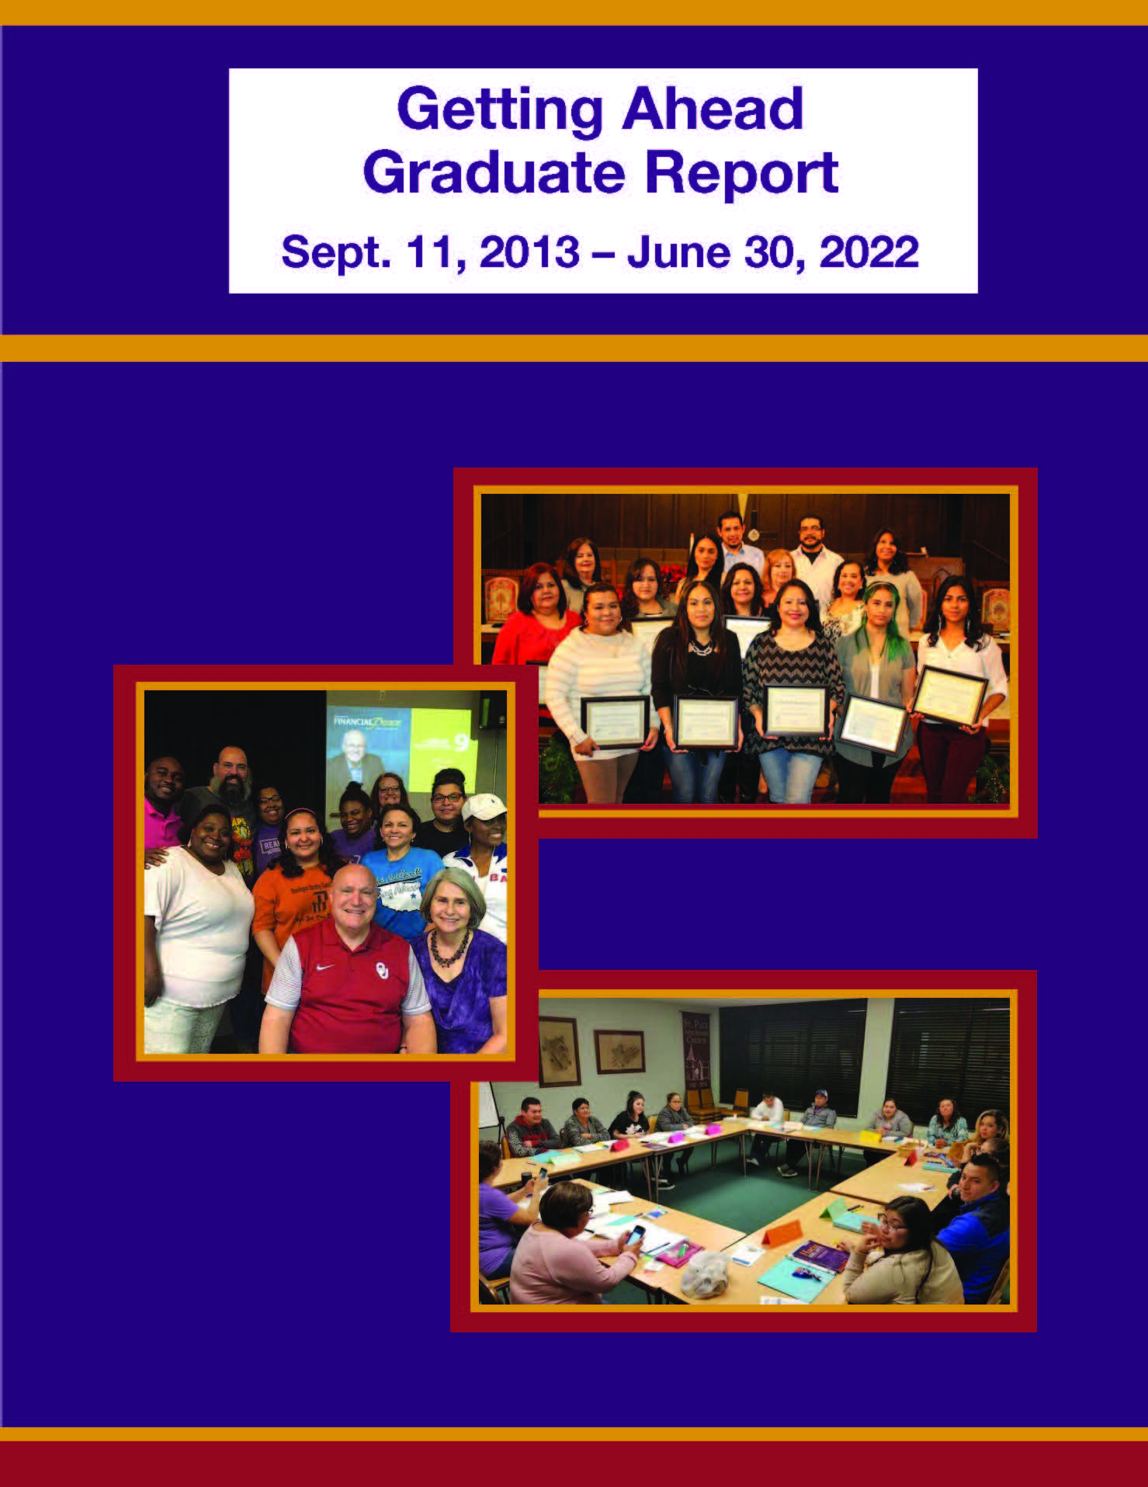


Slide 2
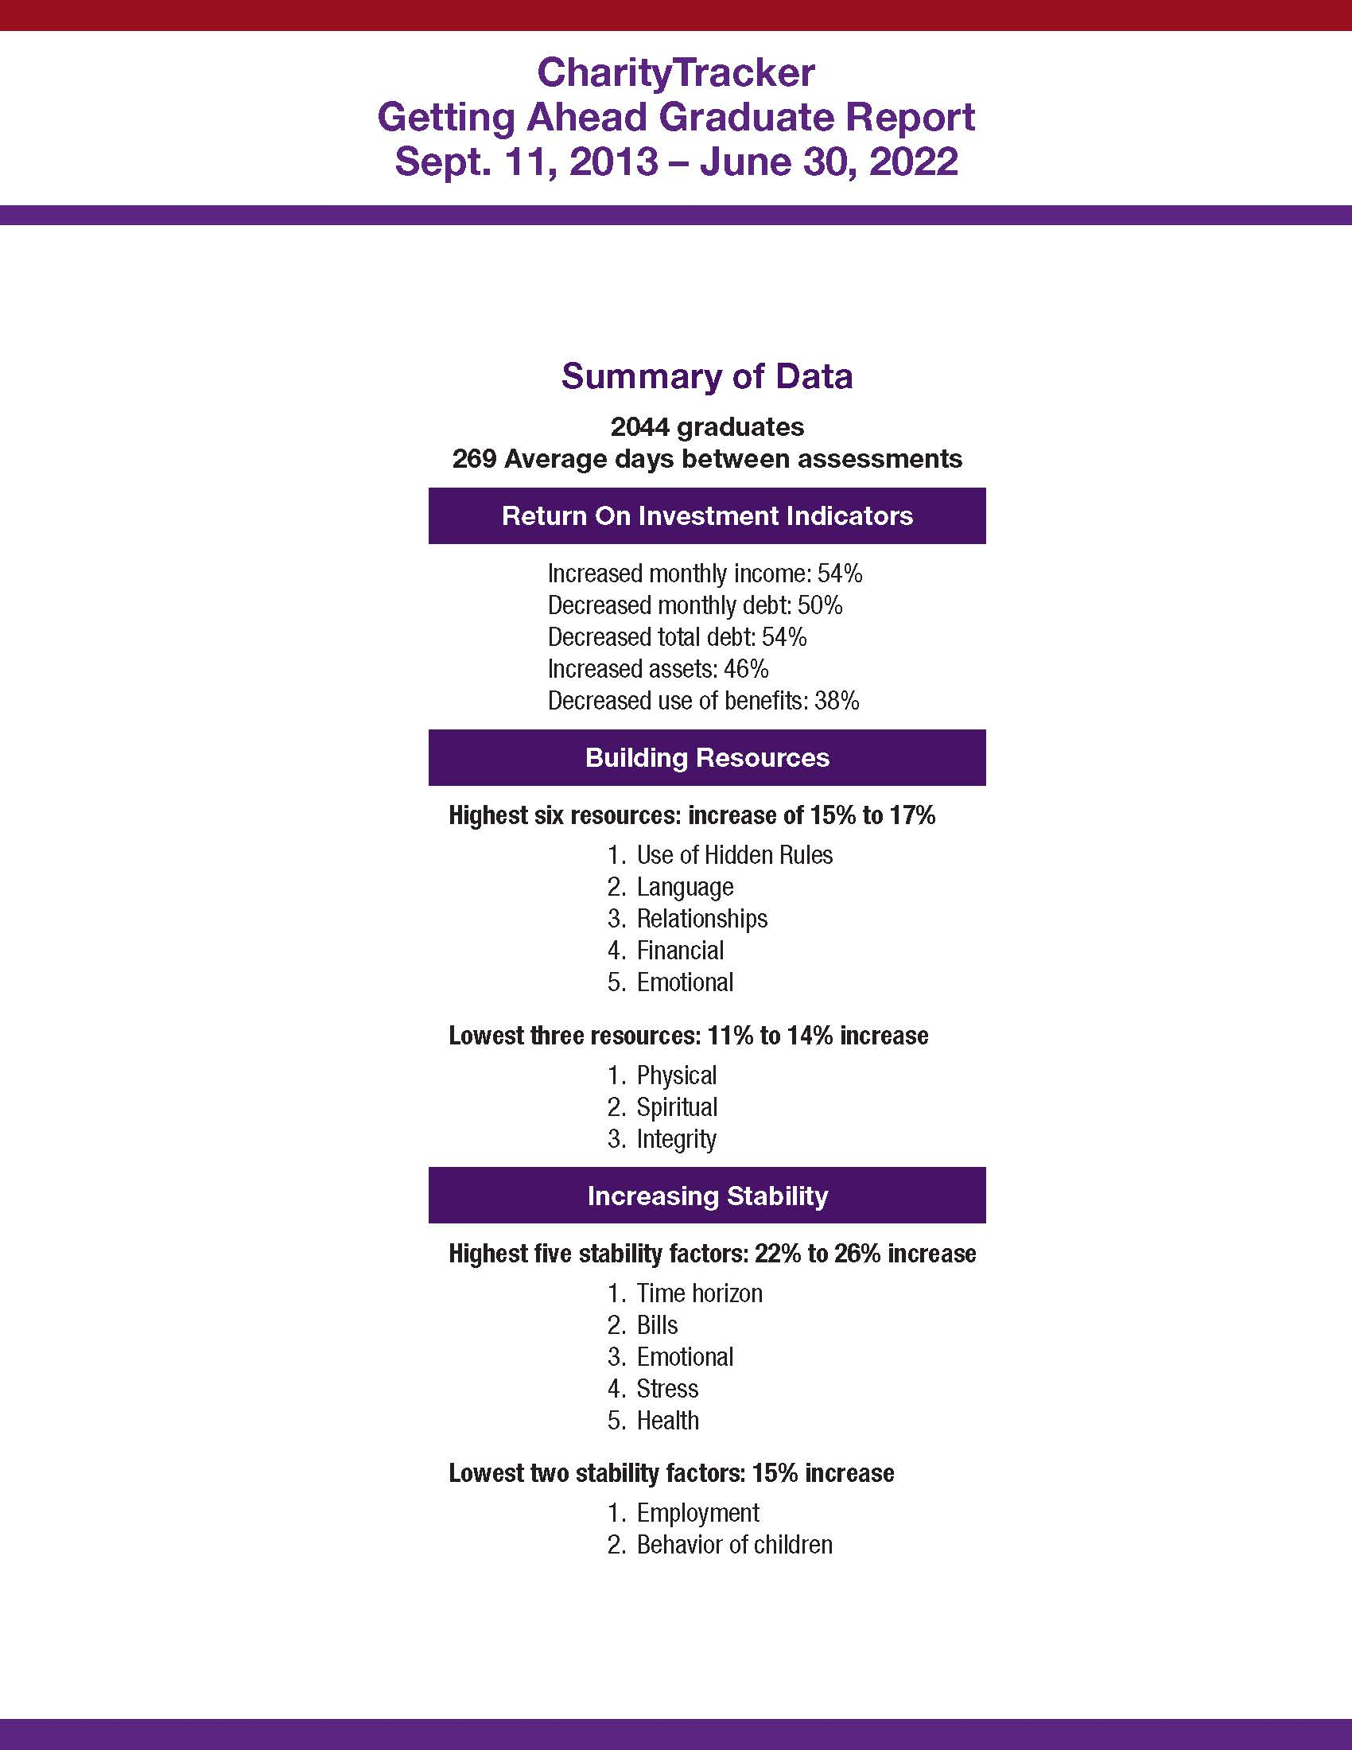
Notes:
Getting Ahead investigators complete a self-assessment of 11 resources. This graph demonstrates the improvement noted by investigators as a group. Note that there were 1,804 graduates in the database, but each section of this report shows the number of graduates from all states that completed that assessment. Also note that the average number of days between assessments is 196, just a little more than half a year. That is not much time to make changes. Getting Ahead sites are encouraged to support and reassess Getting Ahead graduates over a longer period of time.

Slide 3
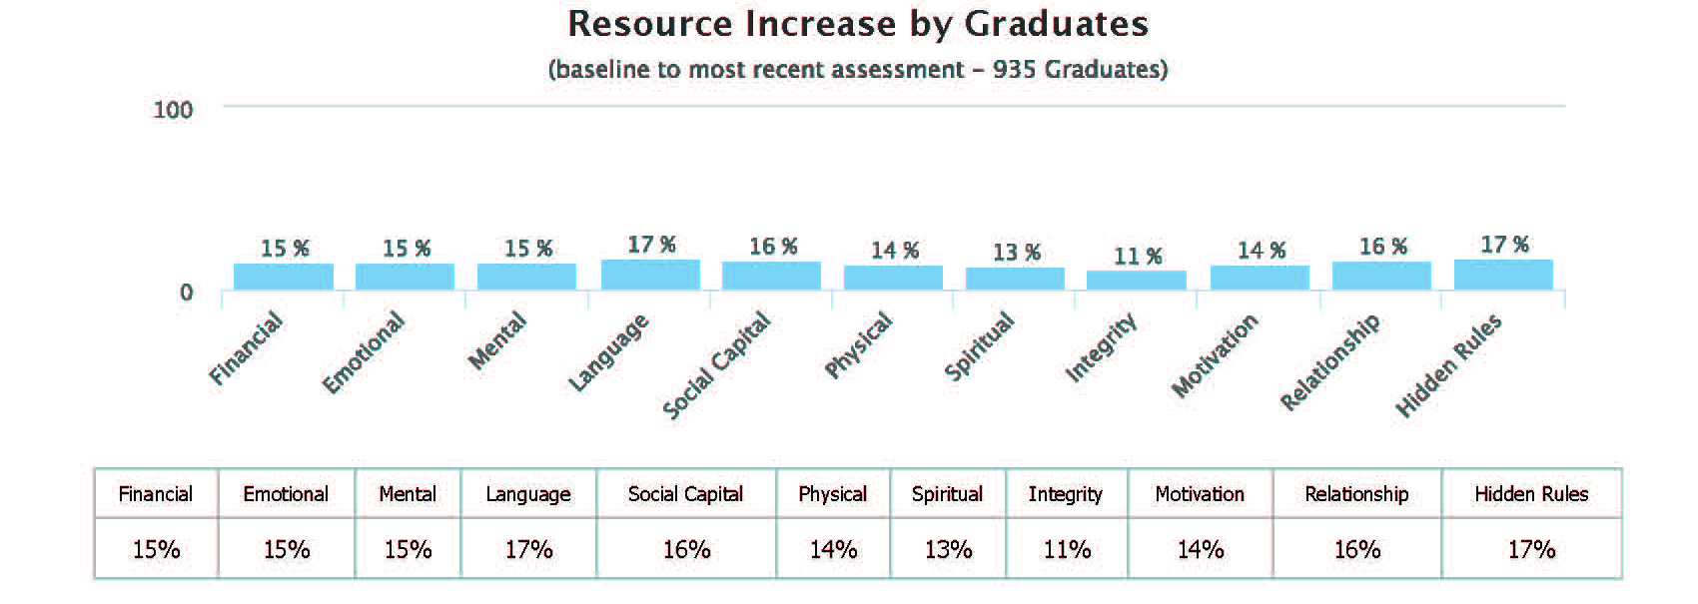

Slide 4
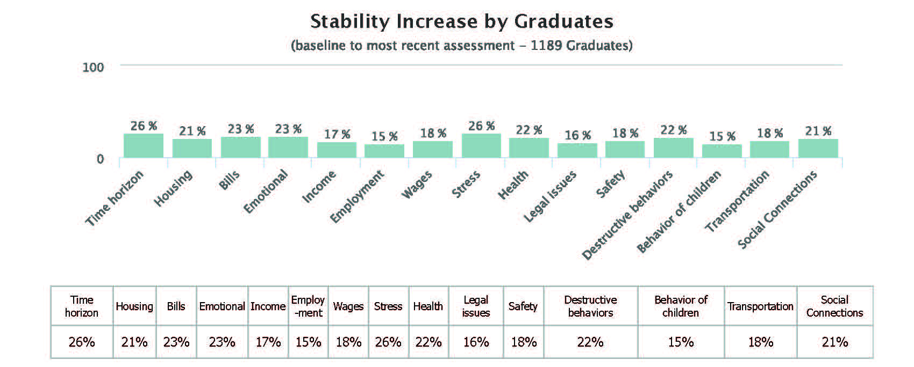

Slide 5
