Slide 1
Getting Ahead in the Workplace Virtual
Philip DeVol

Slide 2
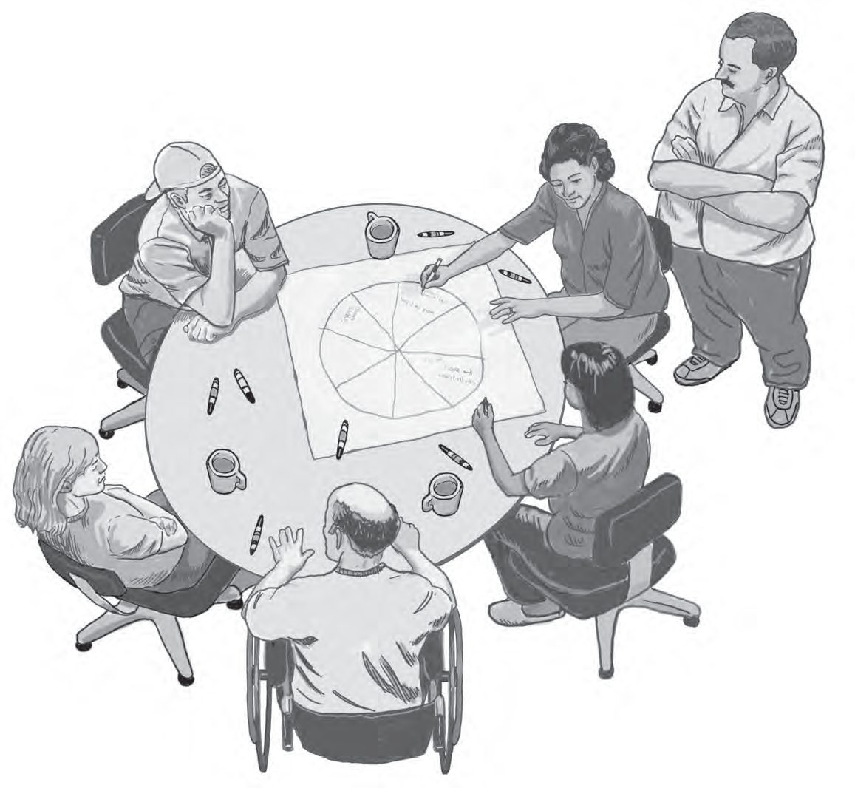
Module 1: My Life Now
Page 9

Slide 3
Mental Model of Economic Instability Activity
Getting Ahead in the Workplace Mental Model of Economic Insecurity
https://fs27.formsite.com/a34qO0/lprtbdrsed/index.html

Slide 4
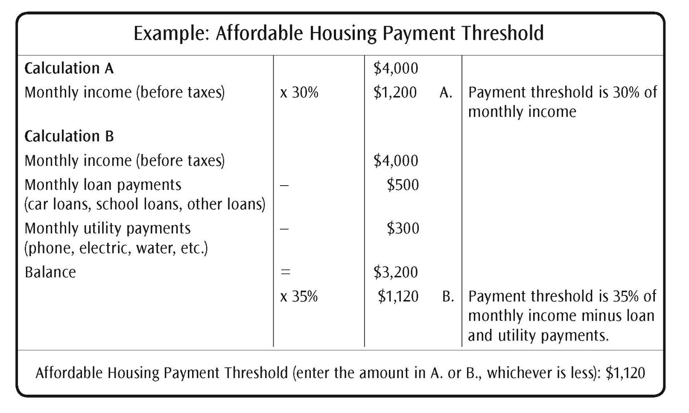
Affordable Housing Payment Threshold Calculator
Page 14

Slide 5
Affordable Housing Payment Threshold Calculator Activity
Getting Ahead in the Workplace Affordable Housing Payment Threshold
https://fs27.formsite.com/a34qO0/d1oeikmzaq/index.htmla
Page 14

Slide 6
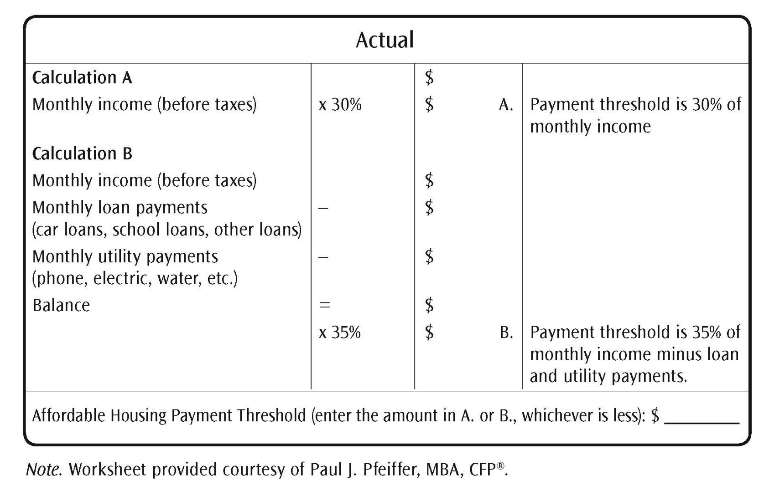
Affordable Housing Payment Threshold Calculator Activity (continued)
Page 14

Slide 7
Debt-to-Income Ratio Activity
Getting Ahead in the Workplace Debt-to-Income Ratio
https://fs27.formsite.com/a34qO0/nixtbboqfq/index.html
Page 20

Slide 8
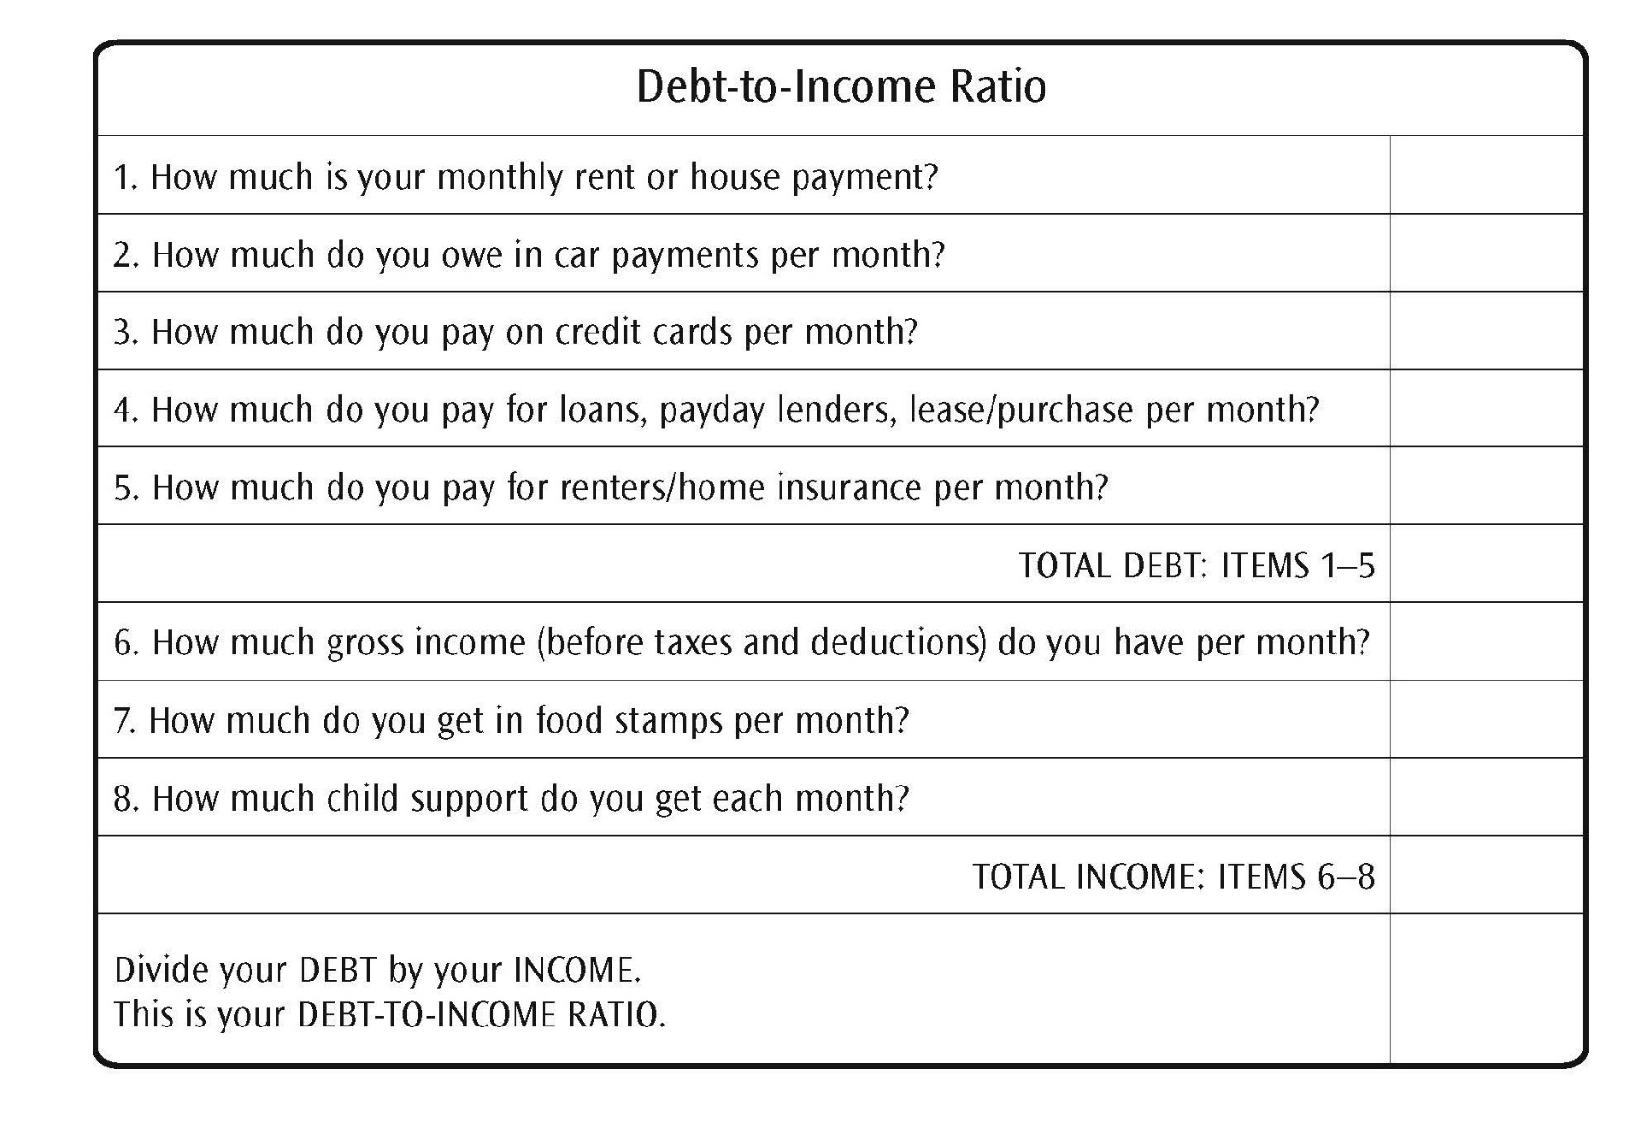
Debt-to-Income Ratio
Page 20

Slide 9
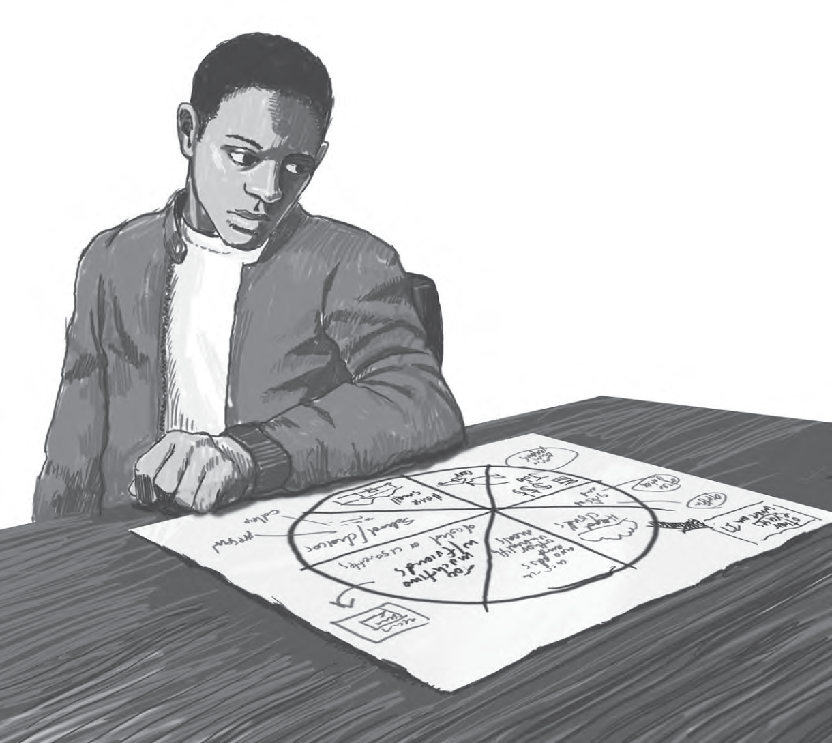
Module 2: Theory of Change
Page 27

Slide 10
Stability Scale Self-Assessment Activity
Getting Ahead in the Workplace Stability Scale
https://fs27.formsite.com/a34qO0/8plpqha8ks/index.html
Page 32

Slide 11
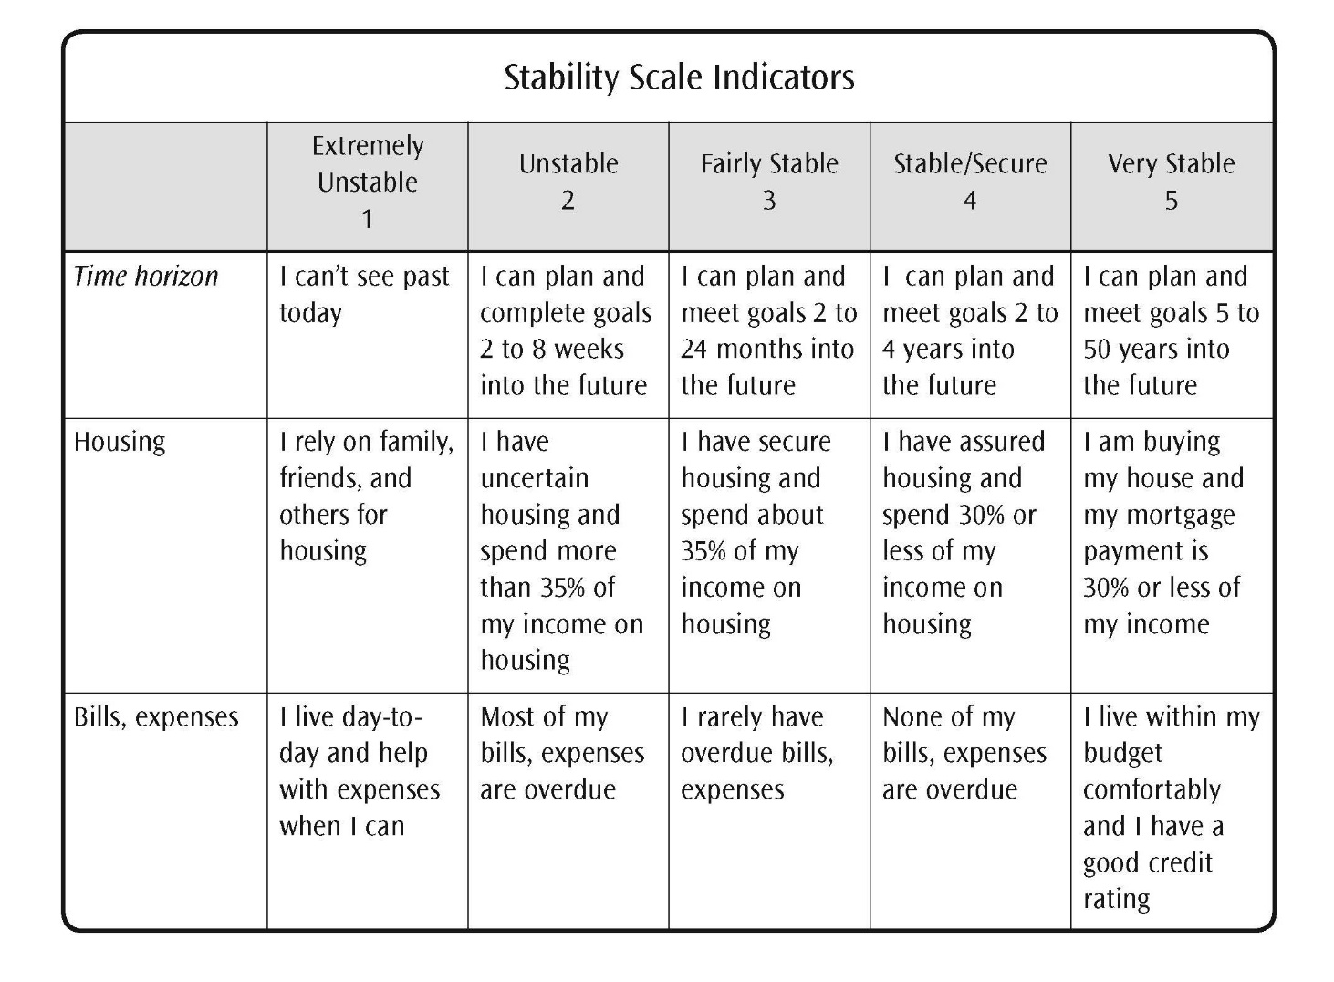
Stability Scale Self-Assessment
Page 32

Slide 12
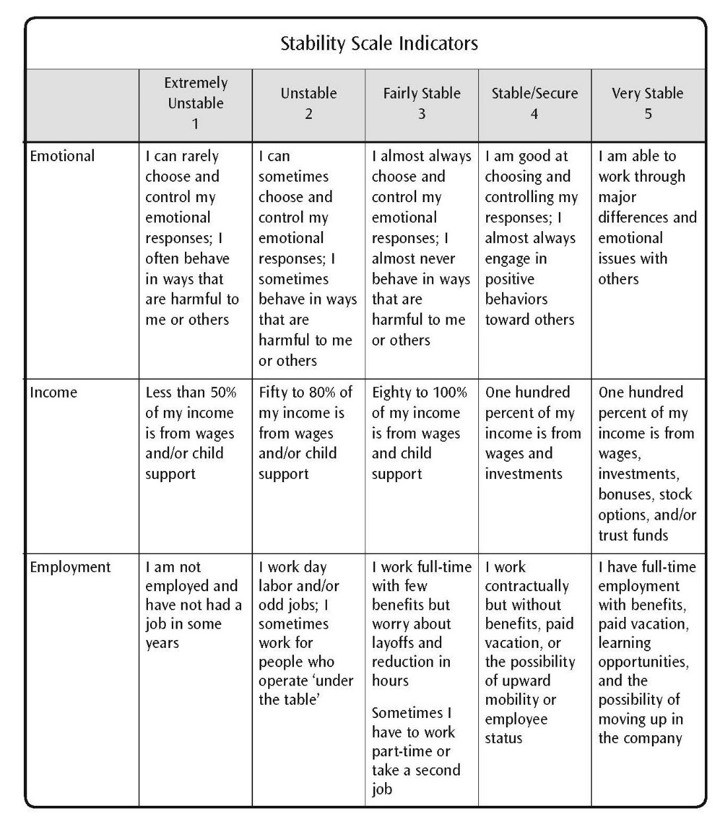
Stability Scale Self-Assessment (continued)
Page 33

Slide 13
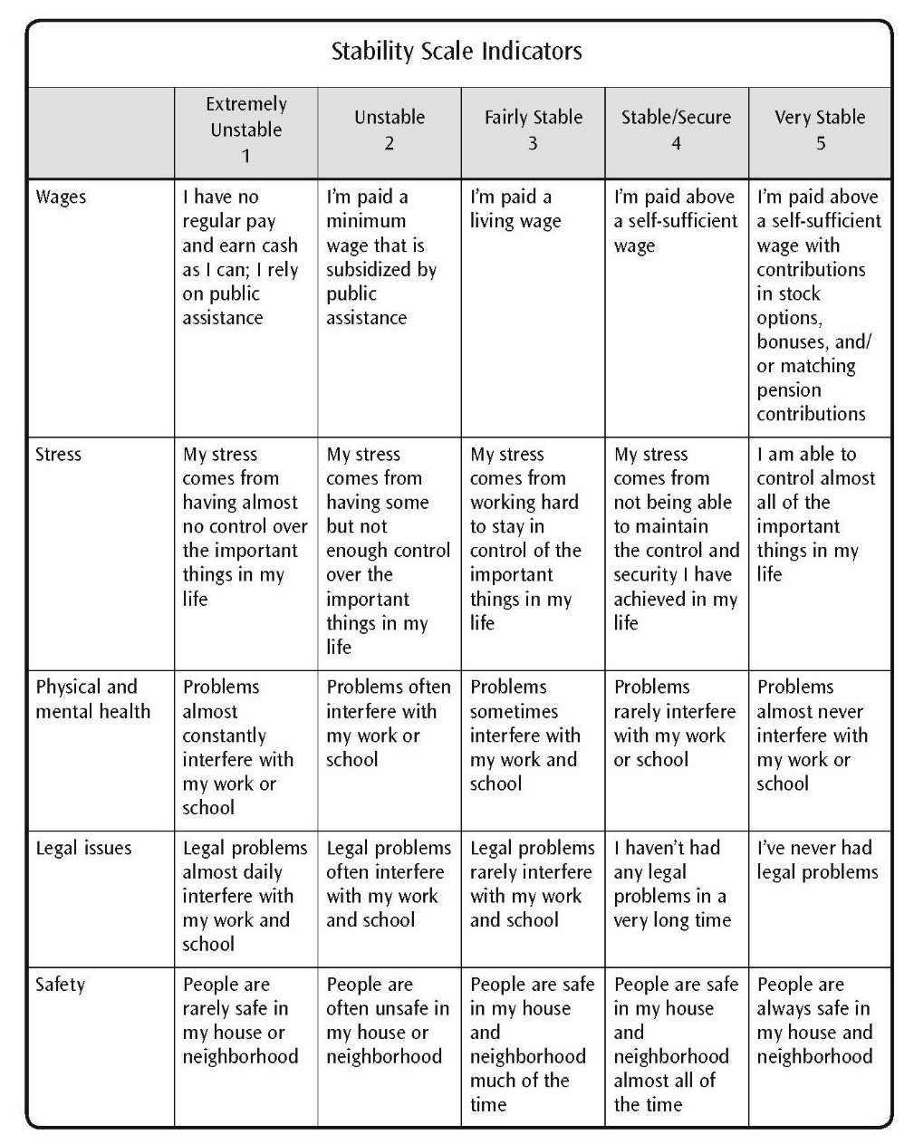
Stability Scale Self-Assessment (continued)
Page 34

Slide 14
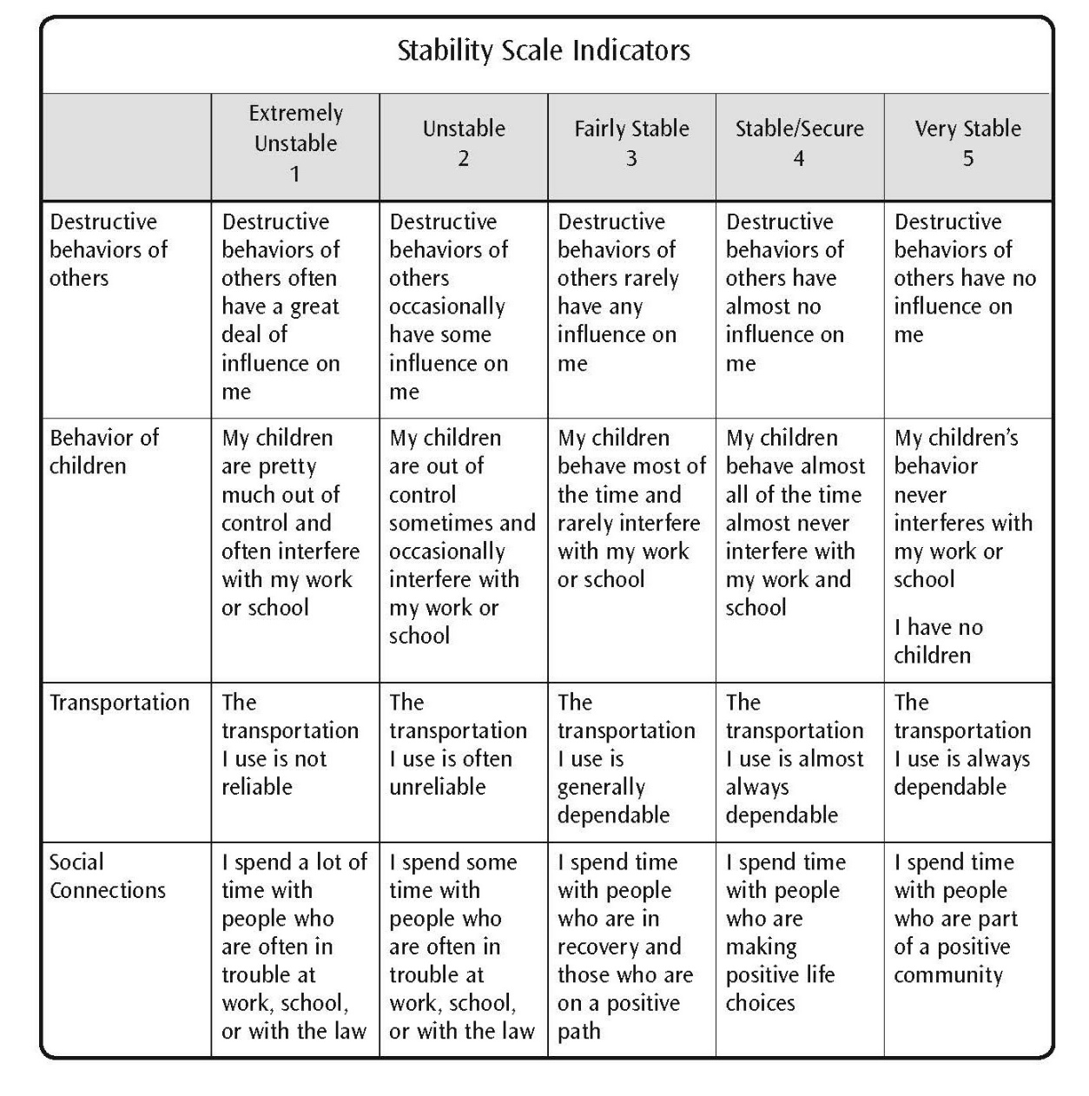
Stability Scale Self-Assessment (continued)
Page 35

Slide 15
Stability Scale Self-Assessment (continued)
Page 36

Slide 16
Model Mental Theory of Change
Abstract
P | L | A | N | S
Procedural Steps
_________
_________
_________
Abstract:
Detached
Objective
Think
Analyze
New information
Education
Plans
Support
Concrete
Future Story
Page 37

Slide 17
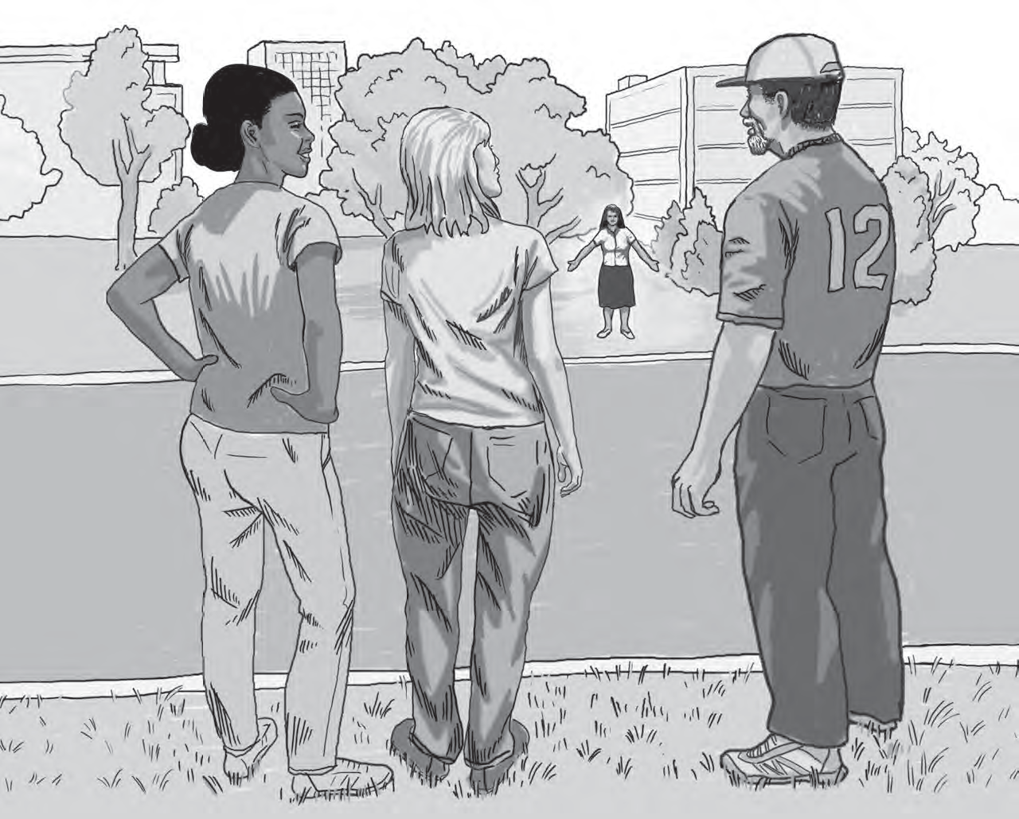
Module 3: Research on the Causes of Poverty and Economic Instability
Page 43

Slide 18
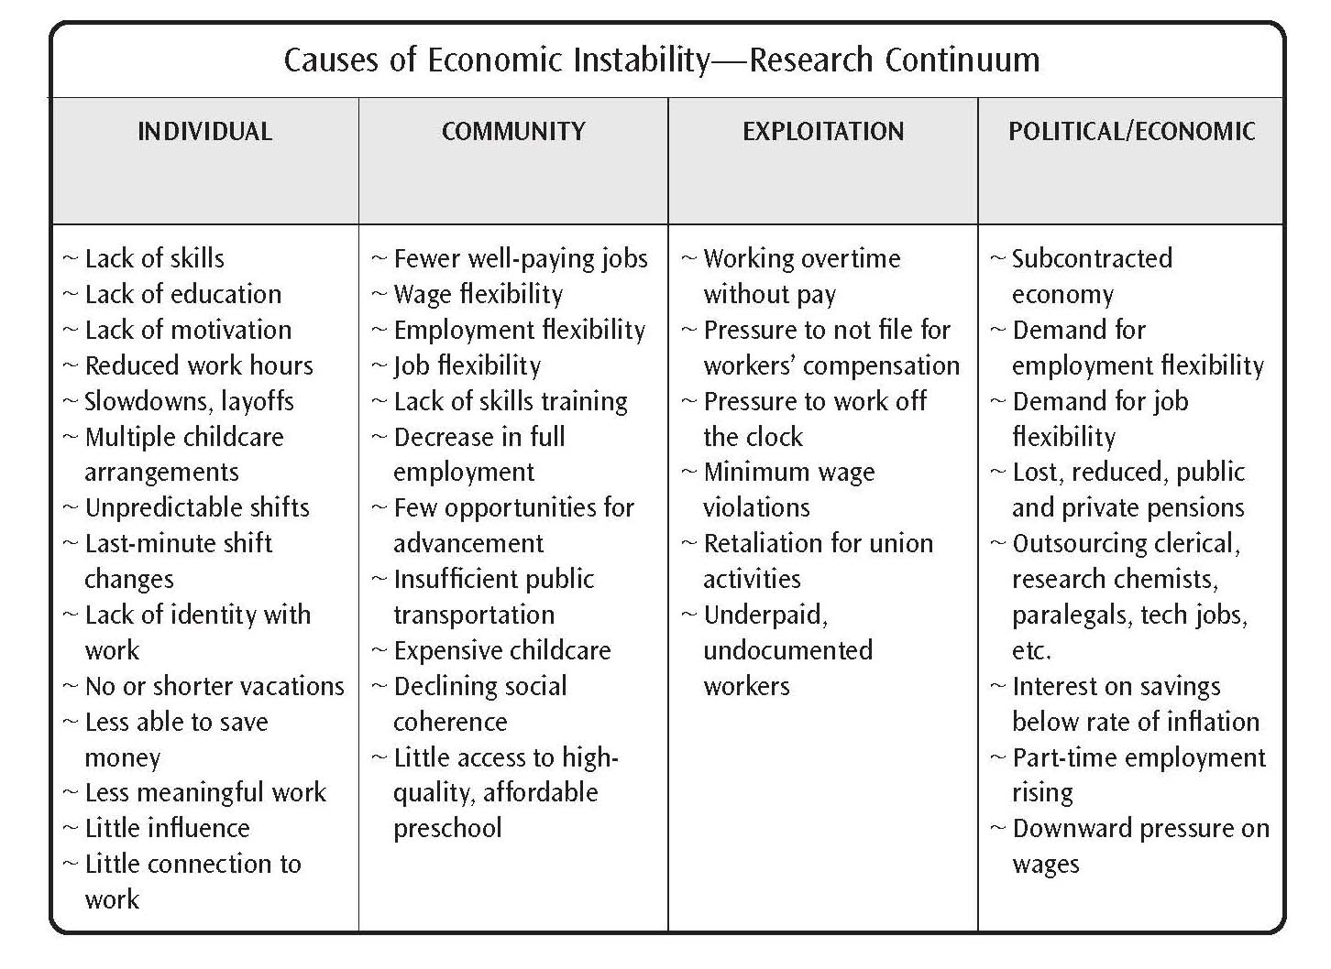
Causes of Economic Instability—Research Continuum
Page 46

Slide 19
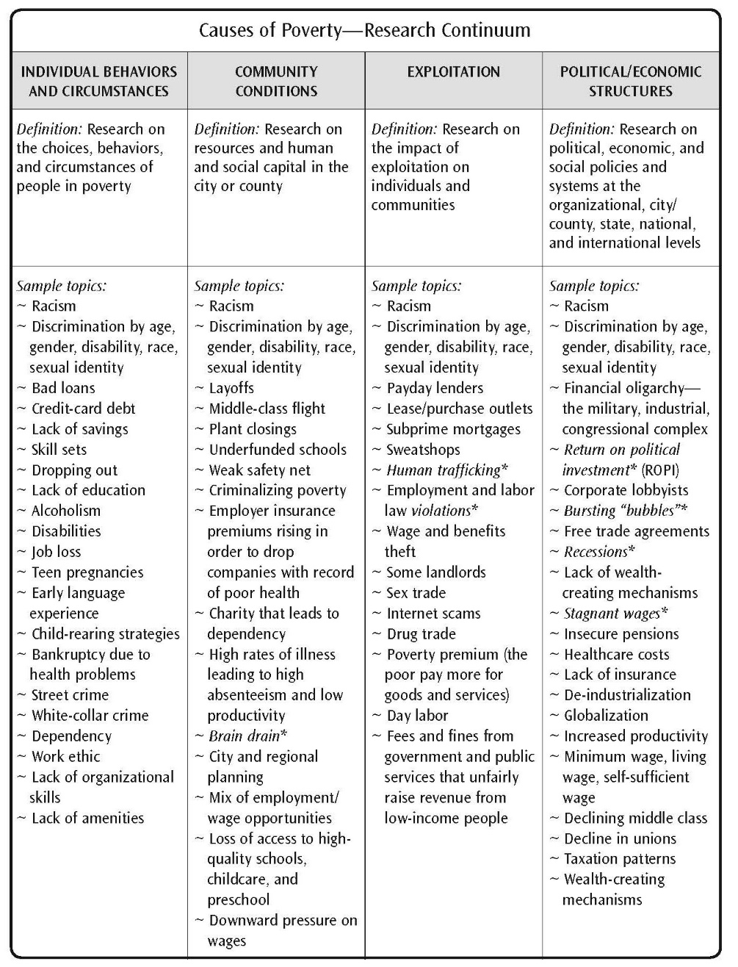
Causes of Poverty—Research Continuum
Page 47

Slide 20
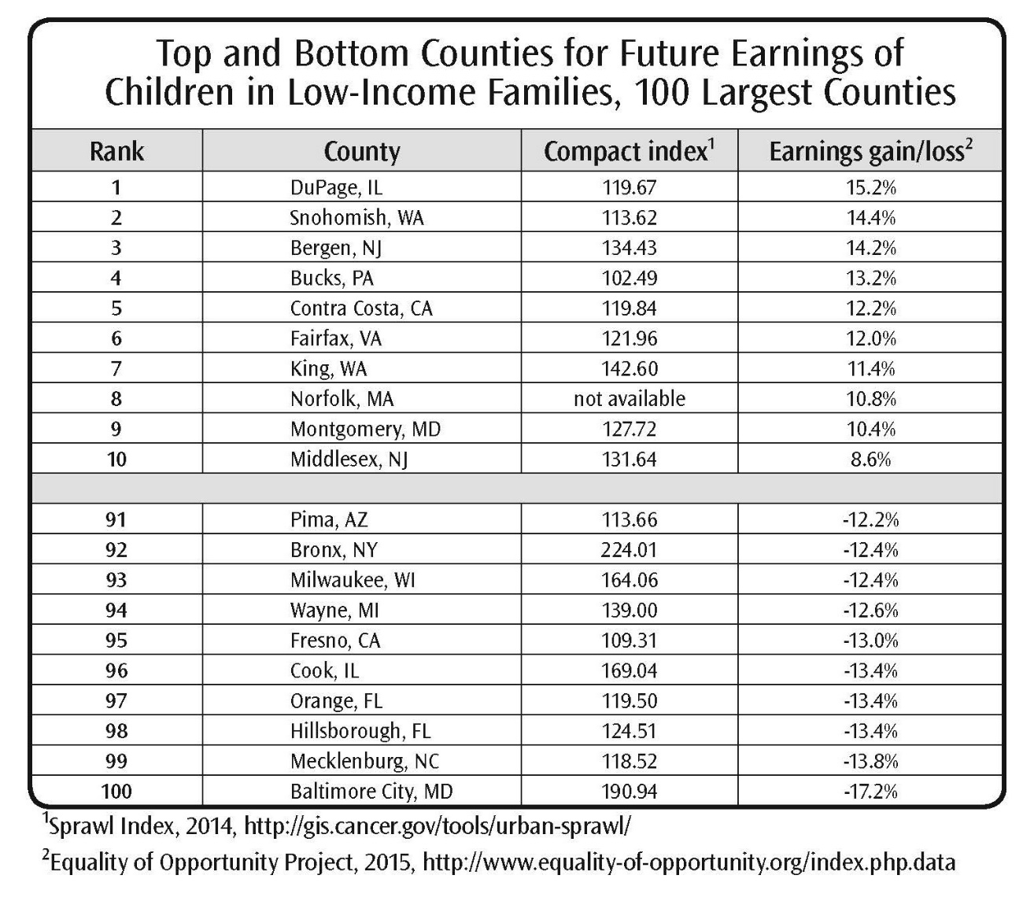
Top and Bottom Counties for Future Earnings of Children in Low-Income Families, 100 Largest Counties
Page 49

Slide 21
Predators Group Activity
GA Workplace Predator Inventory
https://fs27.formsite.com/a34qO0/ns0shnfit5/index.html
Page 51

Slide 22
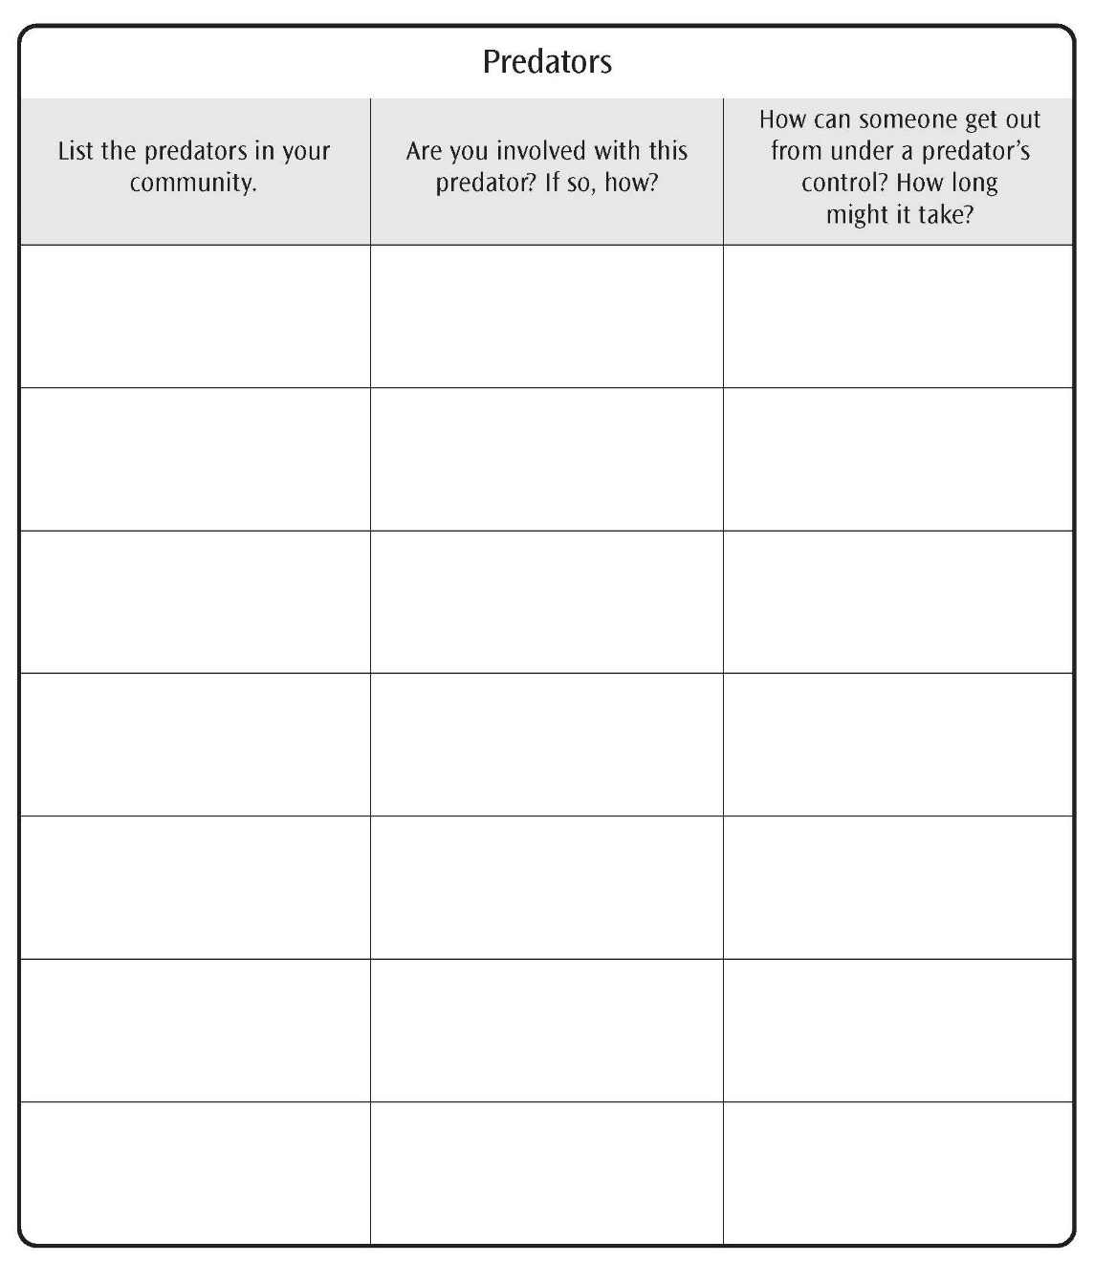
Predator Inventory
Page 51

Slide 23
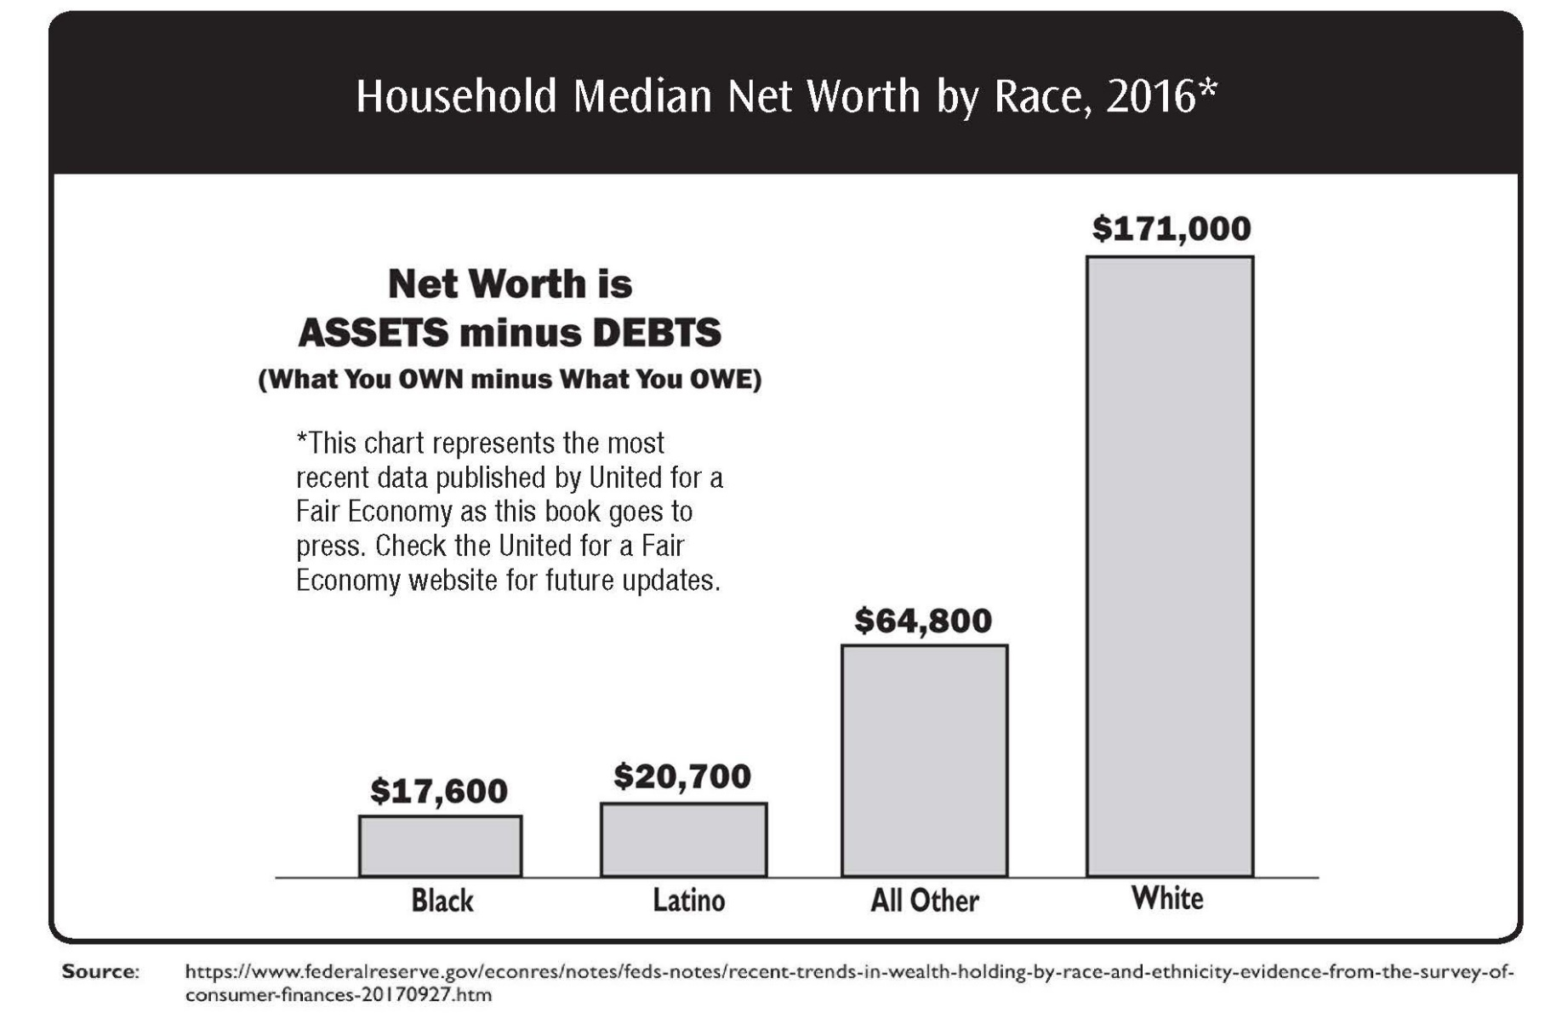
Household Median Net Worth by Race, 2016
Page 54

Slide 24
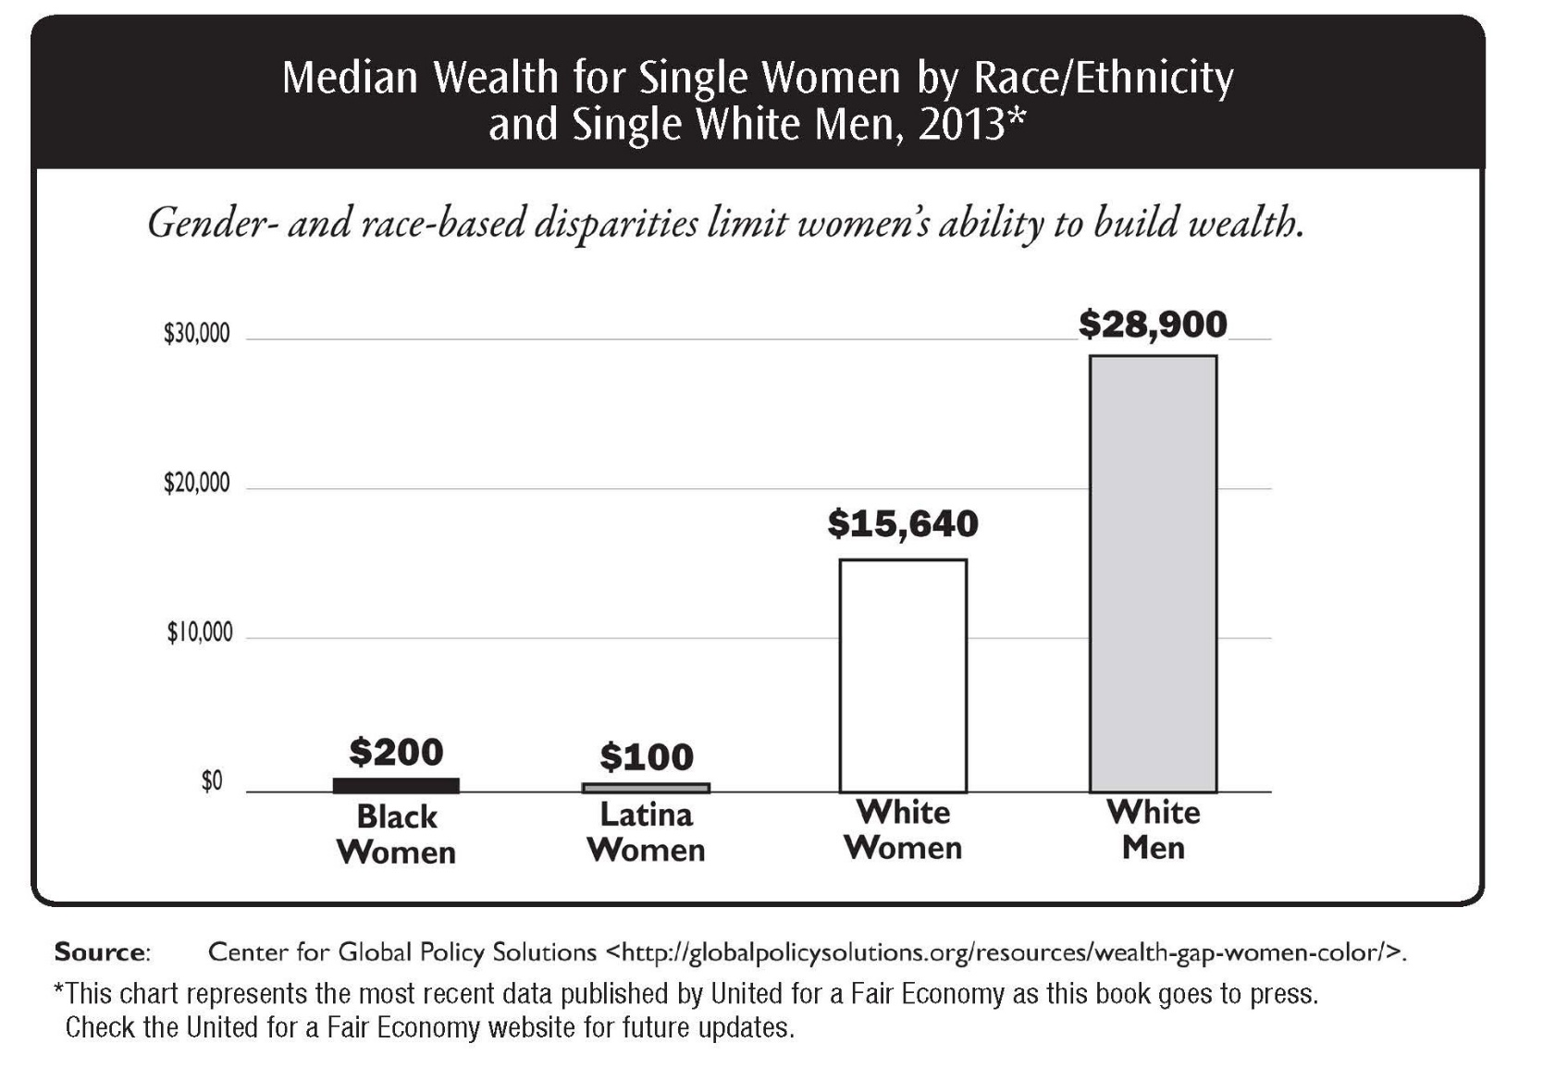
Median Wealth for Single Women by Race/Ethnicity and Single White Men, 2013
Page 55

Slide 25
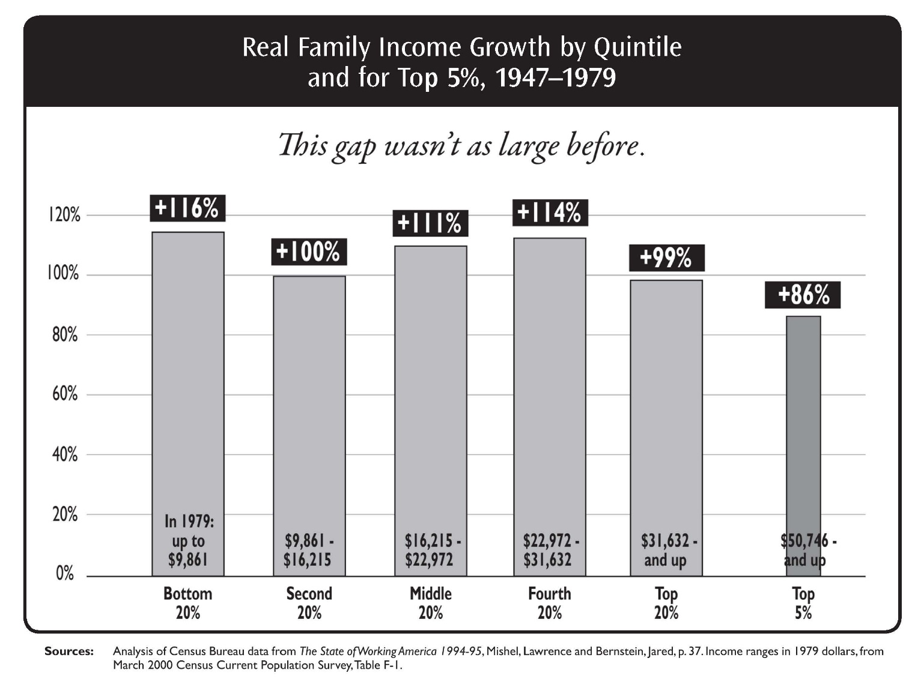
Real Family Income Growth by Quintile and for Top 5%, 1947–1979
Page 58

Slide 26
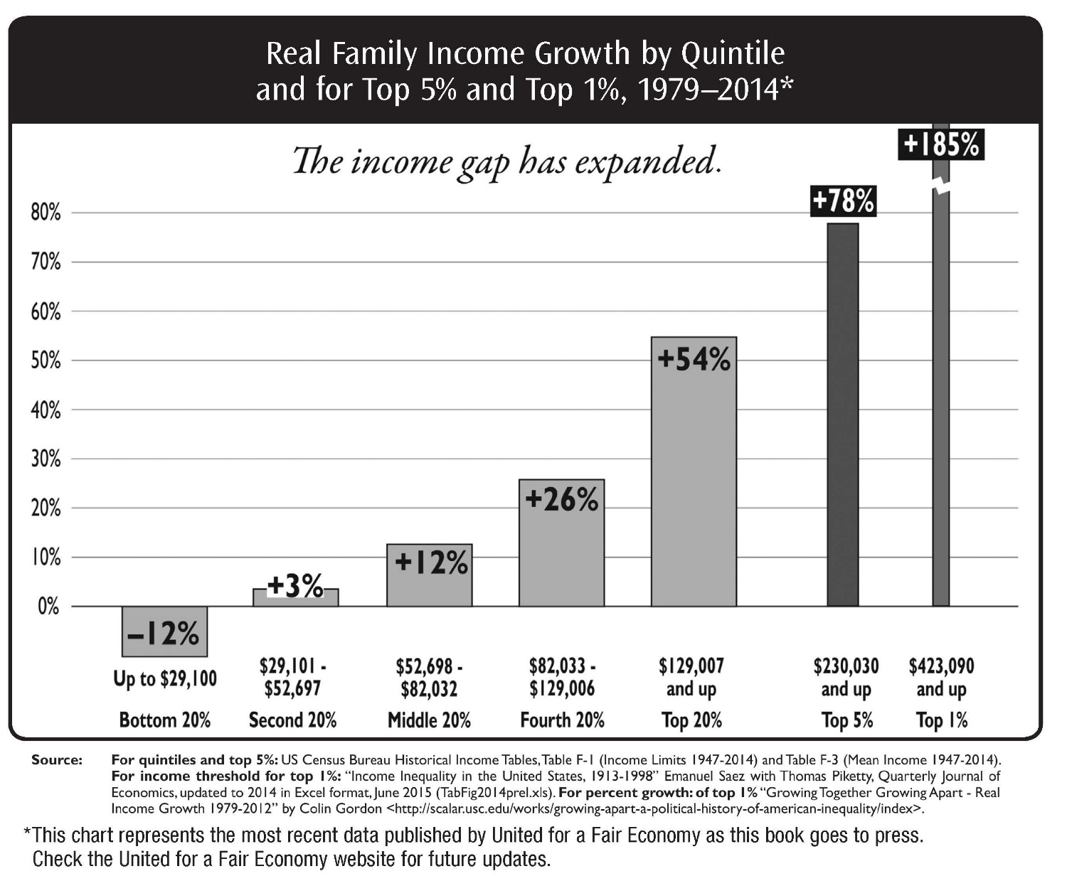
Real Family Income Growth by Quintile and for Top 5% and Top 1%, 1979–2014
Page 58

Slide 27
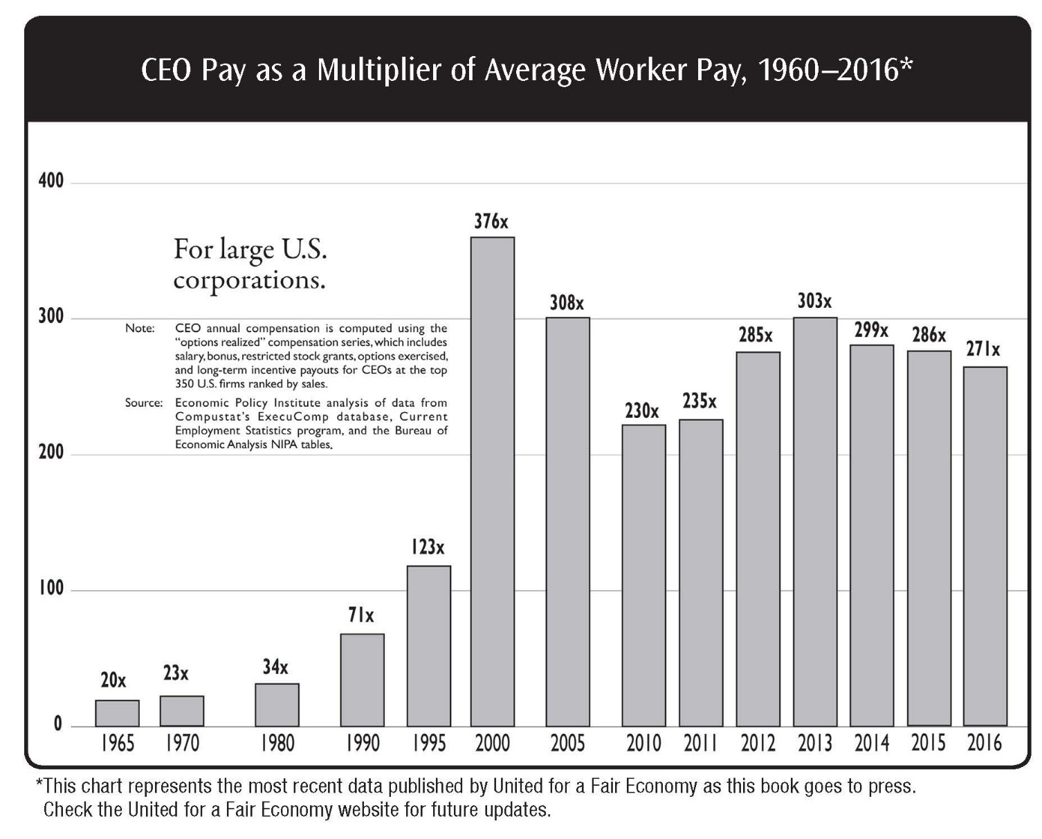
CEO Pay as a Multiplier of Average Worker Pay, 1960–2016
Page 59

Slide 28
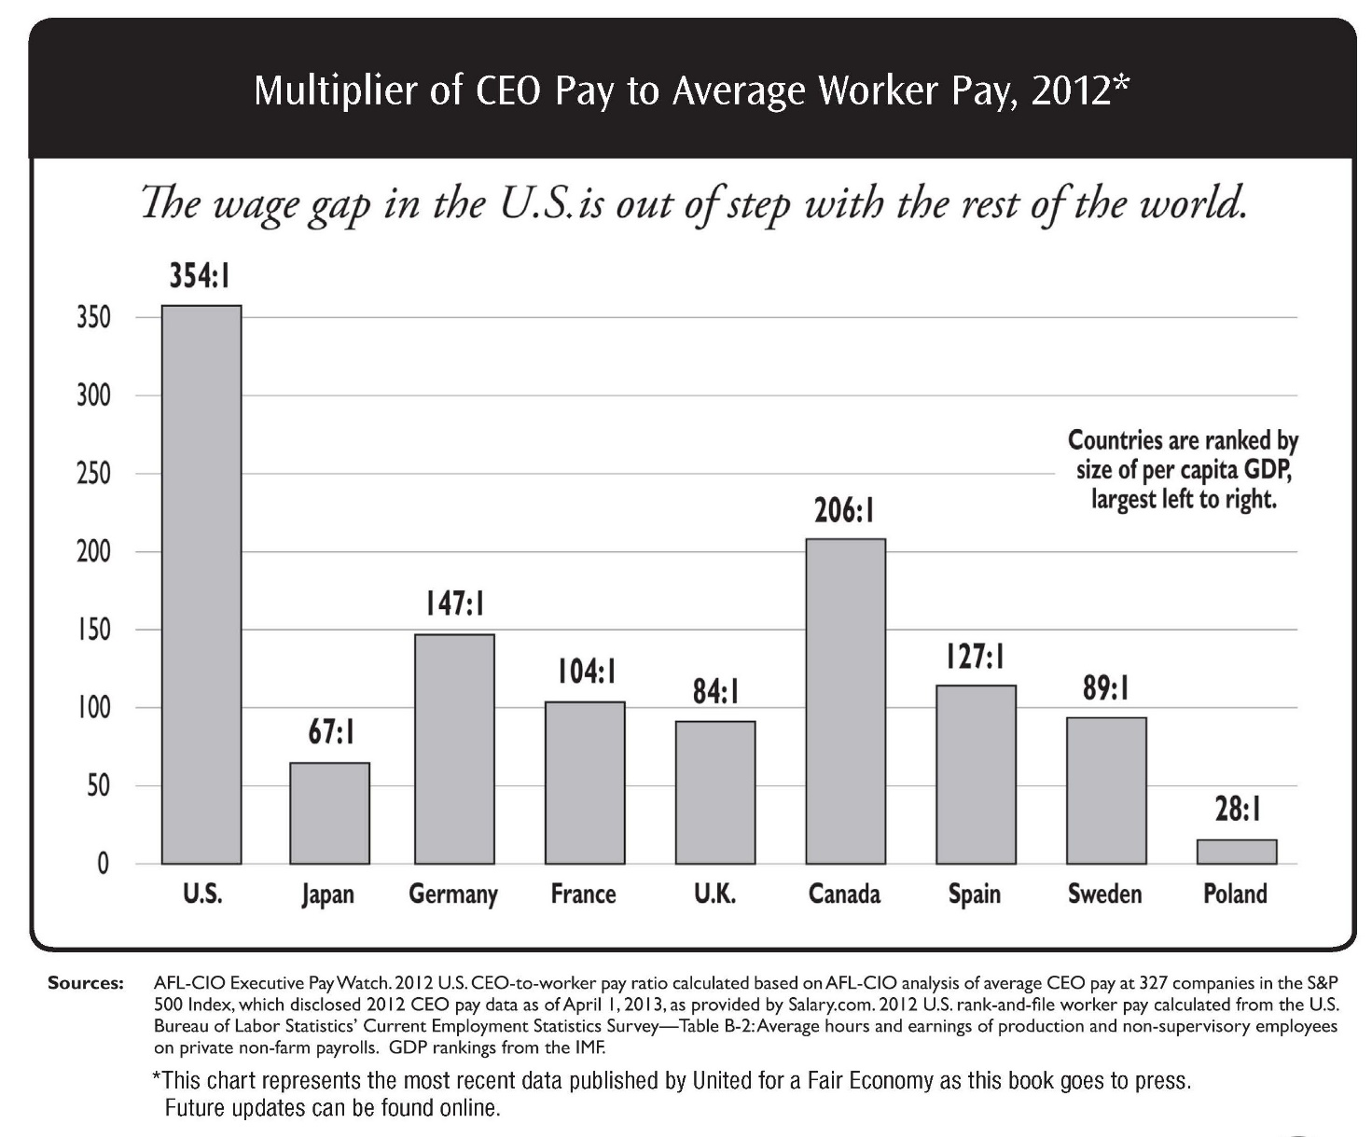
Multiplier of CEO Pay to Average Worker Pay, 2012
Page 60

Slide 29
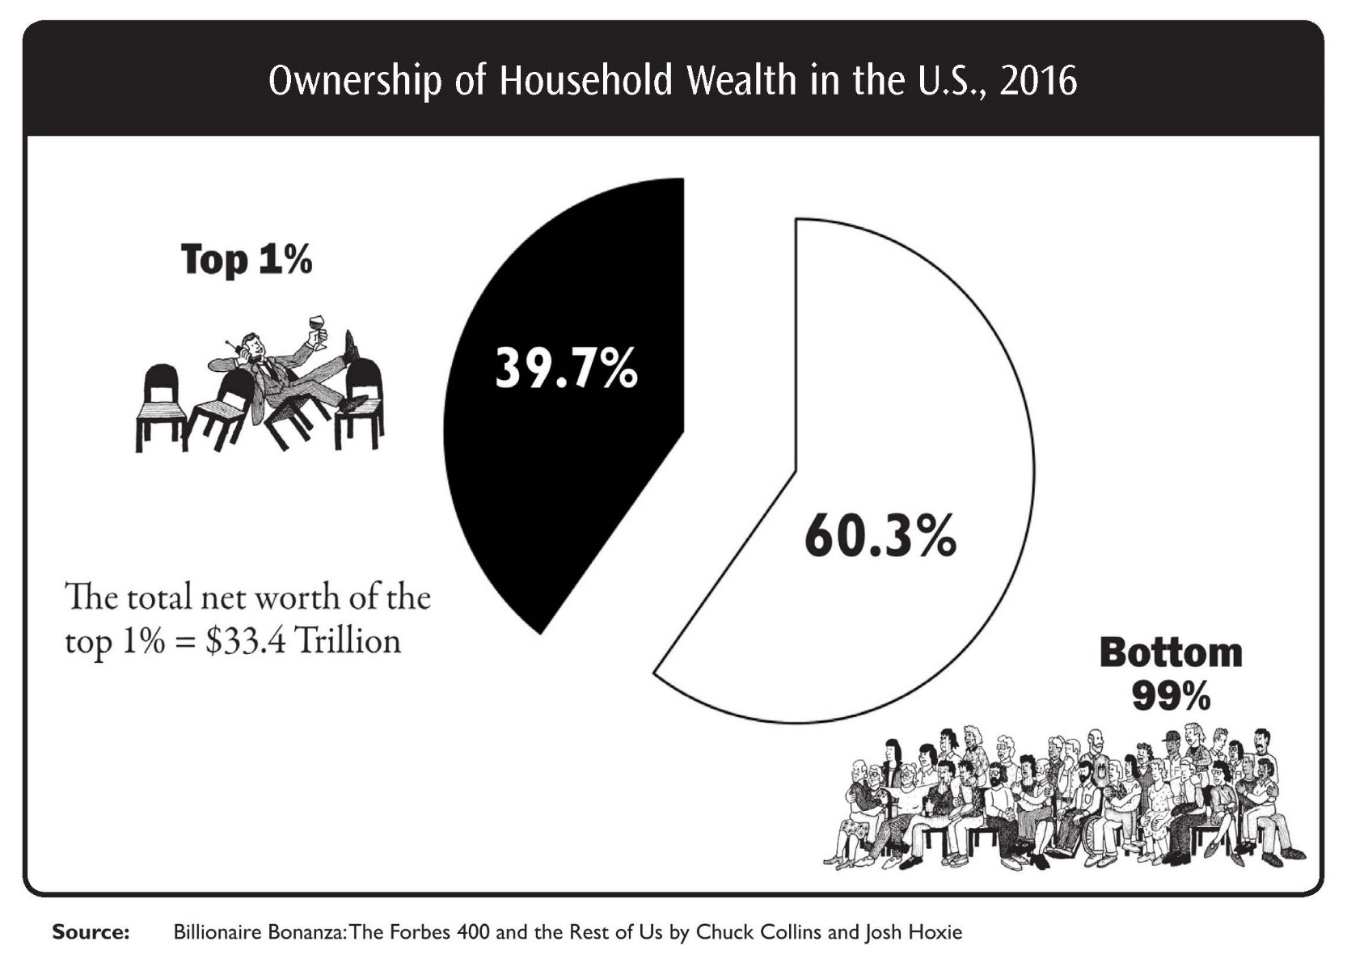
Ownership of Household Wealth in the U.S., 2016
Page 61

Slide 30
Mental Model of Middle Class Activity
Getting Ahead in the Workplace Mental Model of Middle Class
https://fs27.formsite.com/a34qO0/uxhcymd3sc/index.html
Page 64

Slide 31
Mental Model of Wealth Activity
Getting Ahead in the Workplace Mental Model of Wealth
https://fs27.formsite.com/a34qO0/szmug9l15q/index.html
Page 64

Slide 32
Community Sustainability Grid Activity
Getting Ahead in the Workplace Community Sustainability Grid
https://fs27.formsite.com/a34qO0/1pyymz2kz1/index.html
Page 67

Slide 33
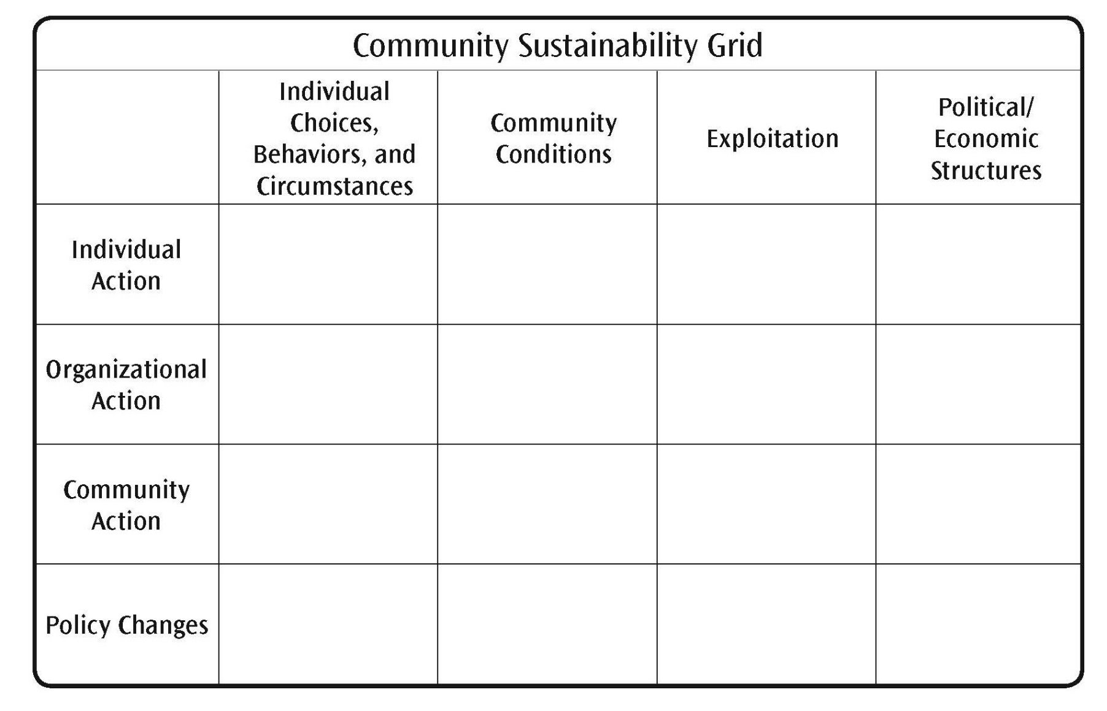
Community Sustainability Grid
Page 67

Slide 34
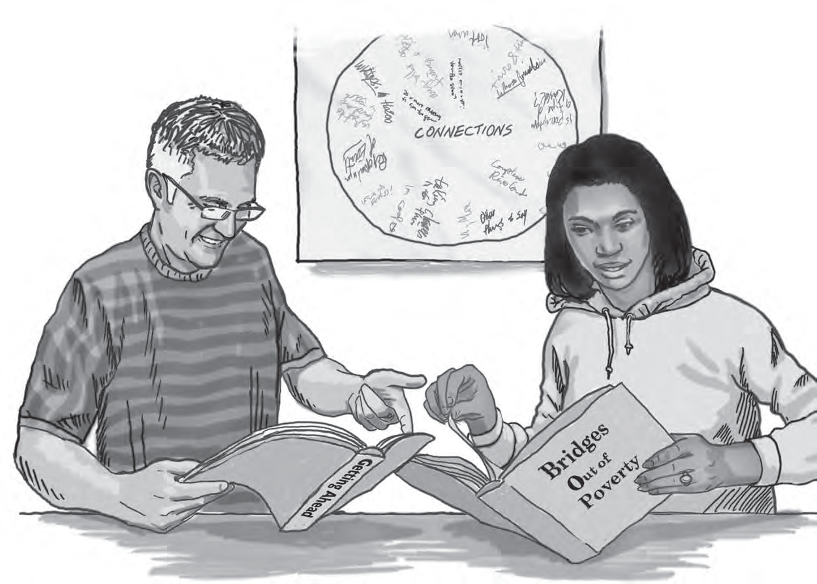
Module 4: Hidden Rules of Economic Class
Page 71

Slide 35
Hidden Rules of Economic Class Group Activity
Getting Ahead in the Workplace Hidden Rules
https://fs27.formsite.com/a34qO0/bj2ib18zxd/index.html
Page 74

Slide 36
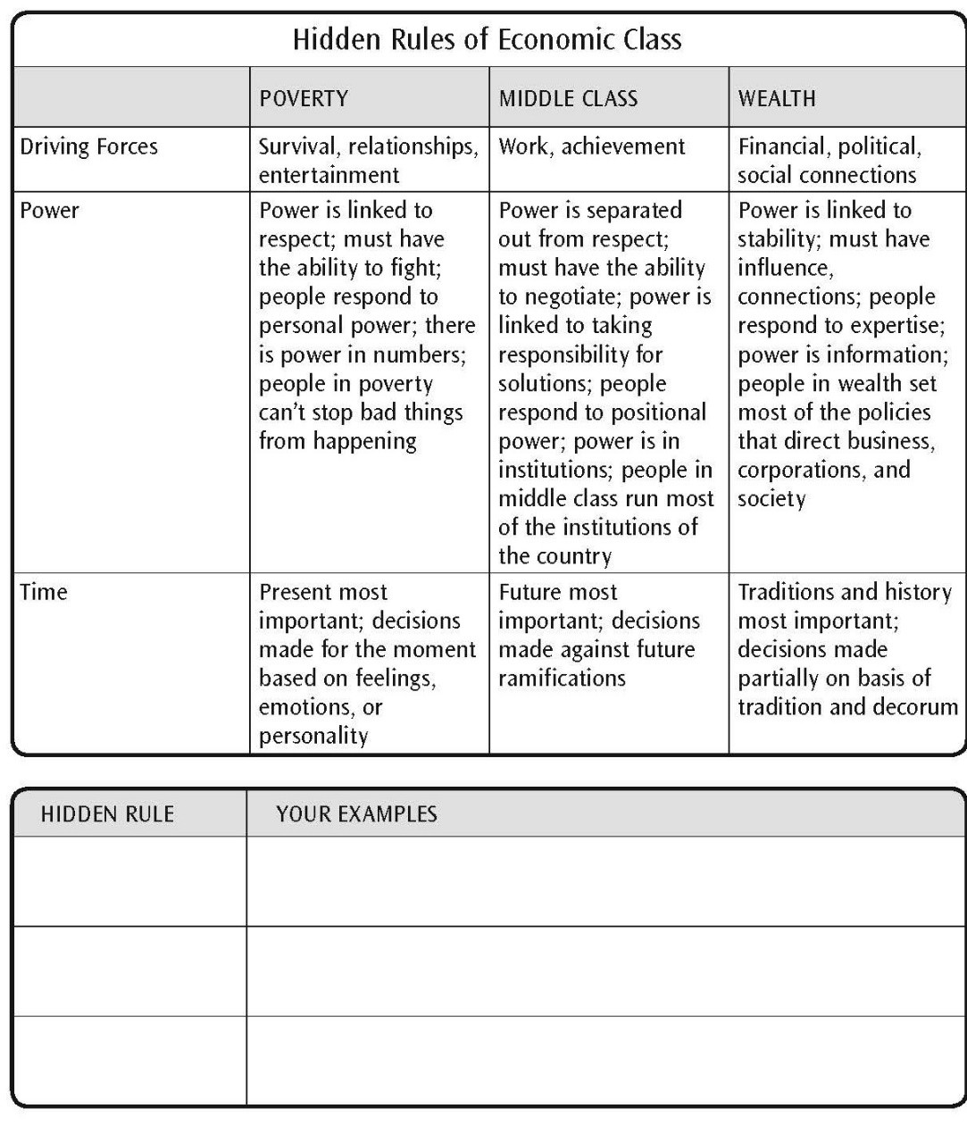
Hidden Rules of Economic Class
Page 76

Slide 37
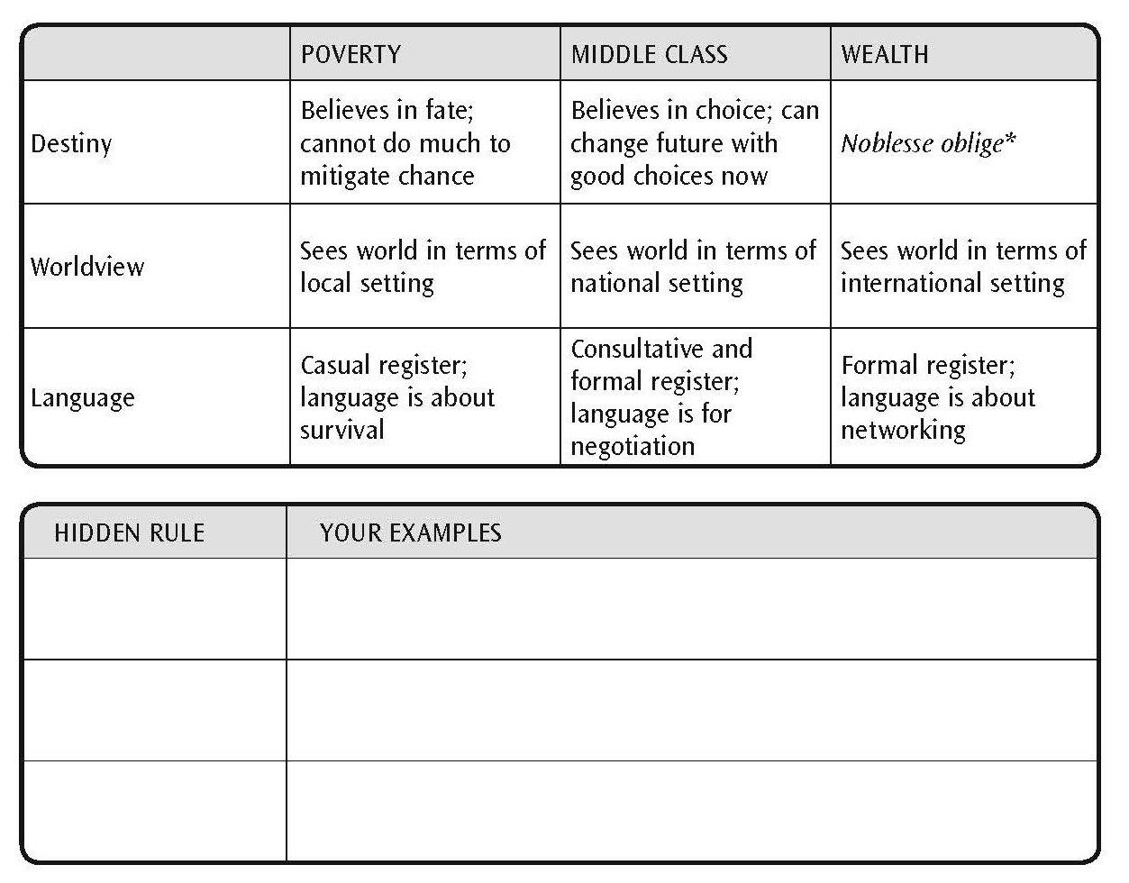
Hidden Rules of Economic Class (continued)
Page 77

Slide 38
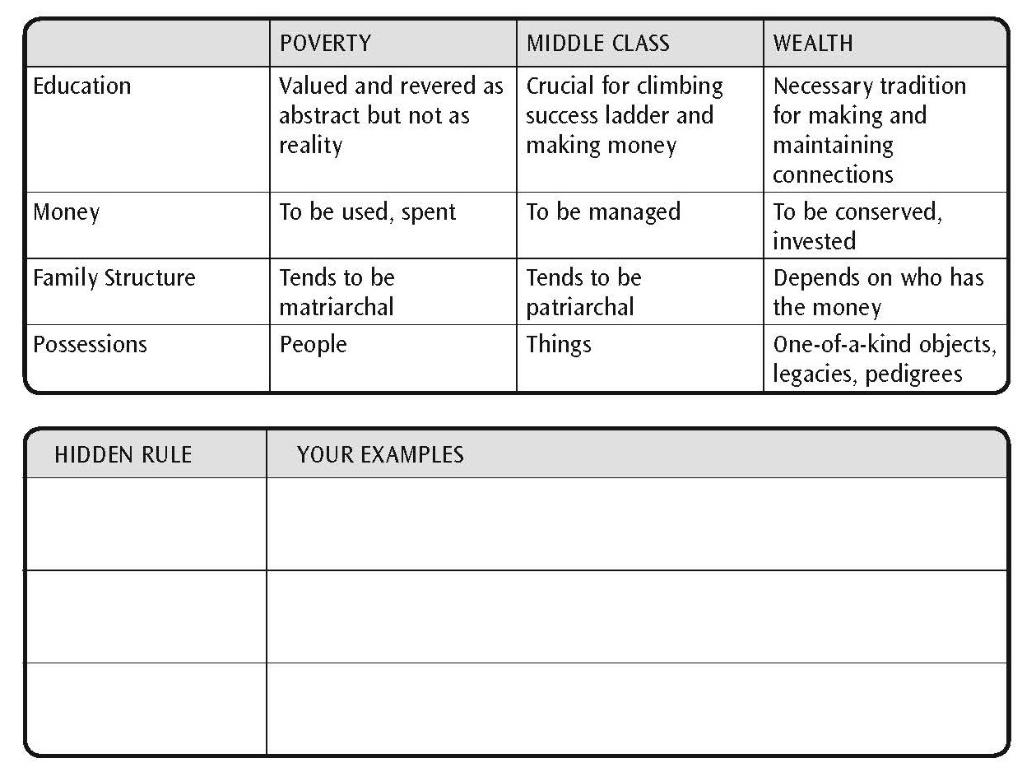
Hidden Rules of Economic Class (continued)
Page 77

Slide 39
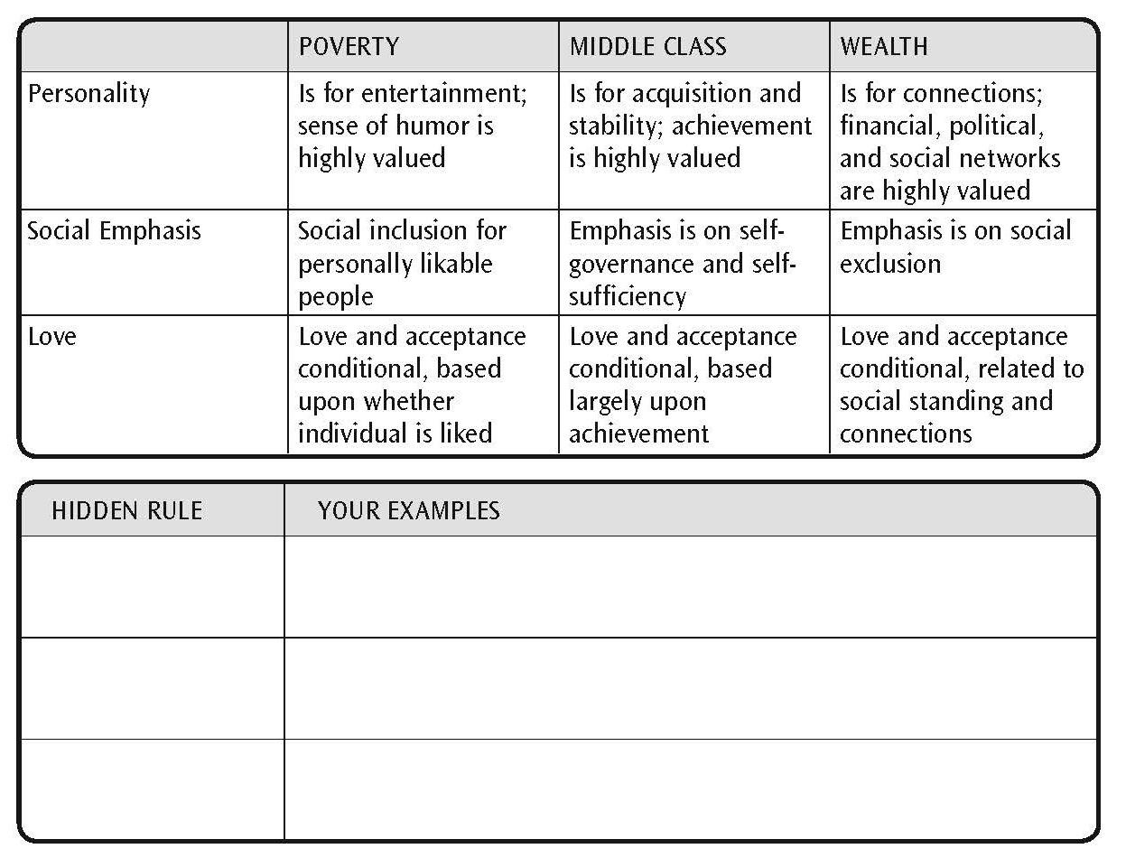
Hidden Rules of Economic Class (continued)
Page 78

Slide 40
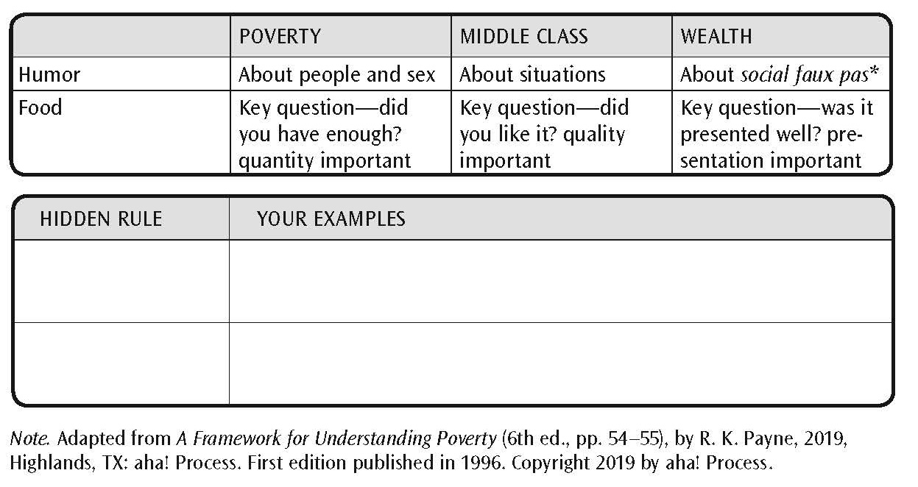
Hidden Rules of Economic Class (continued)
Page 78

Slide 41
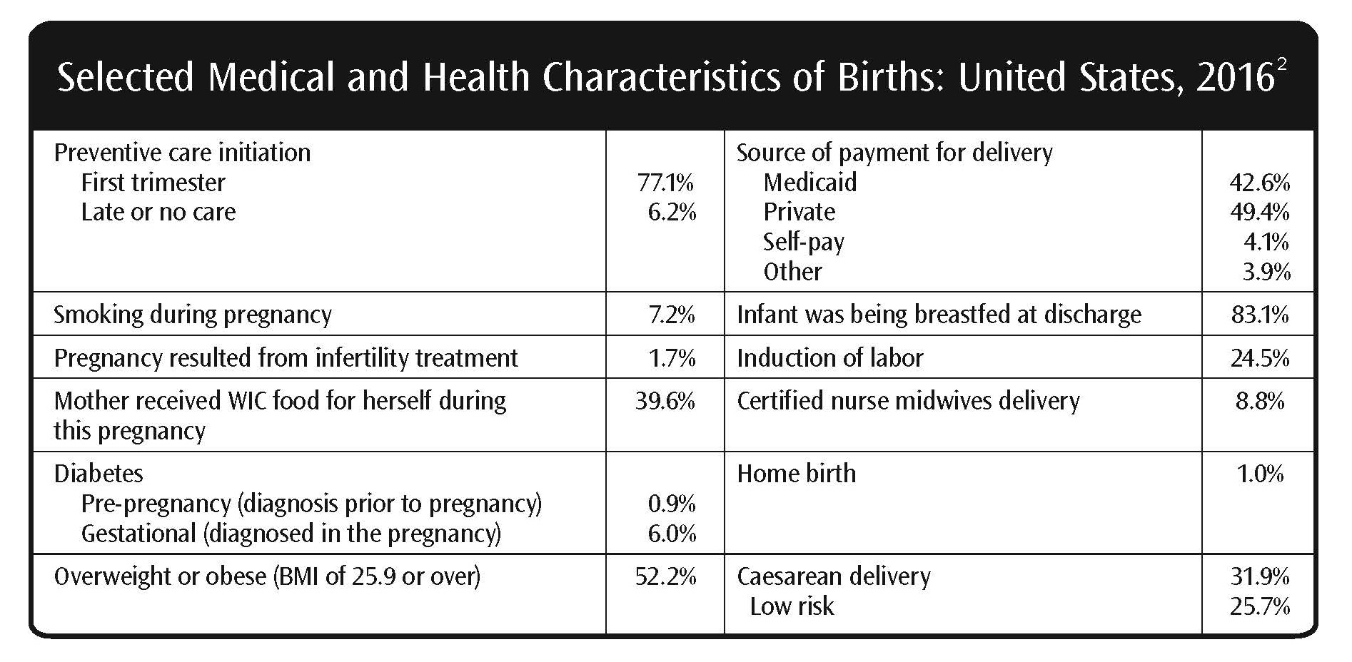
Selected Medical and Health Characteristics of Births: United States, 2016
Page 81

Slide 42
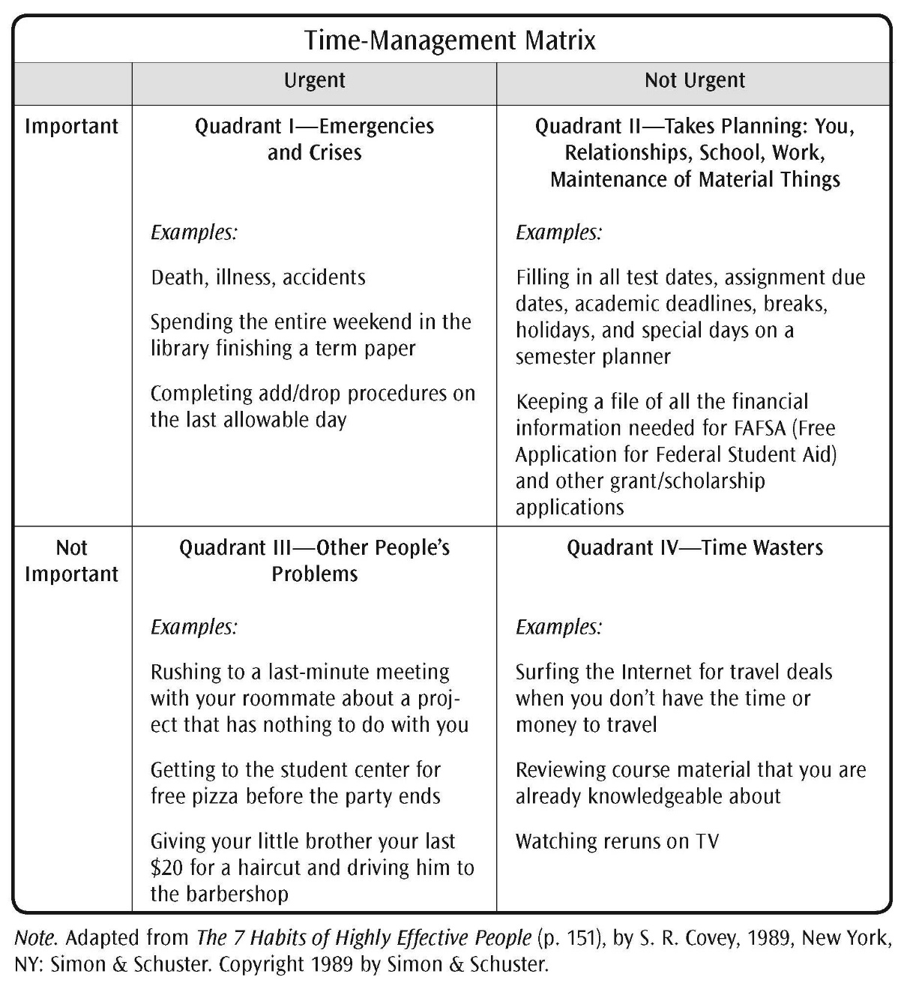
Time-Management Matrix
Page 86

Slide 43
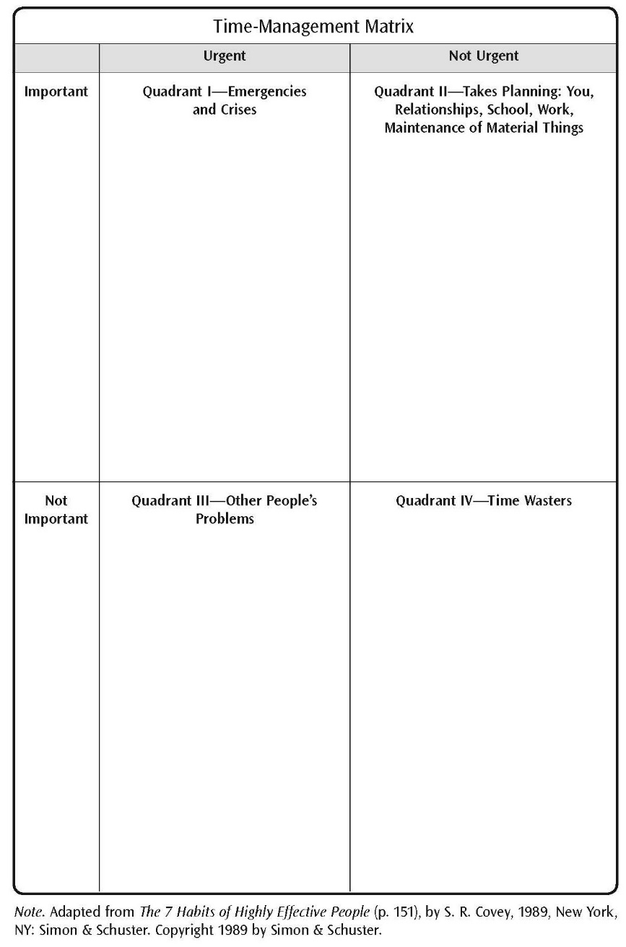
Time-Management Form
Page 88

Slide 44
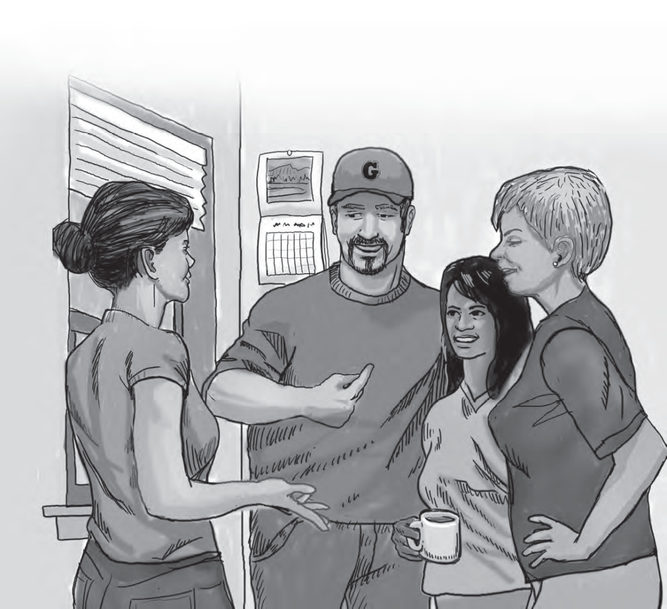
Module 5: The Importance of Language
Page 91

Slide 45
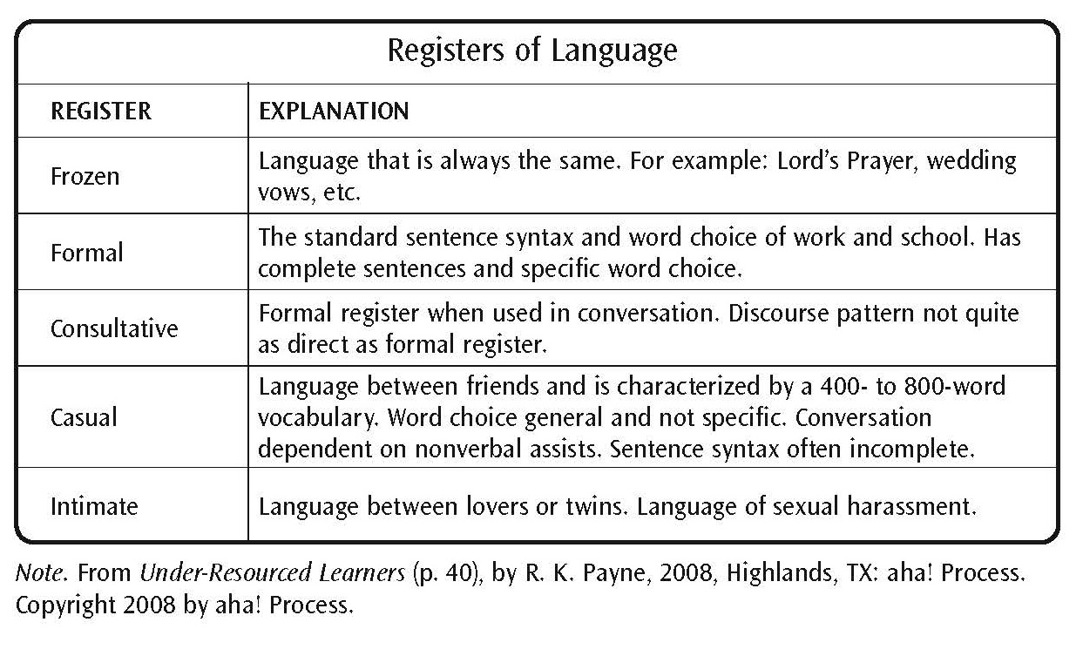
Registers of Language
Page 93

Slide 46
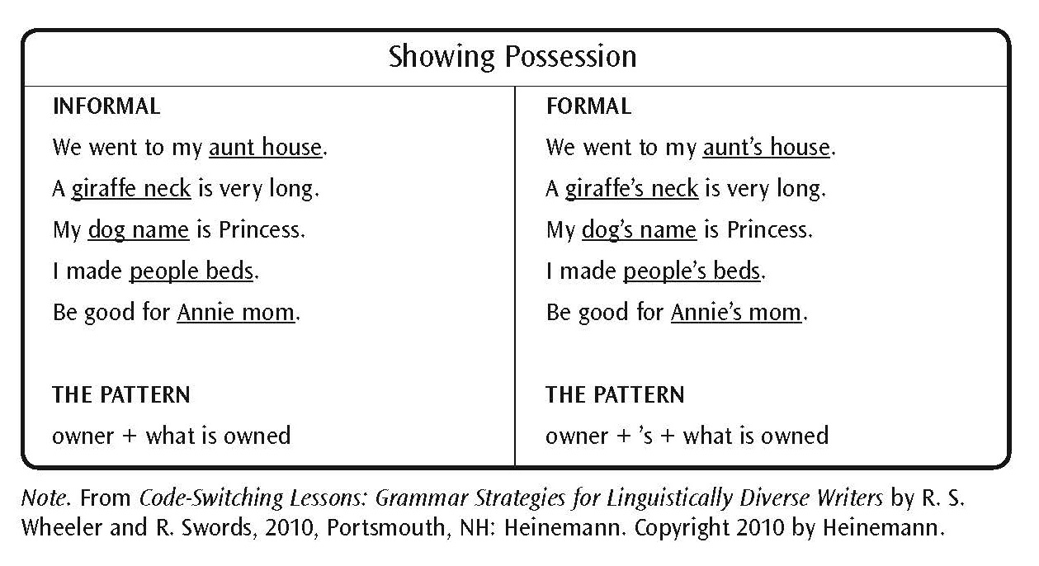
Showing Possession
Page 96

Slide 47
Past Time Patterns
Page 97

Slide 48
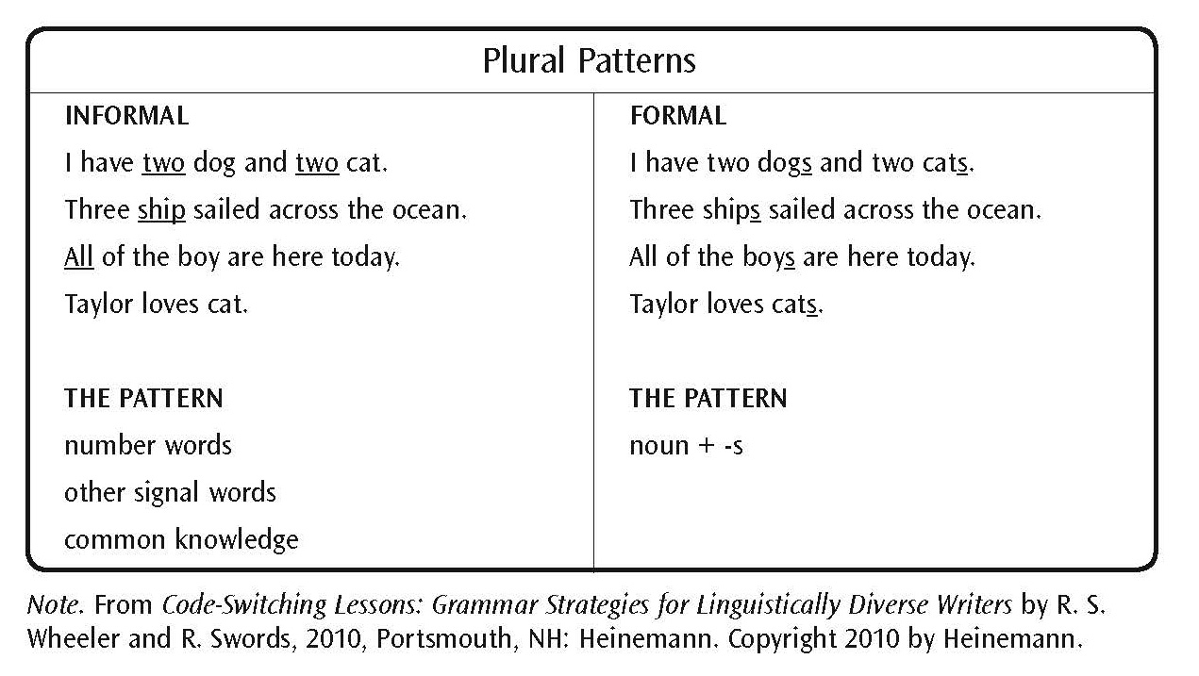
Plural Patterns
Page 97

Slide 49
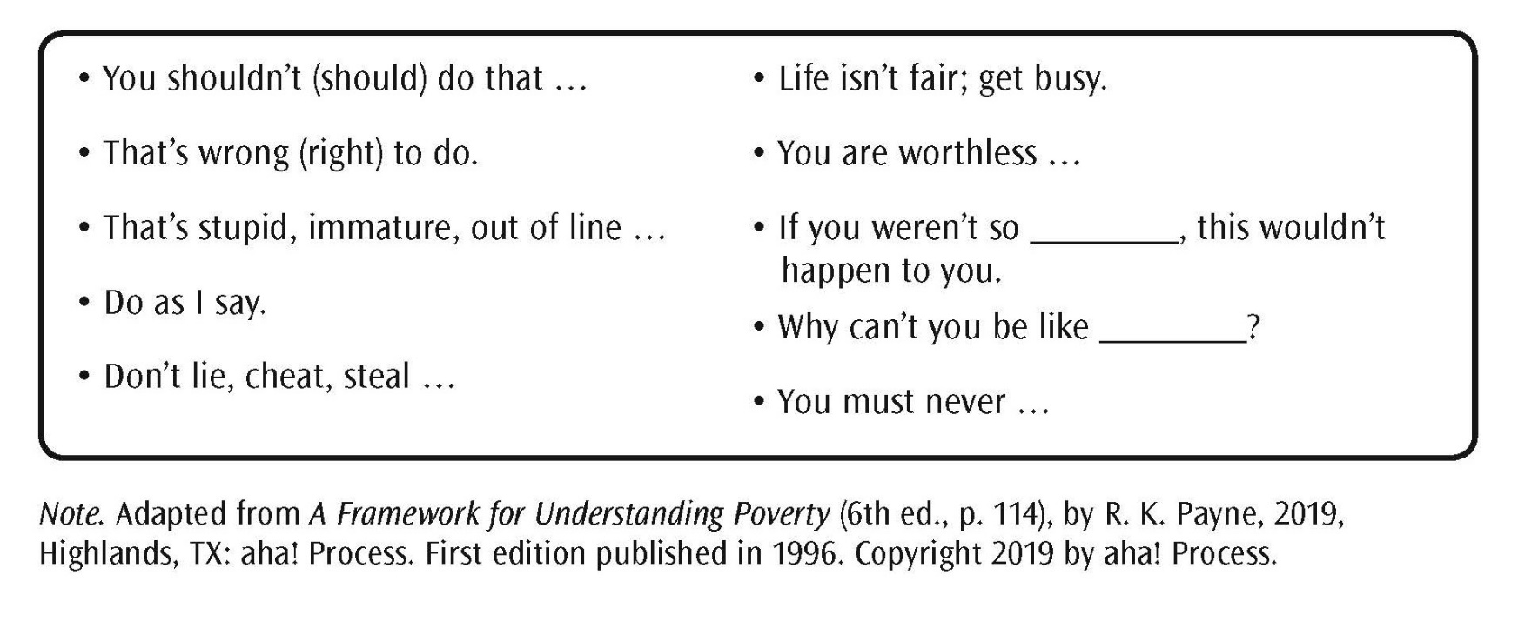
Parent Voice
Page 98

Slide 50
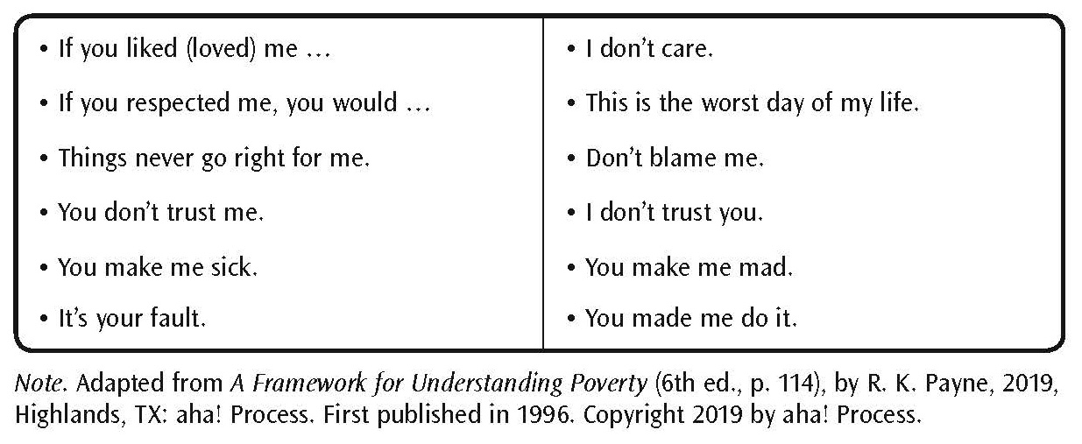
Child Voice
Page 99

Slide 51
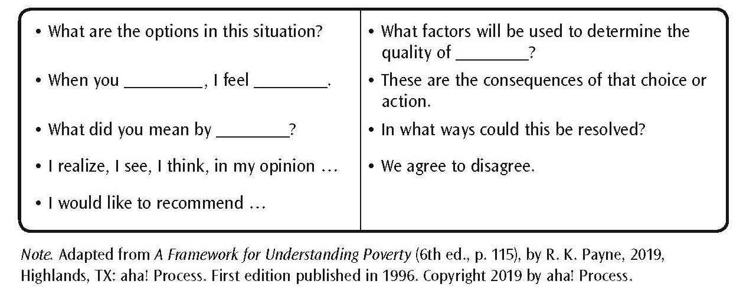
Adult Voice
Page 100

Slide 52
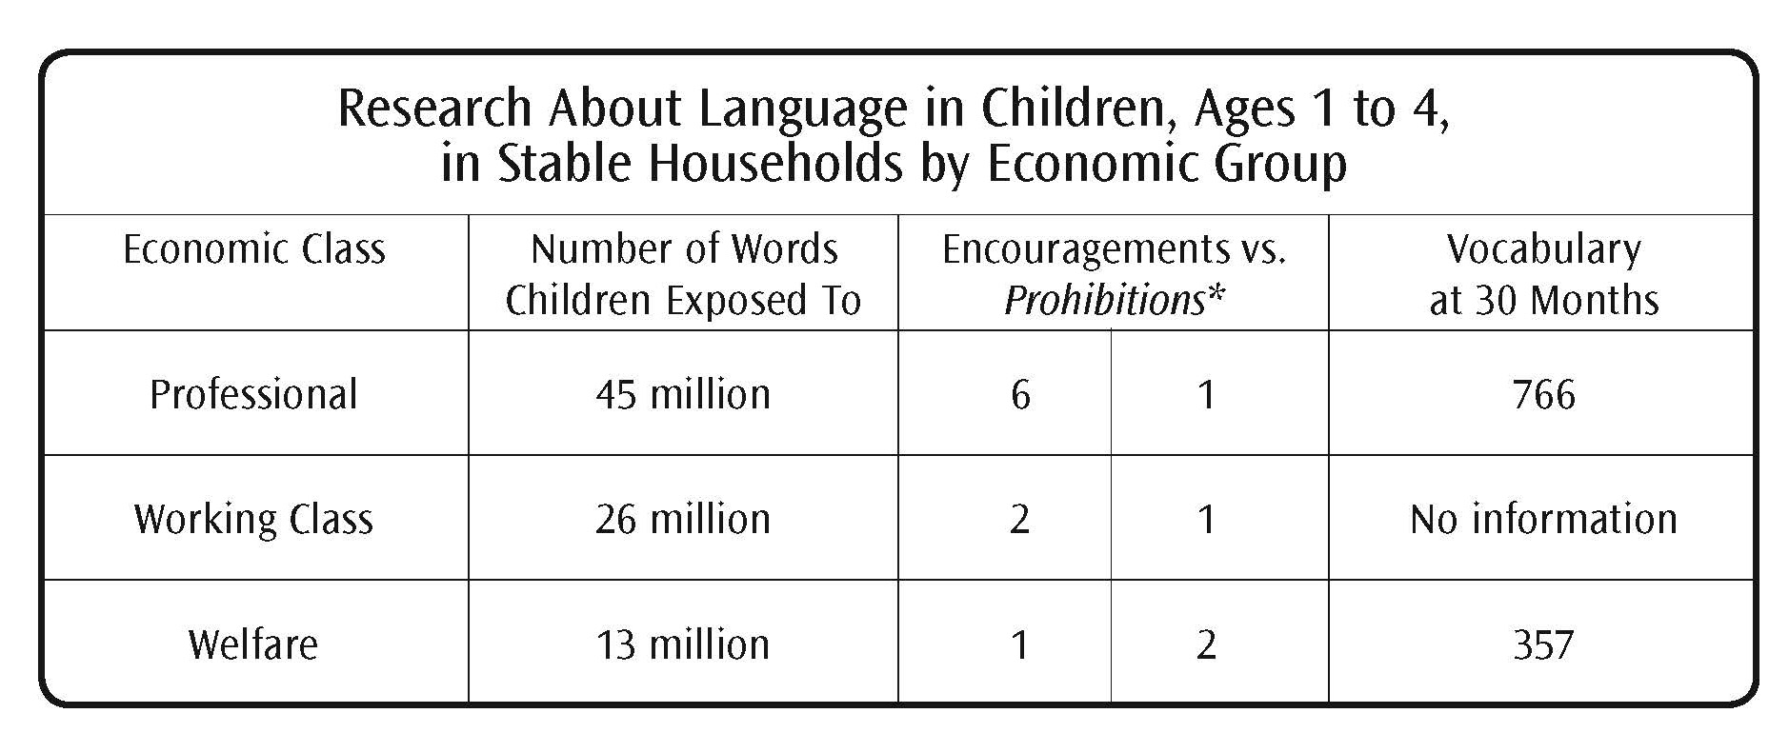
Research About Language in Children, Ages 1 to 4, in Stable Households by Economic Group
Source: Meaningful Differences in the Everyday Experience of Young American Children. Hart & T. Risley. (1995).
Page 104

Slide 53
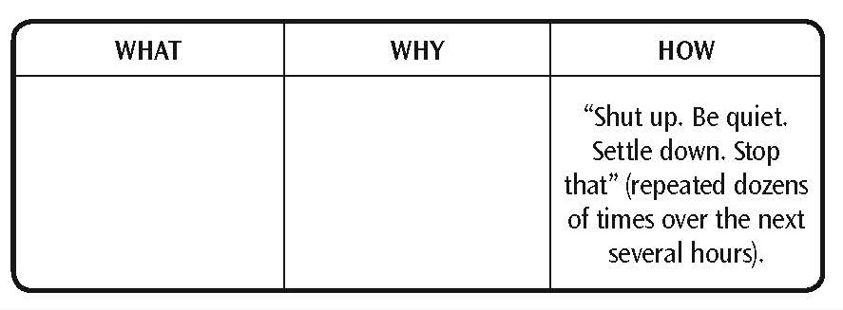
Mediation: the What, the Why, the How
Page 105

Slide 54
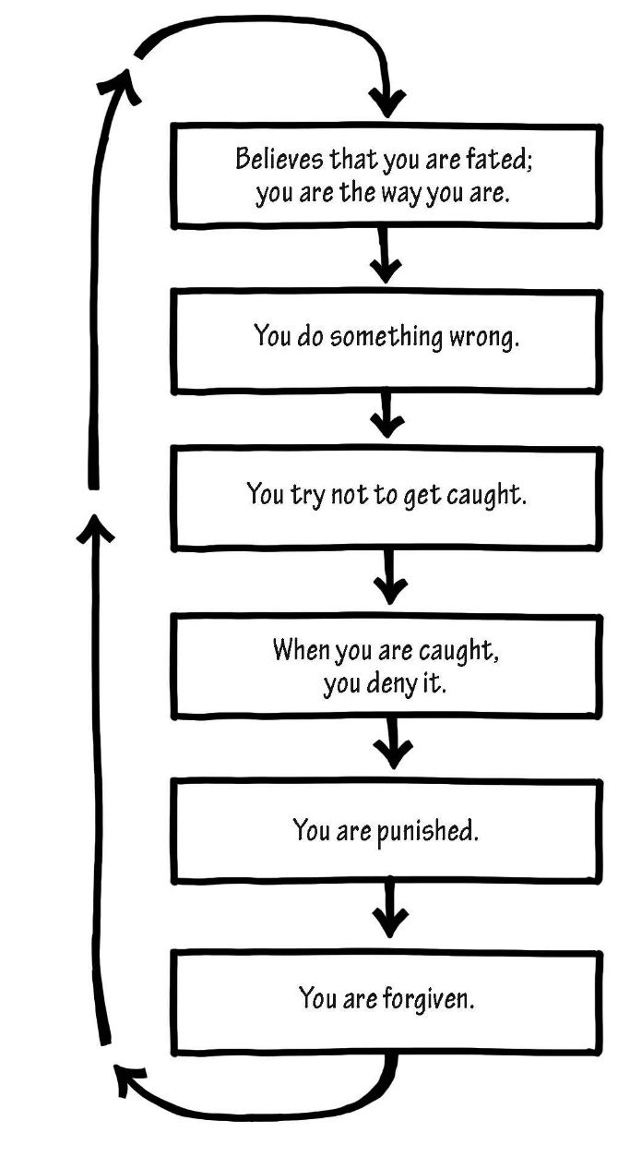
Penance/Forgiveness Cycle
Page 108

Slide 55
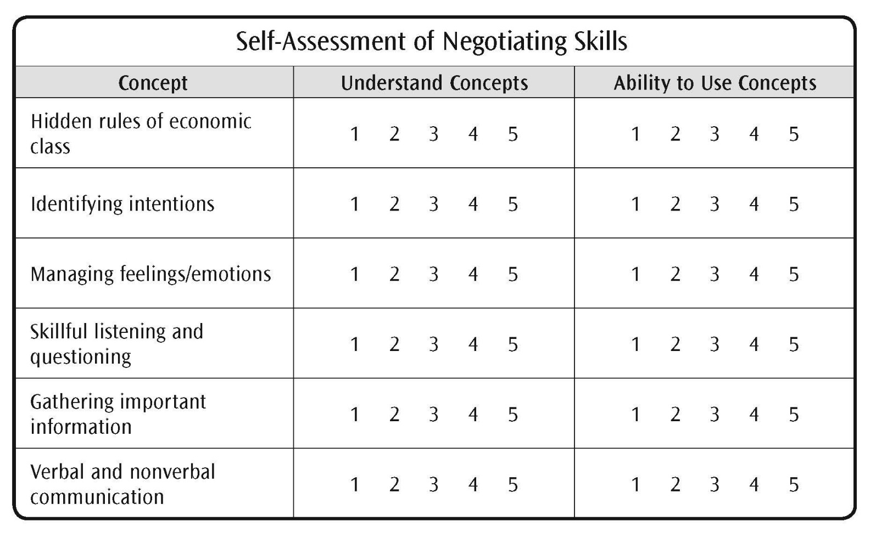
Self-Assessment of Negotiating Skills
Page 114

Slide 56
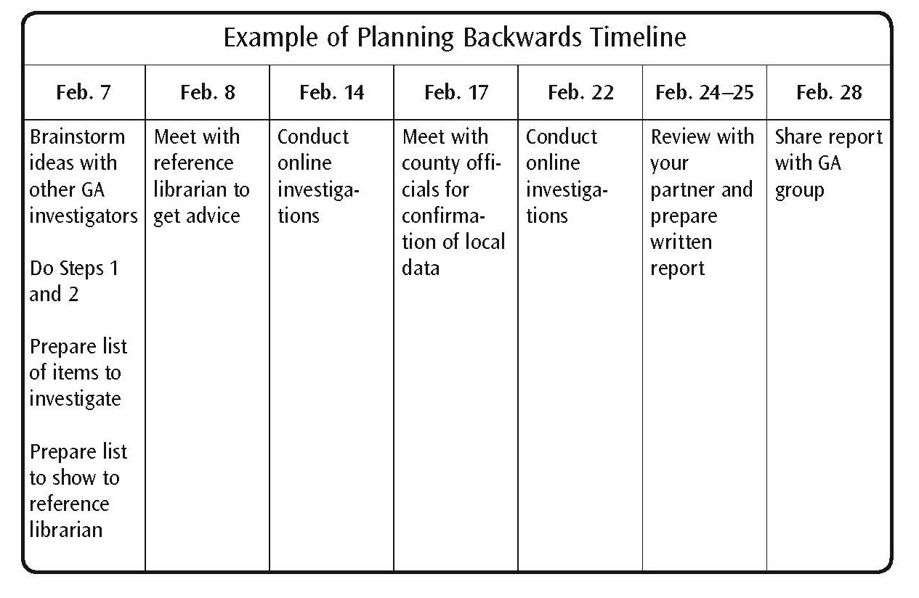
Example of Planning Backwards Timeline
Page 116

Slide 57
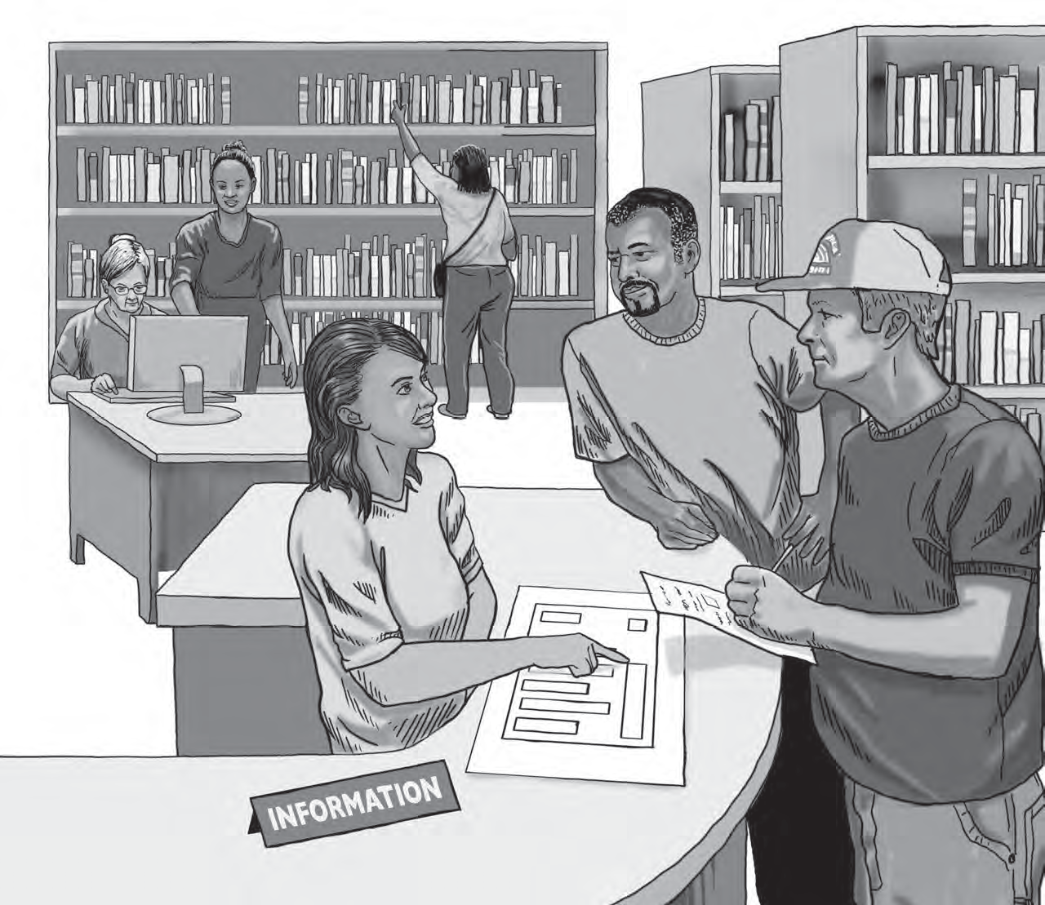
Module 6: Eleven Resources
Page 119

Slide 58
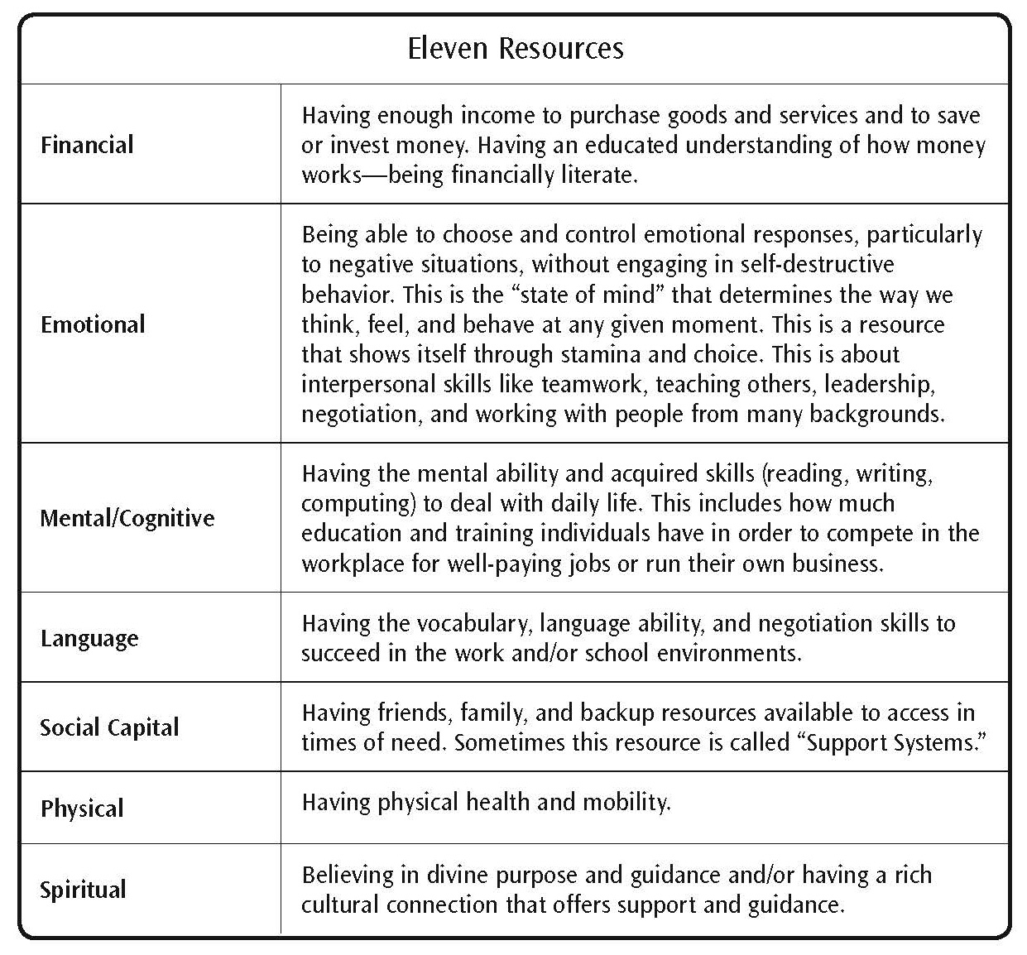
Defining Resources
Page 121

Slide 59
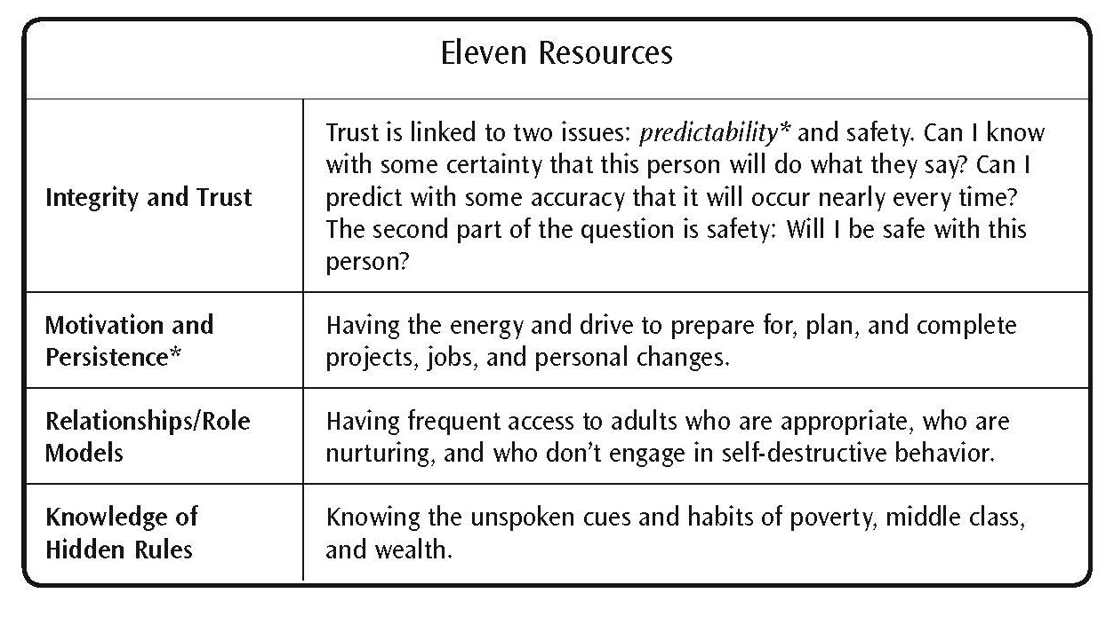
Defining Resources (continued)
Page 122

Slide 60
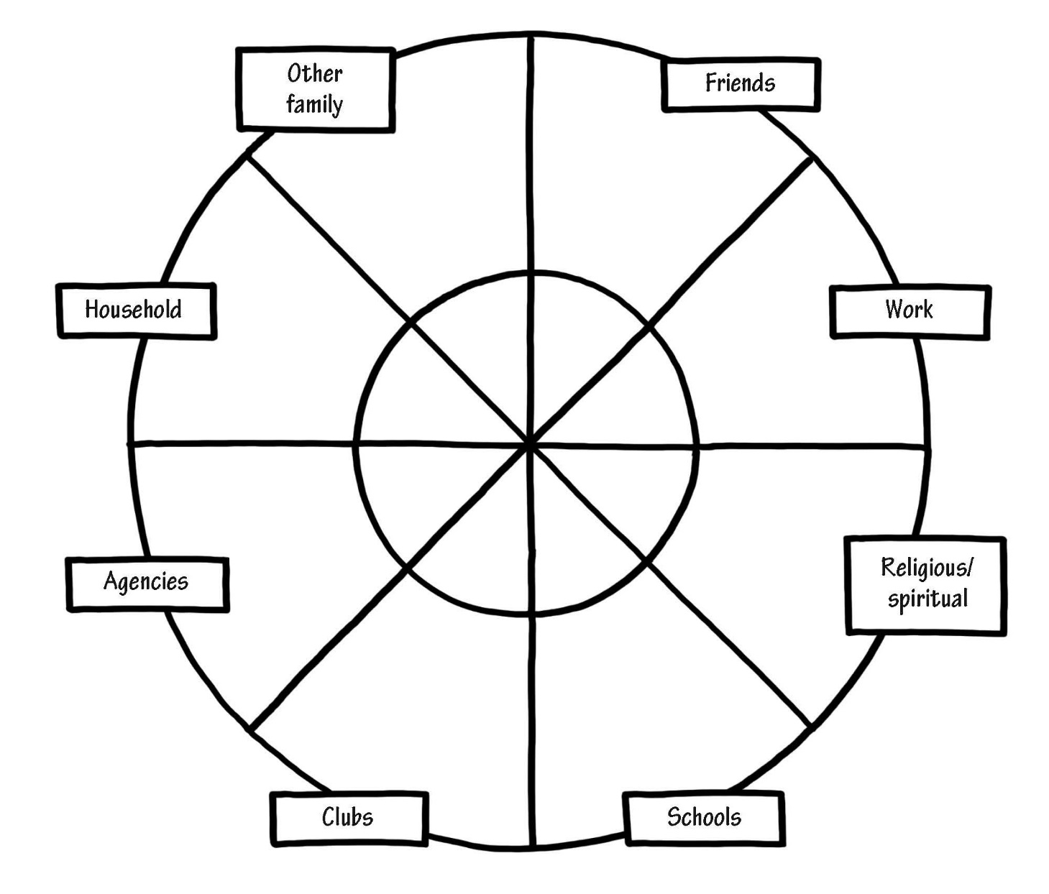
Mental Model of Personal Social Capital
Page 125

Slide 61
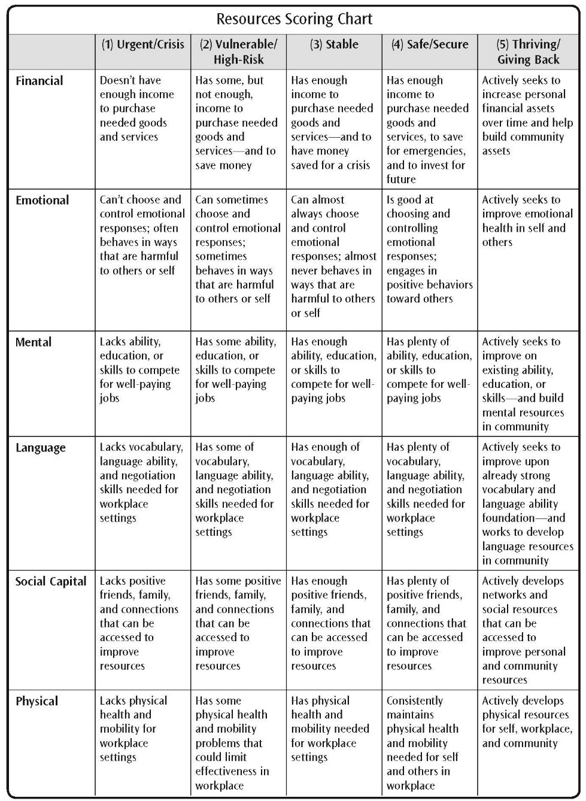
Resources Scoring Chart
Page 133

Slide 62
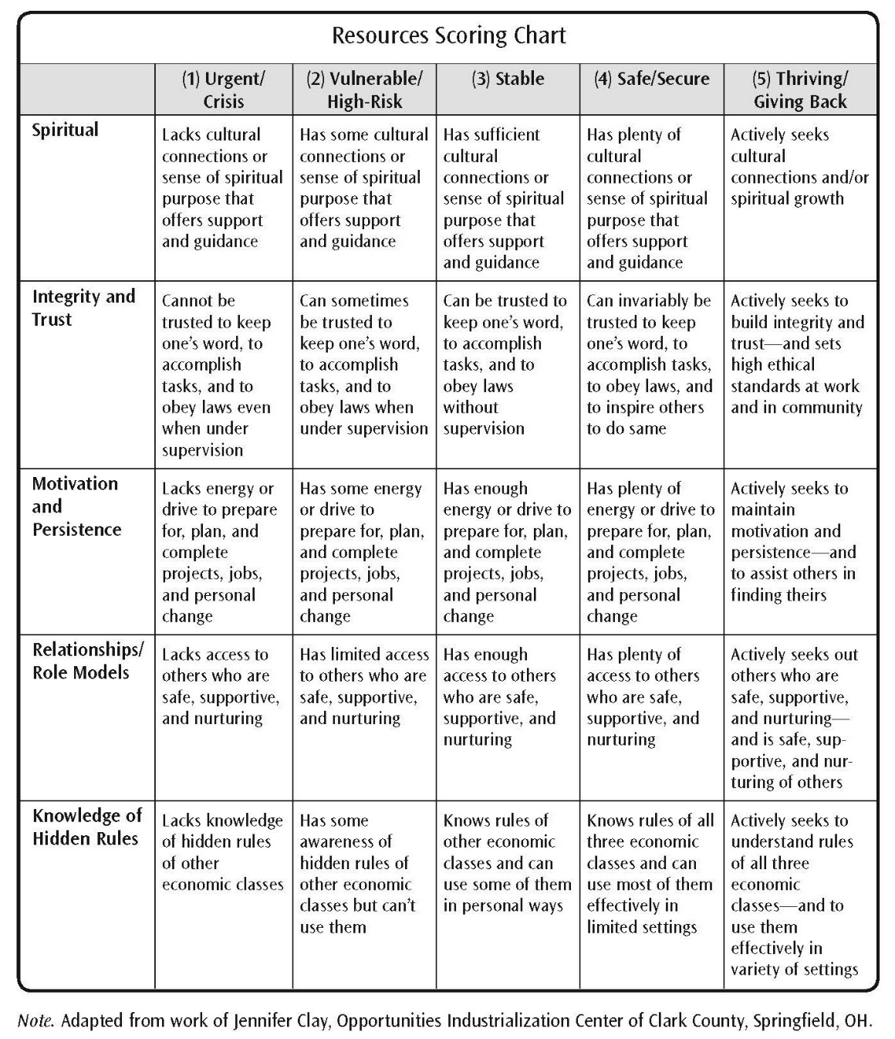
Resources Scoring Chart (continued)
Page 134

Slide 63
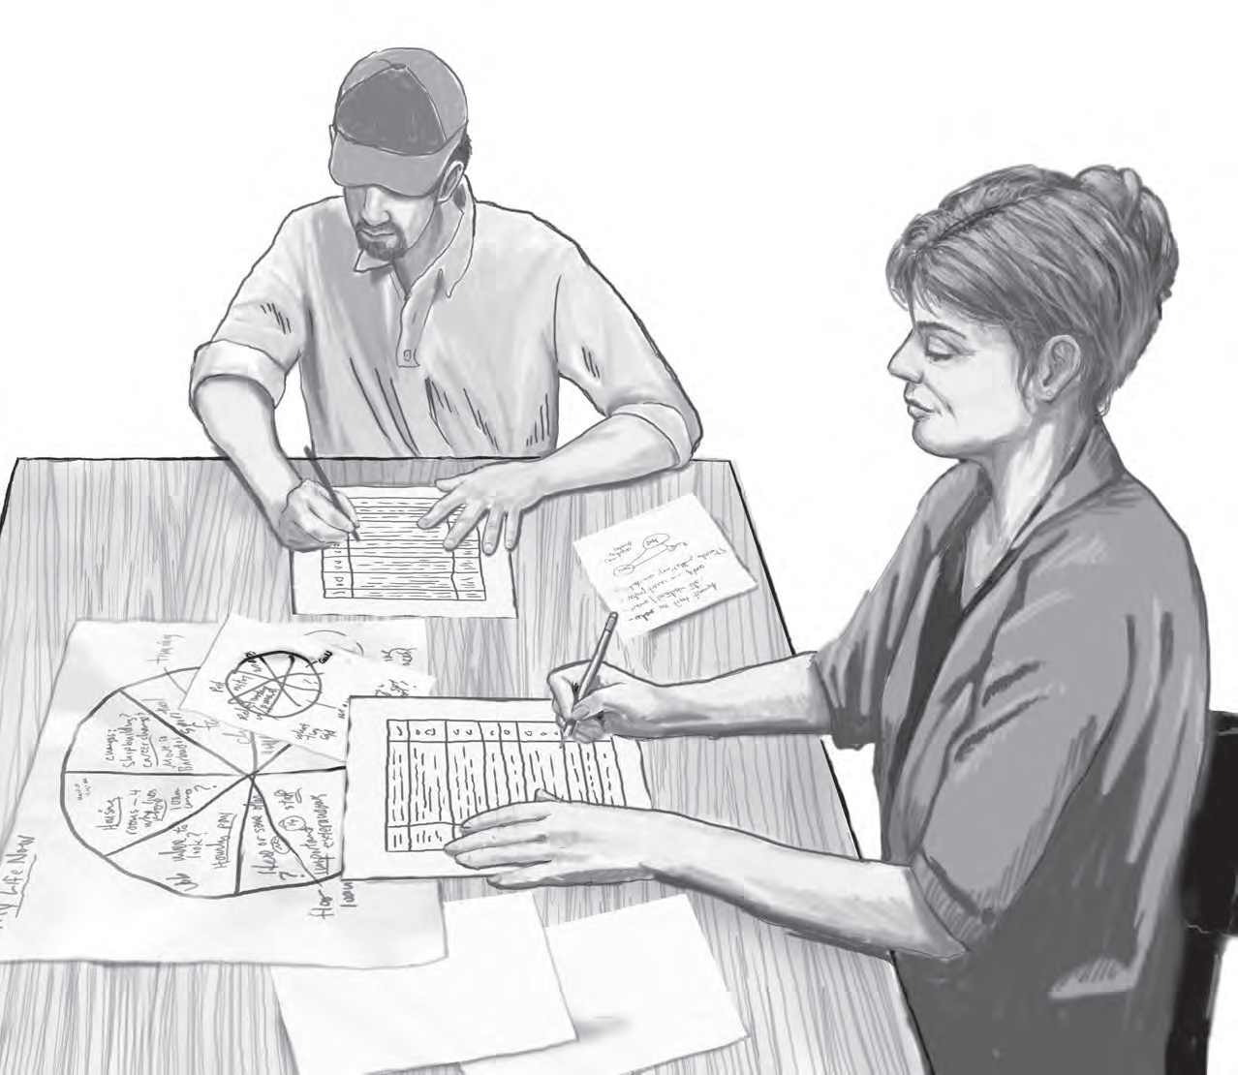
Module 7: Self-Assessment of Resources
Page 139

Slide 64
Self-Assessment of Resources Activity
Getting Ahead in the Workplace Self-Assessment
https://fs27.formsite.com/a34qO0/gmk7mufyje/index.html
Getting Ahead in the Workplace Demographics
https://fs27.formsite.com/a34qO0/lpsj2c79c1/index.html
Getting Ahead in the Workplace Return on Investment
https://fs27.formsite.com/a34qO0/zhe74pjxhz/index.html
Page 140–141

Slide 65
Self-Assessment of Resources
Page 142

Slide 66
Self-Assessment of Resources
Page 143

Slide 67
Self-Assessment of Resources
Page 144

Slide 68
Self-Assessment of Resources
Page 145

Slide 69
Self-Assessment of Resources
Page 146

Slide 70
Self-Assessment of Resources
Page 147

Slide 71
Self-Assessment of Resources
Page 148

Slide 72
Self-Assessment of Resources
Page 149

Slide 73
Self-Assessment of Resources
Page 150

Slide 74
Self-Assessment of Resources
Page 151

Slide 75
Self-Assessment of Resources
Page 152

Slide 76
Self-Assessment of Resources
Page 153

Slide 77
Self-Assessment of Resources
Page 154

Slide 78
Self-Assessment of Resources
Page 155

Slide 79
Self-Assessment of Resources
Page 156

Slide 80
Self-Assessment of Resources
Page 157

Slide 81
Self-Assessment of Resources
Page 158

Slide 82
Self-Assessment of Resources
Page 159

Slide 83
Self-Assessment of Resources
Page 160

Slide 84
Self-Assessment of Resources
Page 161

Slide 85
Self-Assessment of Resources
Page 162

Slide 86
Self-Assessment of Resources
Page 163

Slide 87
Mental Model of Resources
Page 164

Slide 88
Module 8: Community Assessment
Page 167

Slide 89
Community Assessment Activity
Getting Ahead in the Workplace Community Assessment
https://fs27.formsite.com/a34qO0/asbnlqujcm/index.html
Page 169

Slide 90
Community Assessment
Page 170

Slide 91
Community Assessment
Page 171

Slide 92
Community Assessment
Page 172

Slide 93
Community Assessment
Page 173

Slide 94
Community Assessment
Page 174

Slide 95
Community Assessment
Page 175

Slide 96
Community Assessment
Page 176

Slide 97
Community Assessment
Page 177

Slide 98
Community Assessment
Page 178

Slide 99
Community Assessment Mental Model
Page 179

Slide 100
Community Assets Map
Page 181

Slide 101
One-on-One Relationships
Page 182

Slide 102
Sample Community Map
Page 184

Slide 103
Module 9: Building Resources
Page 187

Slide 104
Analyzing the Differences Between Getting-By and Getting-Ahead Resources
Page 190

Slide 105
Example: Tic-Tac-Toe Diagram
Page 193

Slide 106
Video: Tic-Tac-Toe Activity
https://spaces.hightail.com/receive/JAjfdjCZ47
Page 193

Slide 107
Example: Resource Development Worksheet for Building Emotional Resources
Page 194

Slide 108
Example: Resource Development Worksheet for Building Emotional Resources (continued)
Page 195

Slide 109
Module 10: Personal and Community Plans
Page 199

Slide 110
Decide What to Work On
Page 202

Slide 111
Define Why You Want to Work on These Resources
Page 202

Slide 112
Example: Procedural Steps
Page 204

Slide 113
Where to Go to Get Help
Page 205

Slide 114
Example: Plan for First Week
Page 205

Slide 115
Example: Closing ‘Back Doors’
Page 206

Slide 116
Example: Support for Change Mental Model
Page 208

Slide 117
For Facilitators Only
Getting Ahead in the Workplace Model Fidelity Scale
https://fs27.formsite.com/a34qO0/br26g1oun1/index.htmla

