Slide 1
Getting Ahead Virtual Charts
Philip DeVol

Slide 2
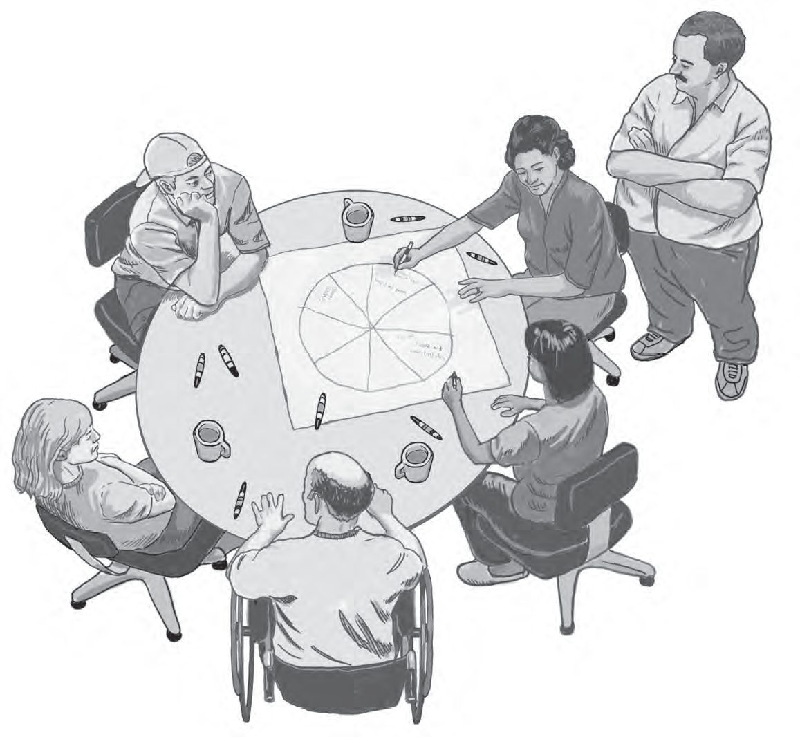
Module 1: My Life Now

Slide 3
Mental Model of Poverty Activity
https://fs27.formsite.com/a34qO0/6nsbmlkp7y/index.html

Slide 4
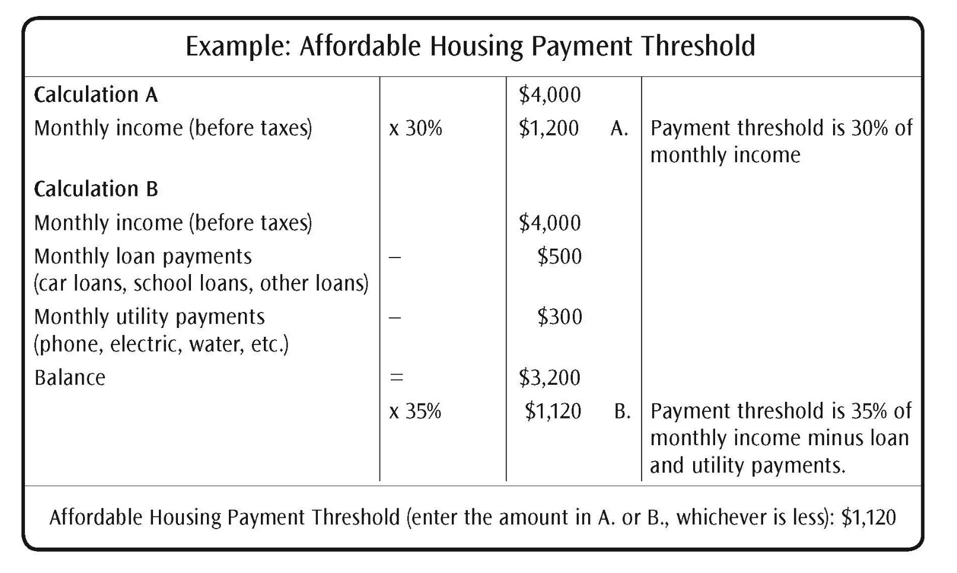
Affordable Housing Payment Threshold Calculator
Page 12

Slide 5
Affordable Housing Payment Threshold Calculator Activity
https://fs27.formsite.com/a34qO0/gryhrpzjqx/index.html
Page 12

Slide 6
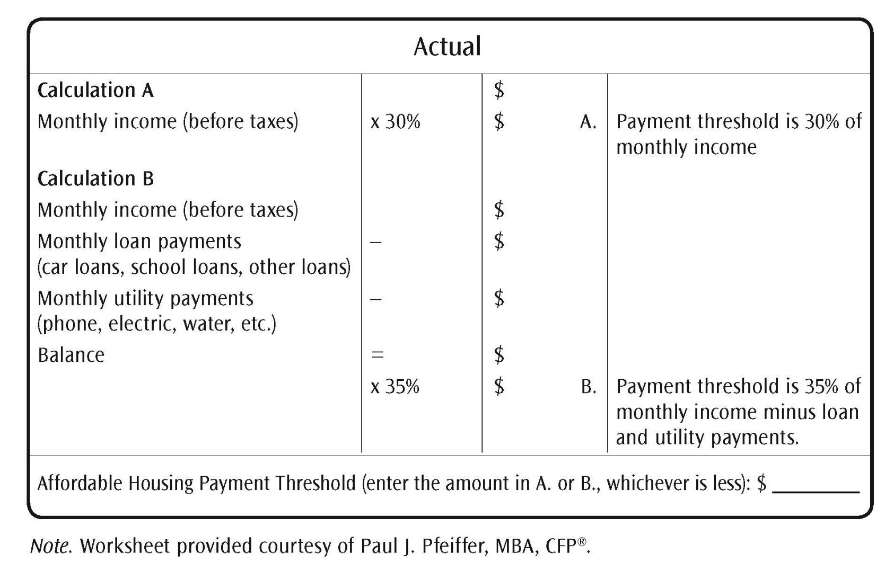
Affordable Housing Payment Threshold Calculator (continued)
Page 12

Slide 7
Debt-to-Income Ratio Activity
https://fs27.formsite.com/a34qO0/aovisga2hw/index.html
Page 18

Slide 8
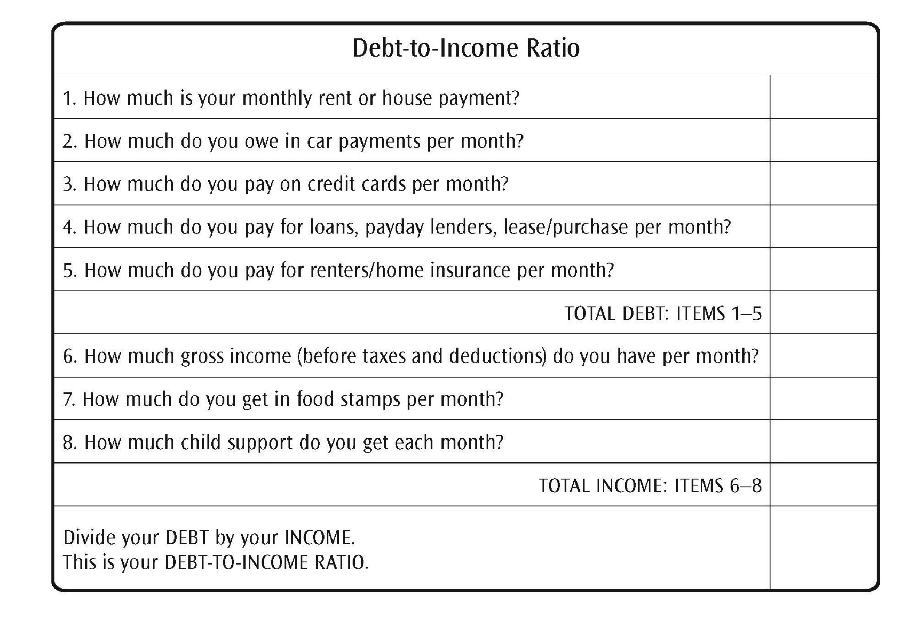
Debt-to-Income Ratio
Page 18

Slide 9
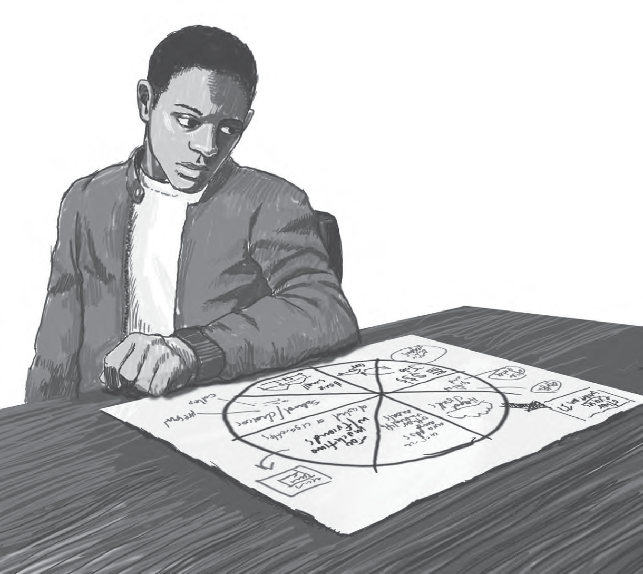
Module 2: Theory of Change
Page 25

Slide 10
Self Assessment of Stability Activity
https://fs27.formsite.com/a34qO0/karddnch4j/index.html
Page 30

Slide 11
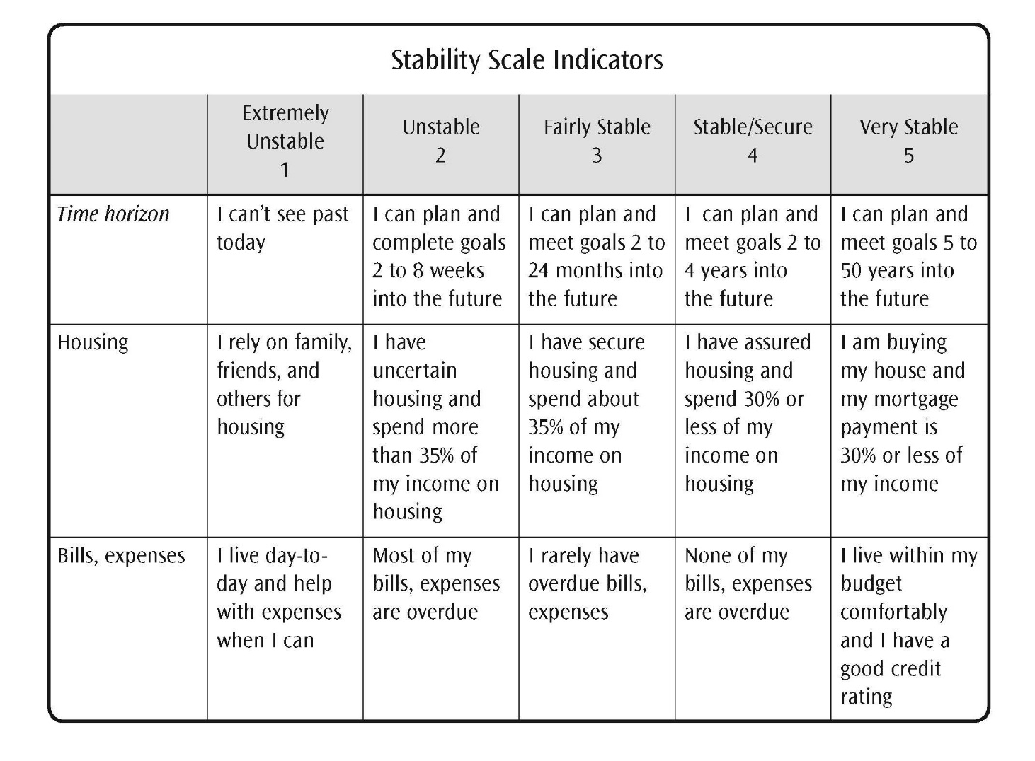
Stability Self-Assessment
Page 30

Slide 12
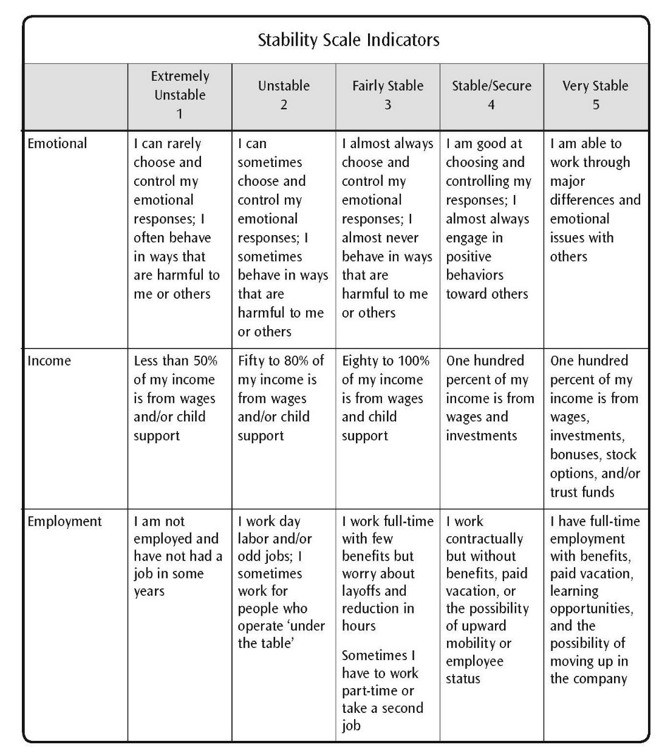
Stability Self-Assessment (continued)
Page 31

Slide 13
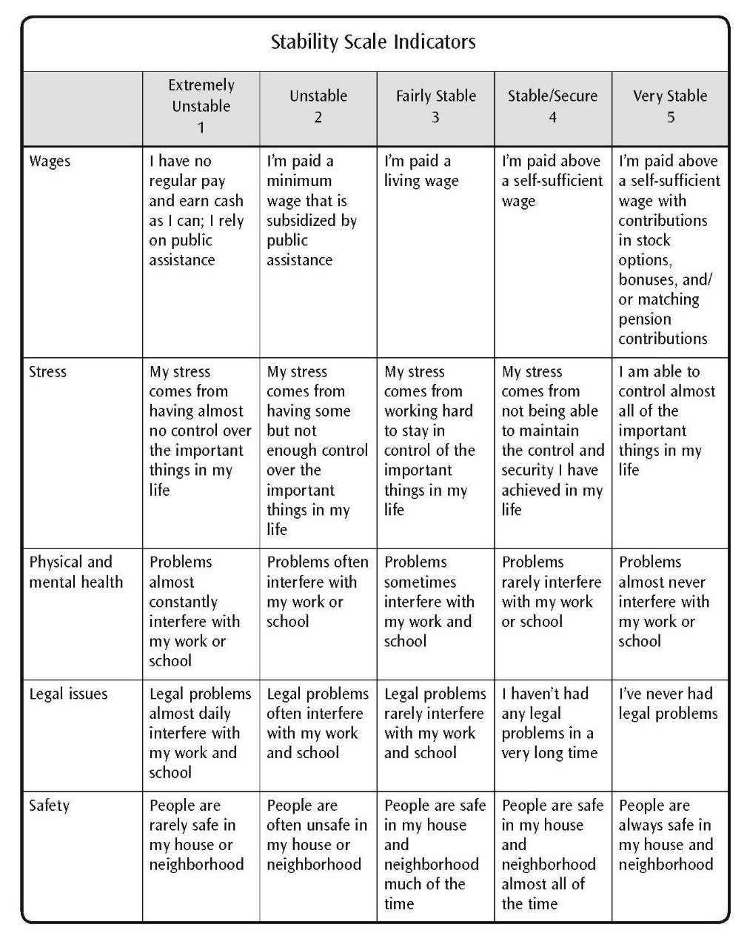
Stability Self-Assessment (continued)
Page 32

Slide 14
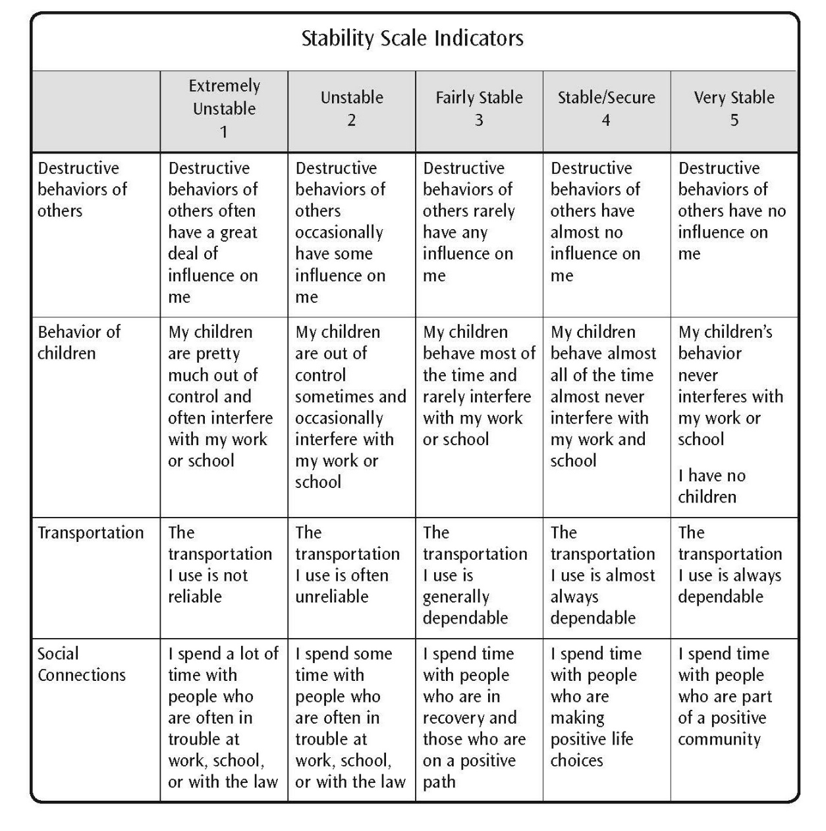
Stability Self-Assessment (continued)
Page 33

Slide 15
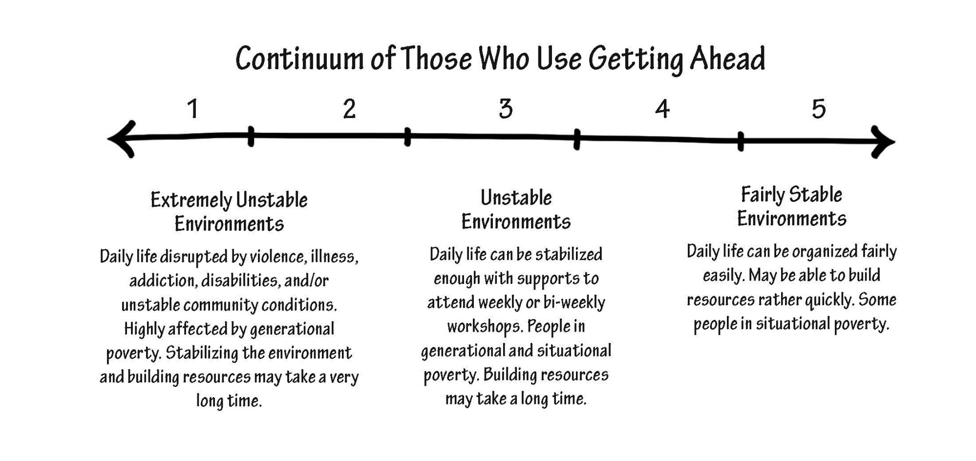
Stability Self-Assessment (continued)
Page 34

Slide 16
Model Mental Theory of Change
Abstract
P | L | A | N | S
Procedural Steps
_________
_________
_________
Abstract:
Detached
Objective
Think
Analyze
New Info
Education
Plans Support
Concrete
Future Story

Slide 17
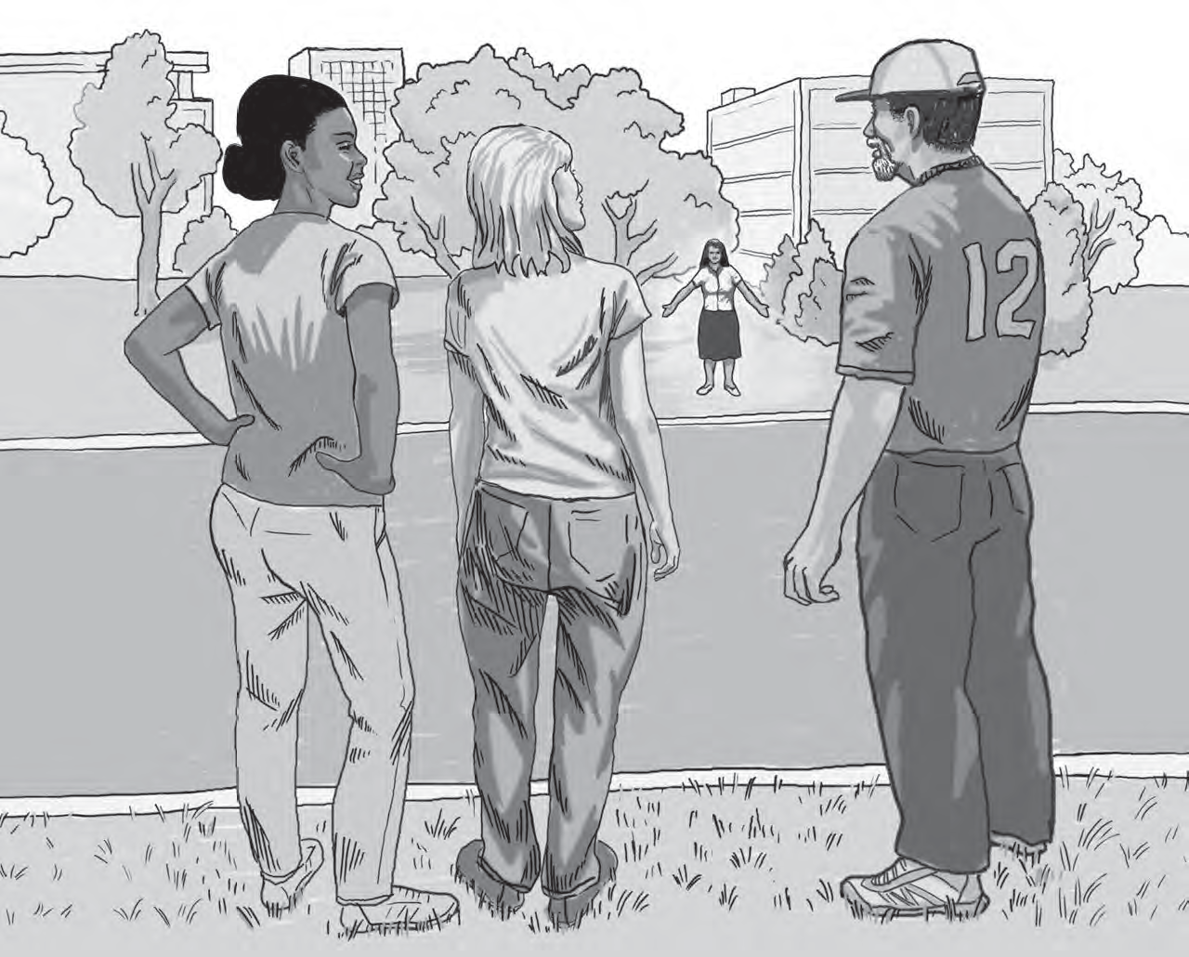
Module 3: Rich/Poor Gap and Research on the Causes of Poverty
Page 41

Slide 18
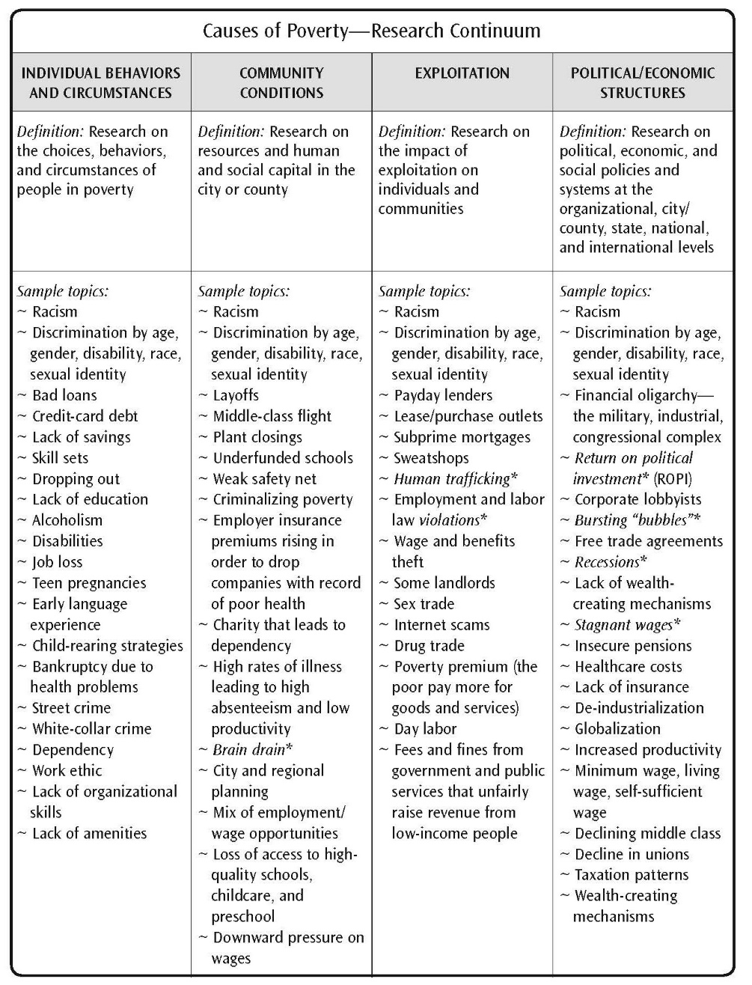
Research Continuum
Page 44

Slide 19
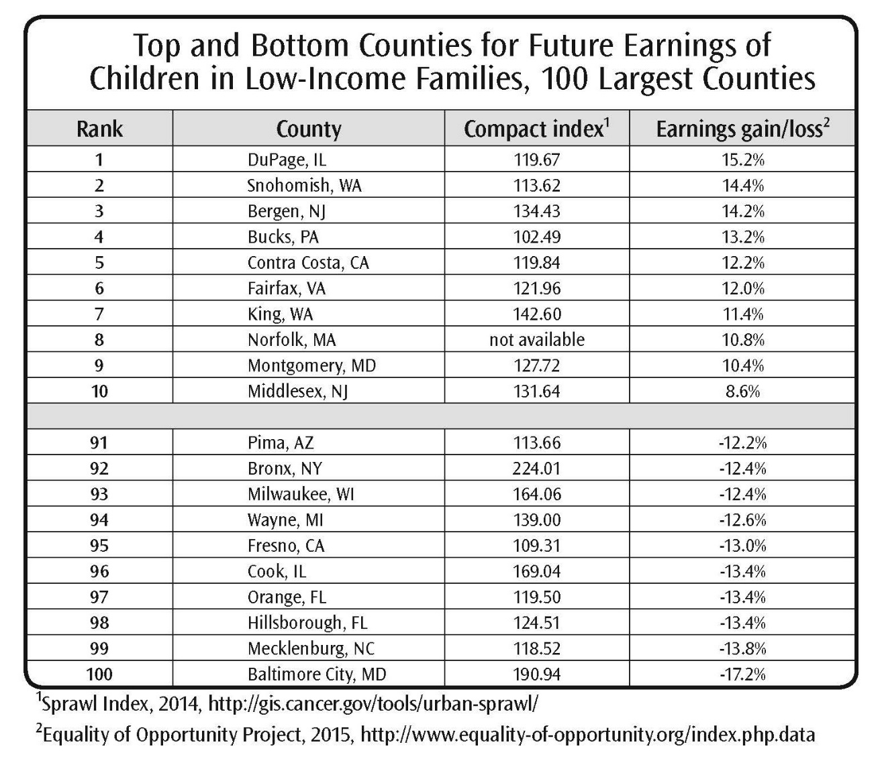
Top and Bottom Counties for Future Earnings of Children in Low-Income Families, 100 Largest Counties
Page 46

Slide 20
Predators Group Activity
https://fs27.formsite.com/a34qO0/is43j3i5yu/index.html

Slide 21
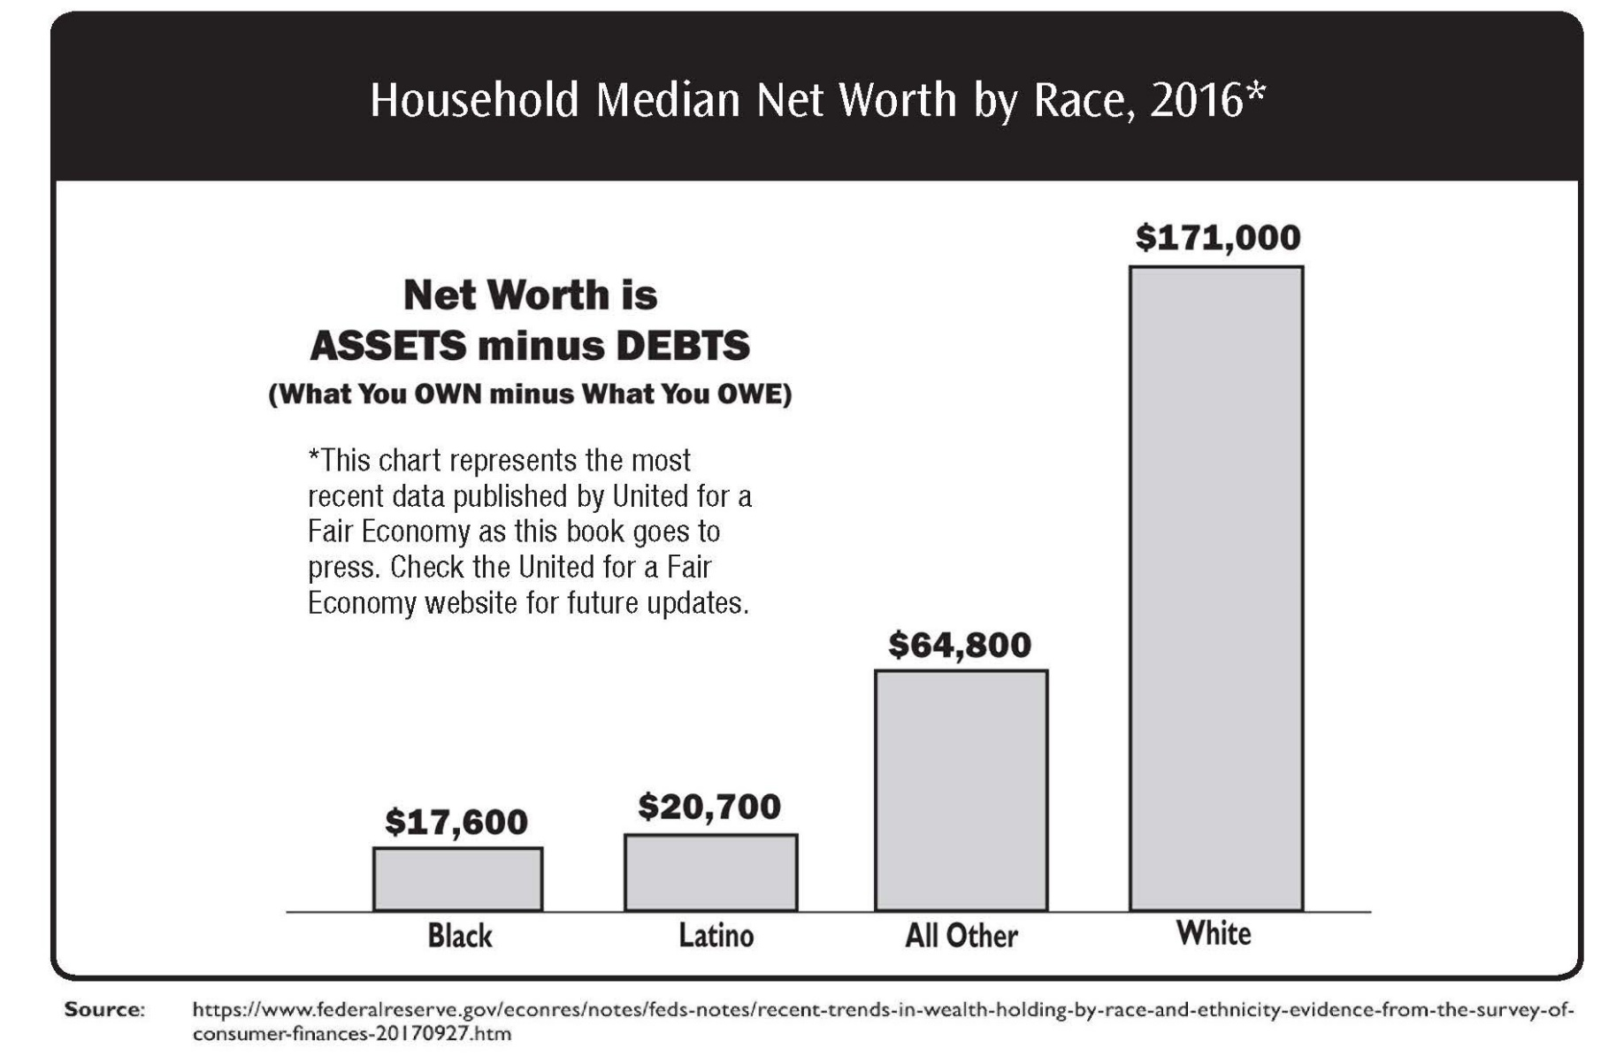
Household Median Net Worth by Race, 2016
Page 51

Slide 22
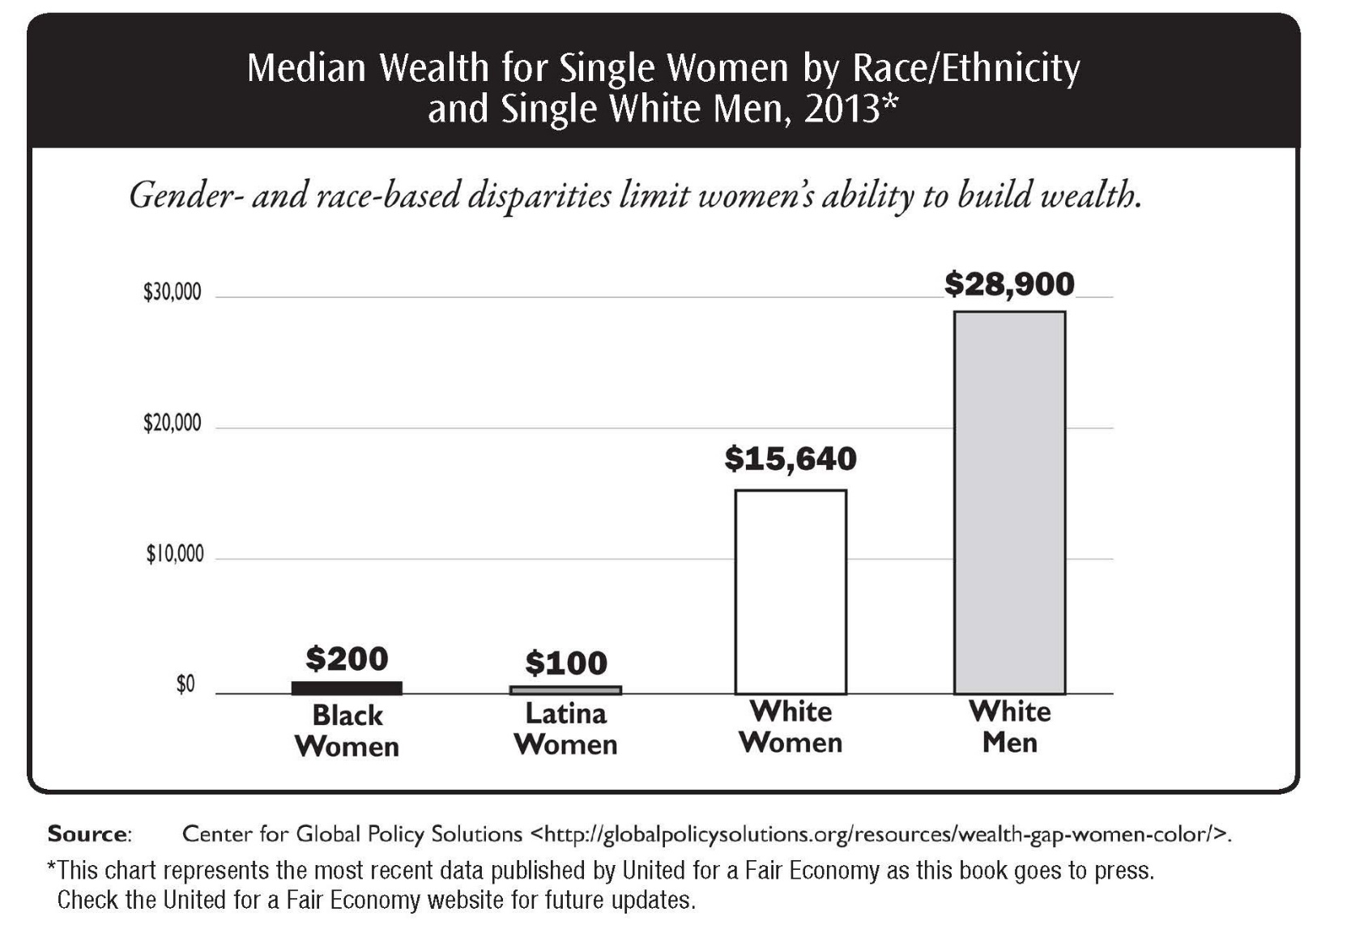
Median Wealth for Single Women by Race/Ethnicityand Single White Men, 2013
Page 52

Slide 23
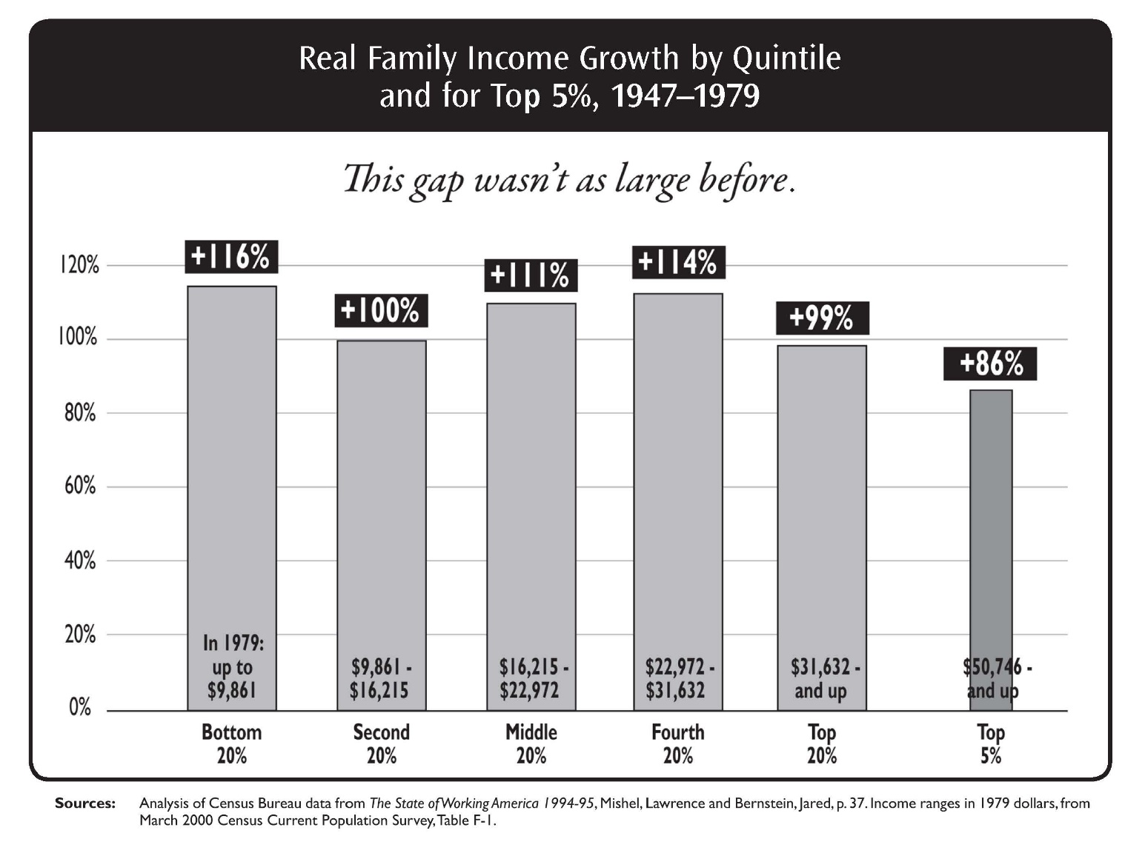
Real Family Income Growth by Quintile and for Top 5%, 1947–1979
Page 55

Slide 24
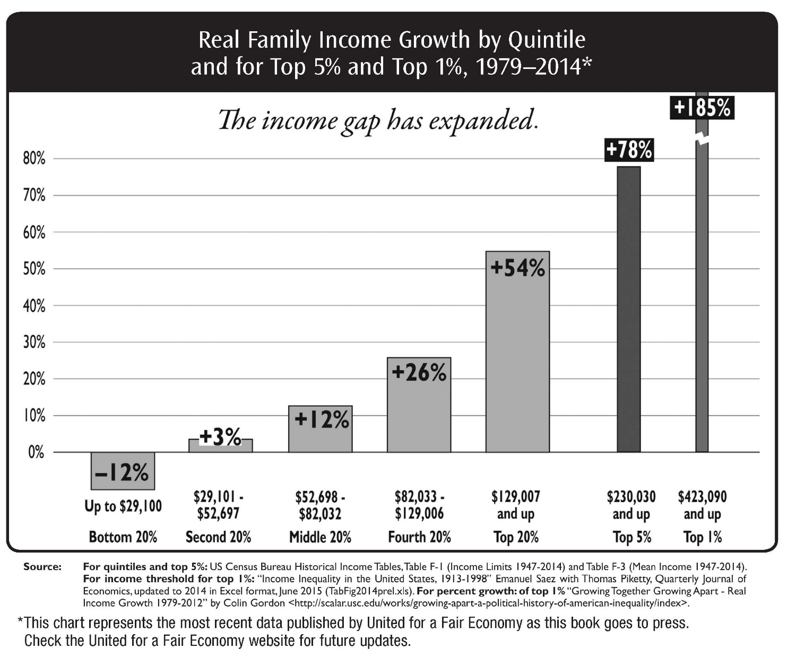
Real Family Income Growth by Quintile and for Top 5% and Top 1%, 1979–2014
Page 55

Slide 25
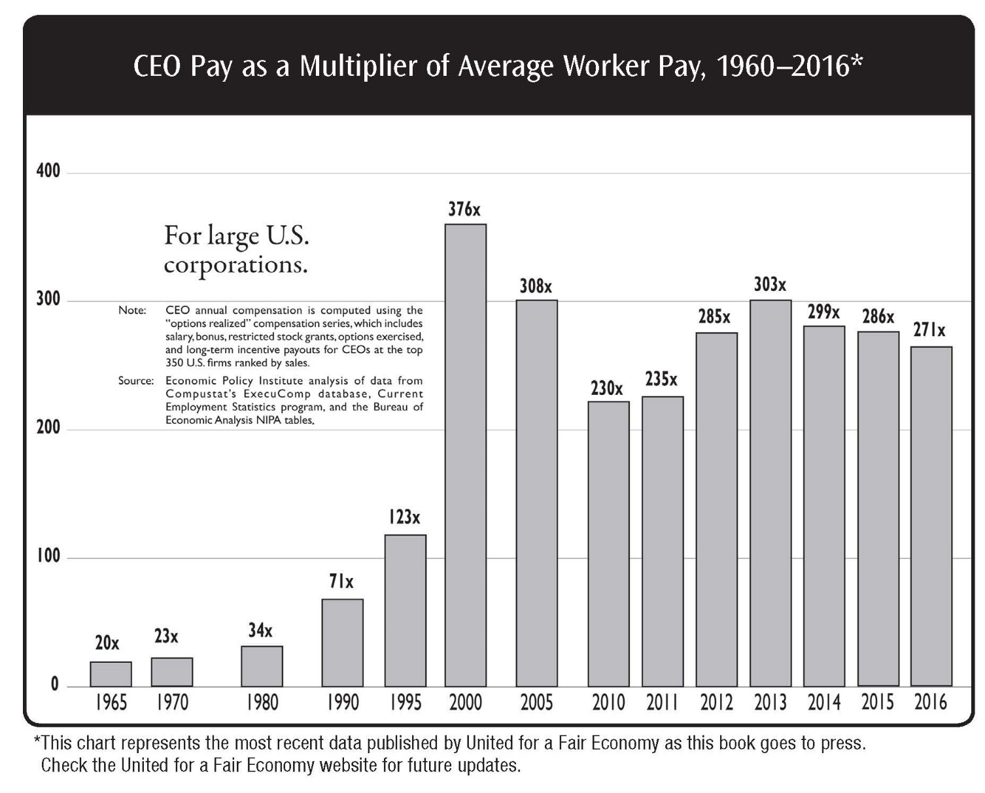
CEO Pay as a Multiplier of Average Worker Pay, 1960–2016
Page 56

Slide 26
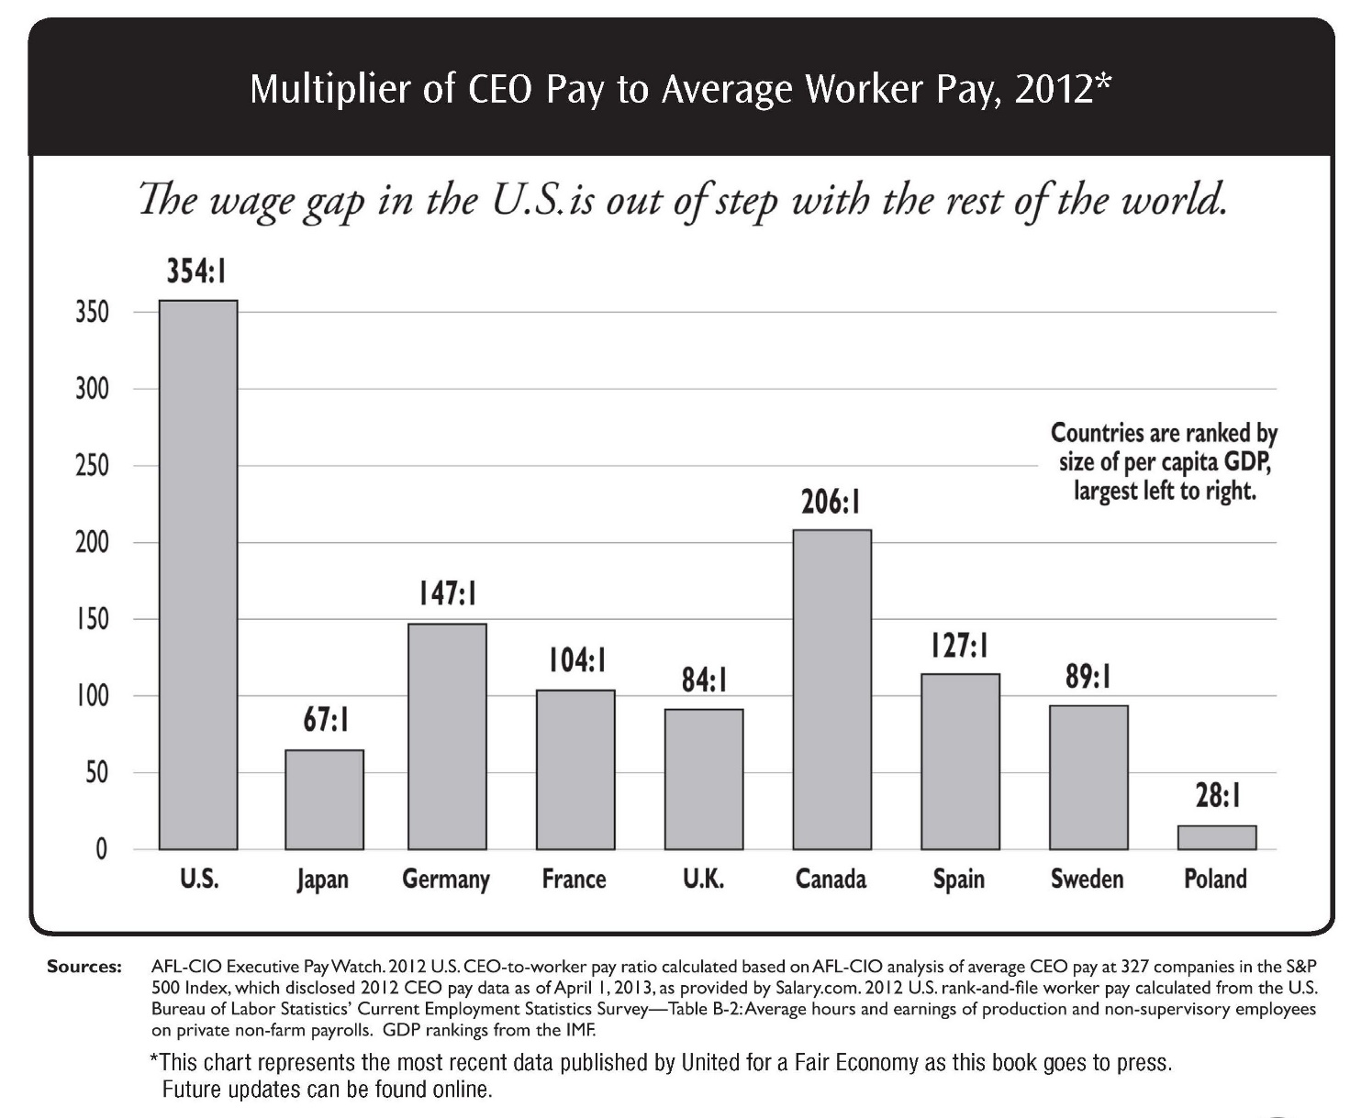
Multiplier of CEO Pay to Average Worker Pay, 2012
Page 57

Slide 27
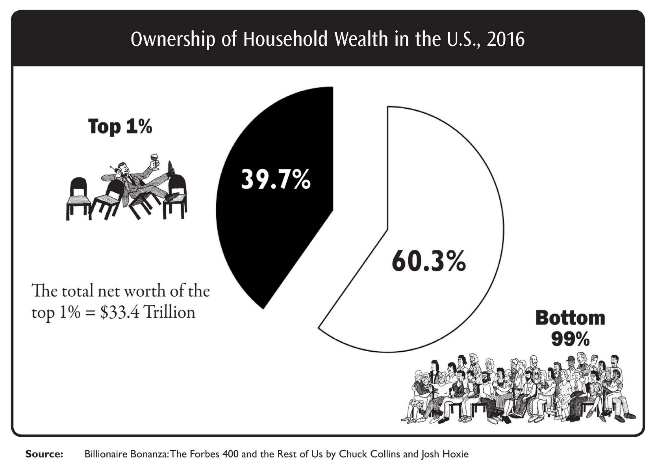
Ownership of Household Wealth in the U.S., 2016
Page 58

Slide 28
Mental Model of Middle Class Activity
Mental Model of Middle Class:
https://fs27.formsite.com/a34qO0/ogq1lwxcw7/index.html

Slide 29
Mental Model of Wealth Activity
Mental Model of Wealth:
https://fs27.formsite.com/a34qO0/wgf9nucckz/index.html

Slide 30
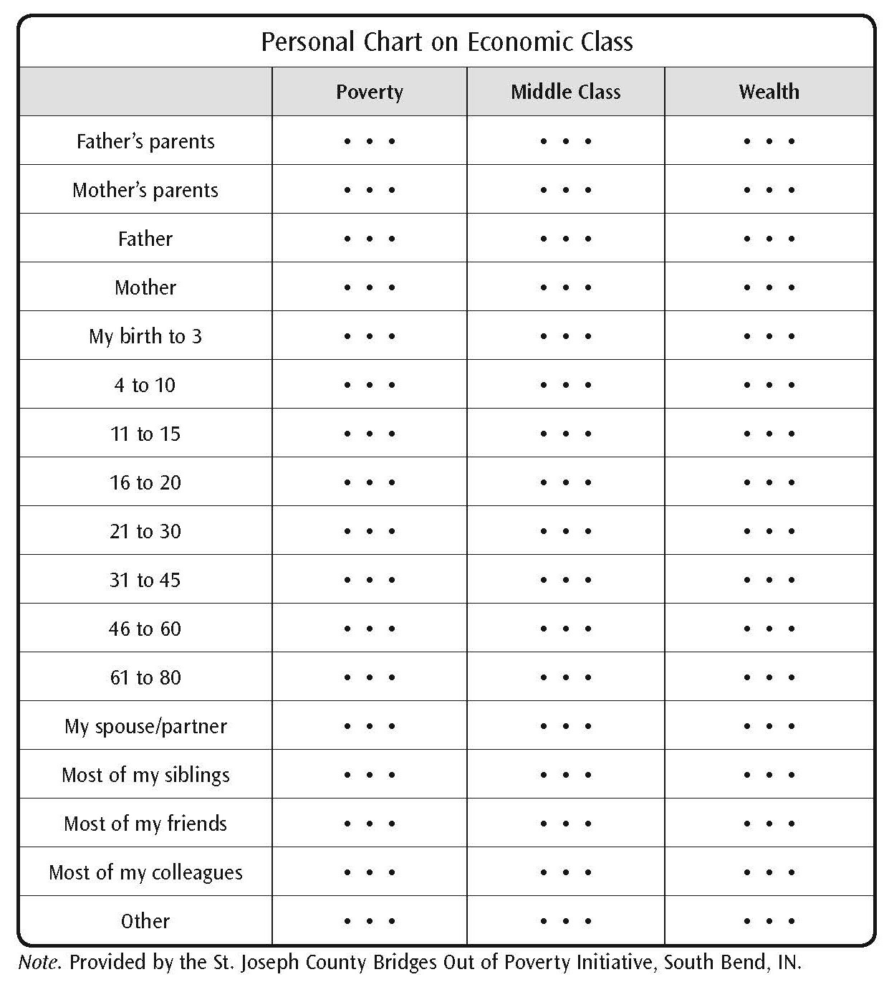
Personal Chart on Economic Class
Page 65

Slide 31
Community Sustainability Grid Activity
https://fs27.formsite.com/a34qO0/wvdtdgn87u/index.html
Page 66

Slide 32
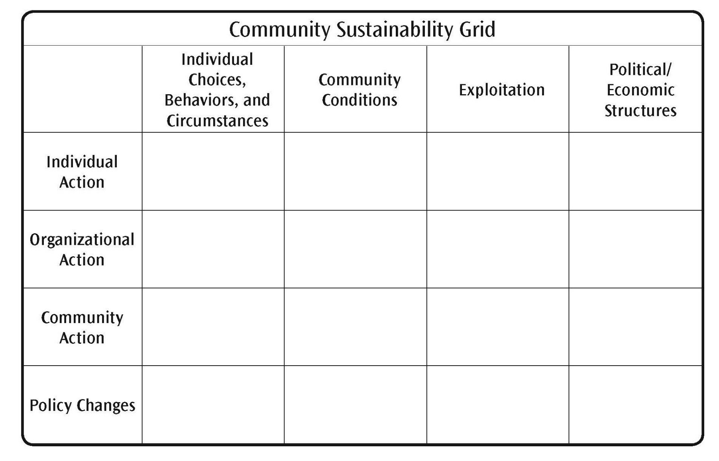
Community Sustainability Grid
Page 66

Slide 33
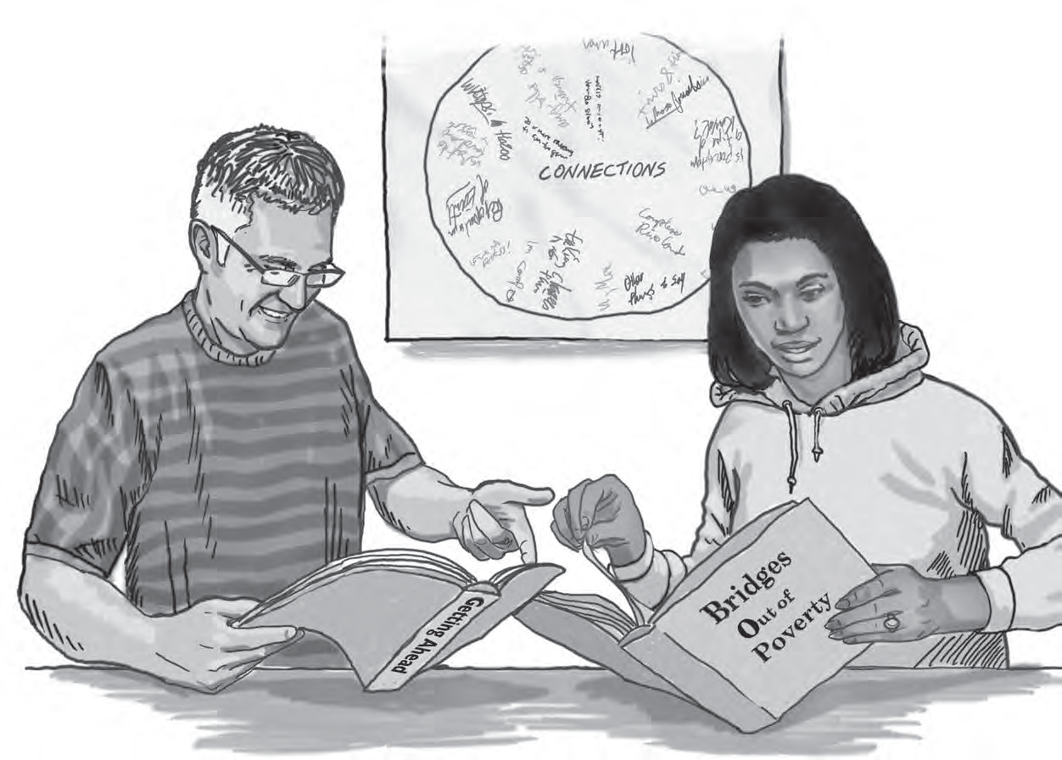
Module 4: Hidden Rules of Economic Class
Page 69

Slide 34
Hidden Rules of Economic Class Group Activity
https://fs27.formsite.com/a34qO0/hvigitzqnc/index.html
Page 74

Slide 35
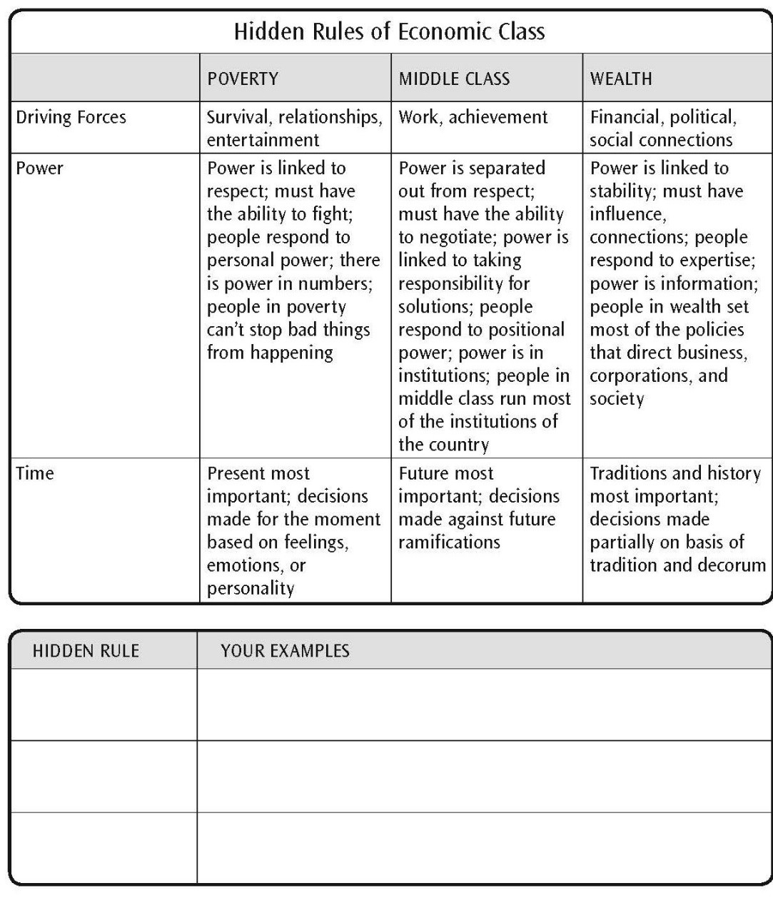
Hidden Rules of Economic Class
Page 74

Slide 36
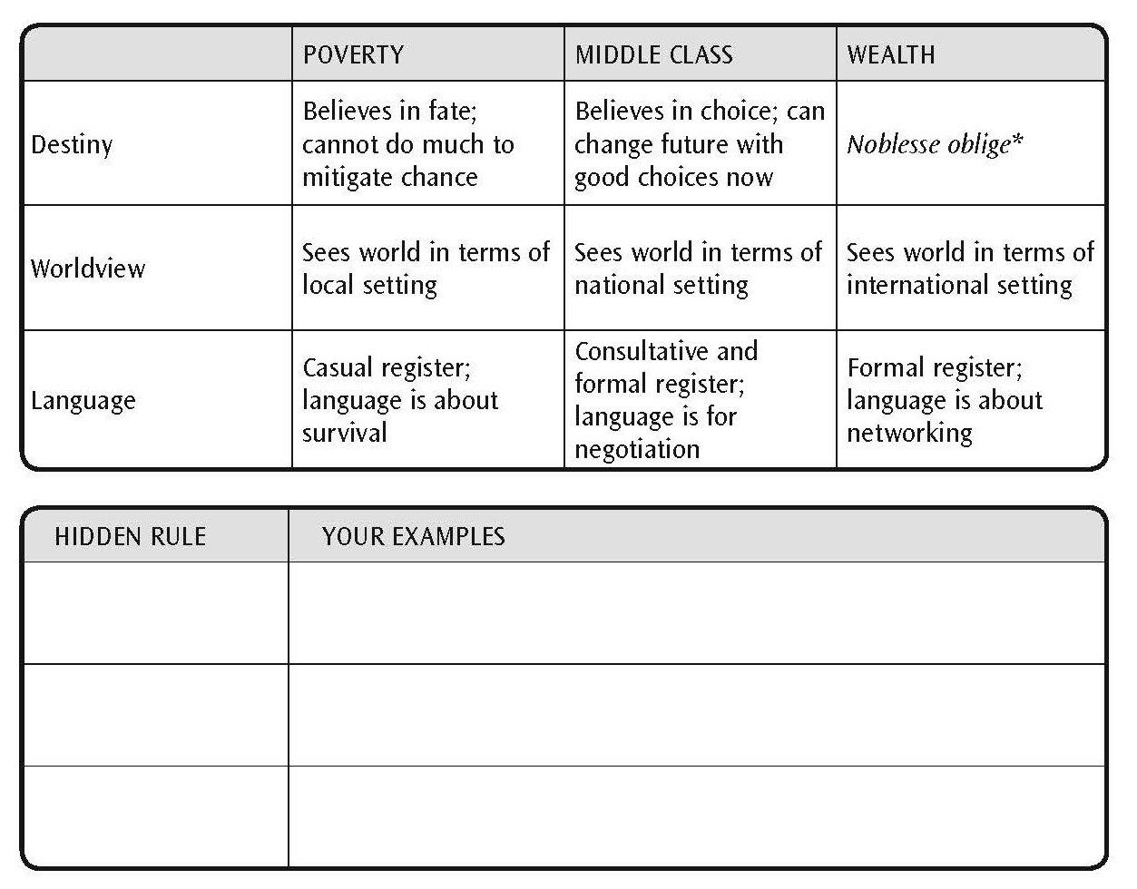
Hidden Rules of Economic Class (continued)
Page 75

Slide 37
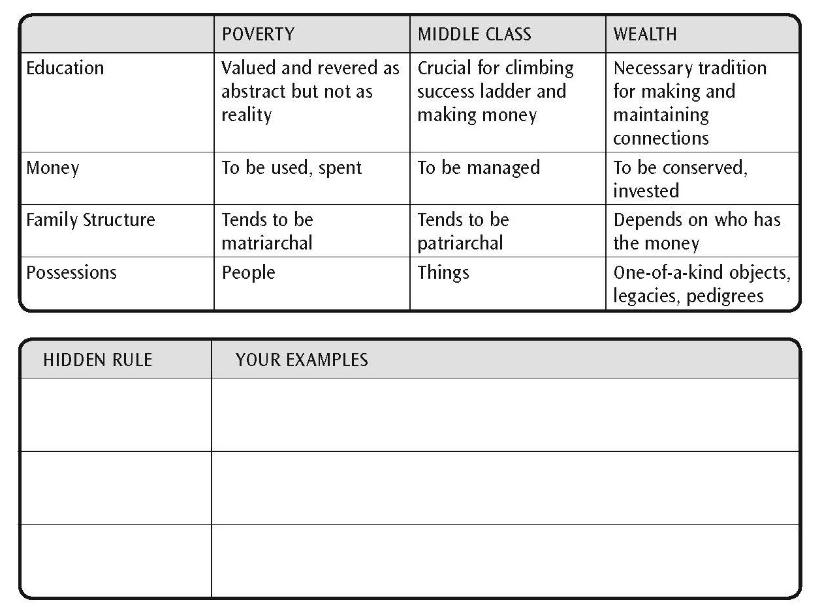
Hidden Rules of Economic Class (continued)
Page 75

Slide 38
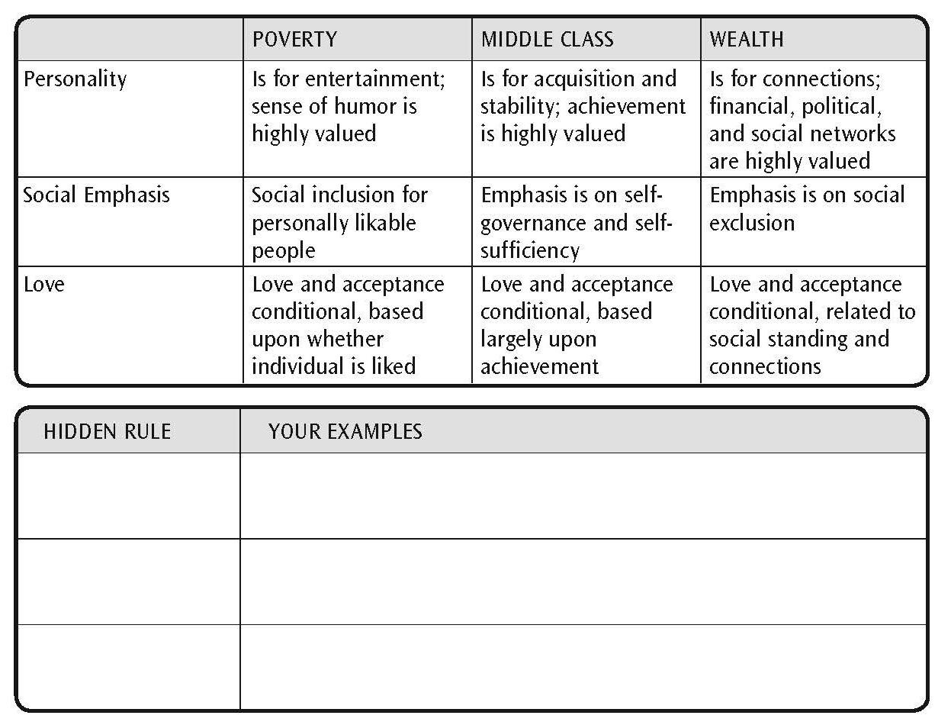
Hidden Rules of Economic Class (continued)
Page 76

Slide 39
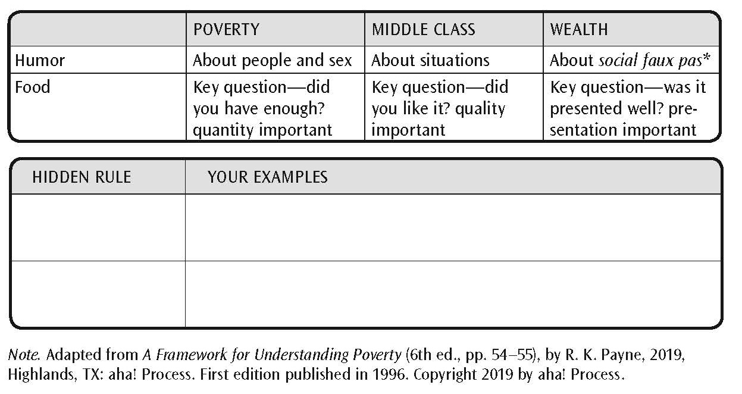
Hidden Rules of Economic Class (continued)
Page 76

Slide 40
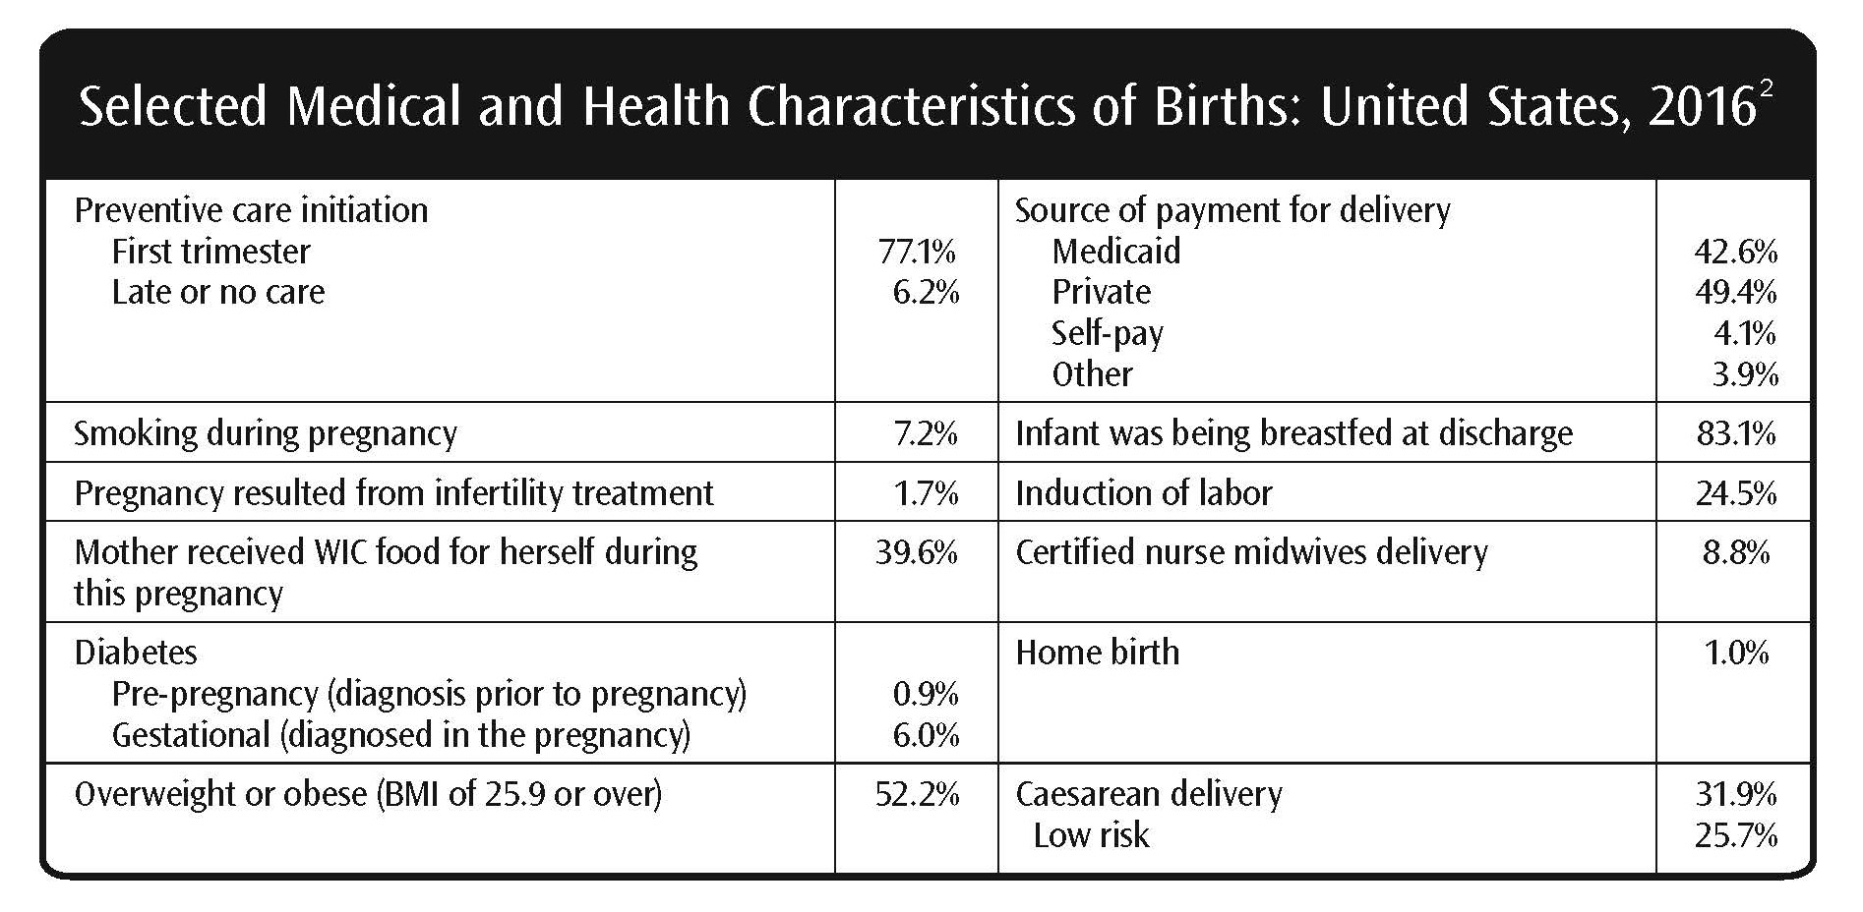
Selected Medical and Health Characteristics of Births: United States, 2016
Page 80

Slide 41
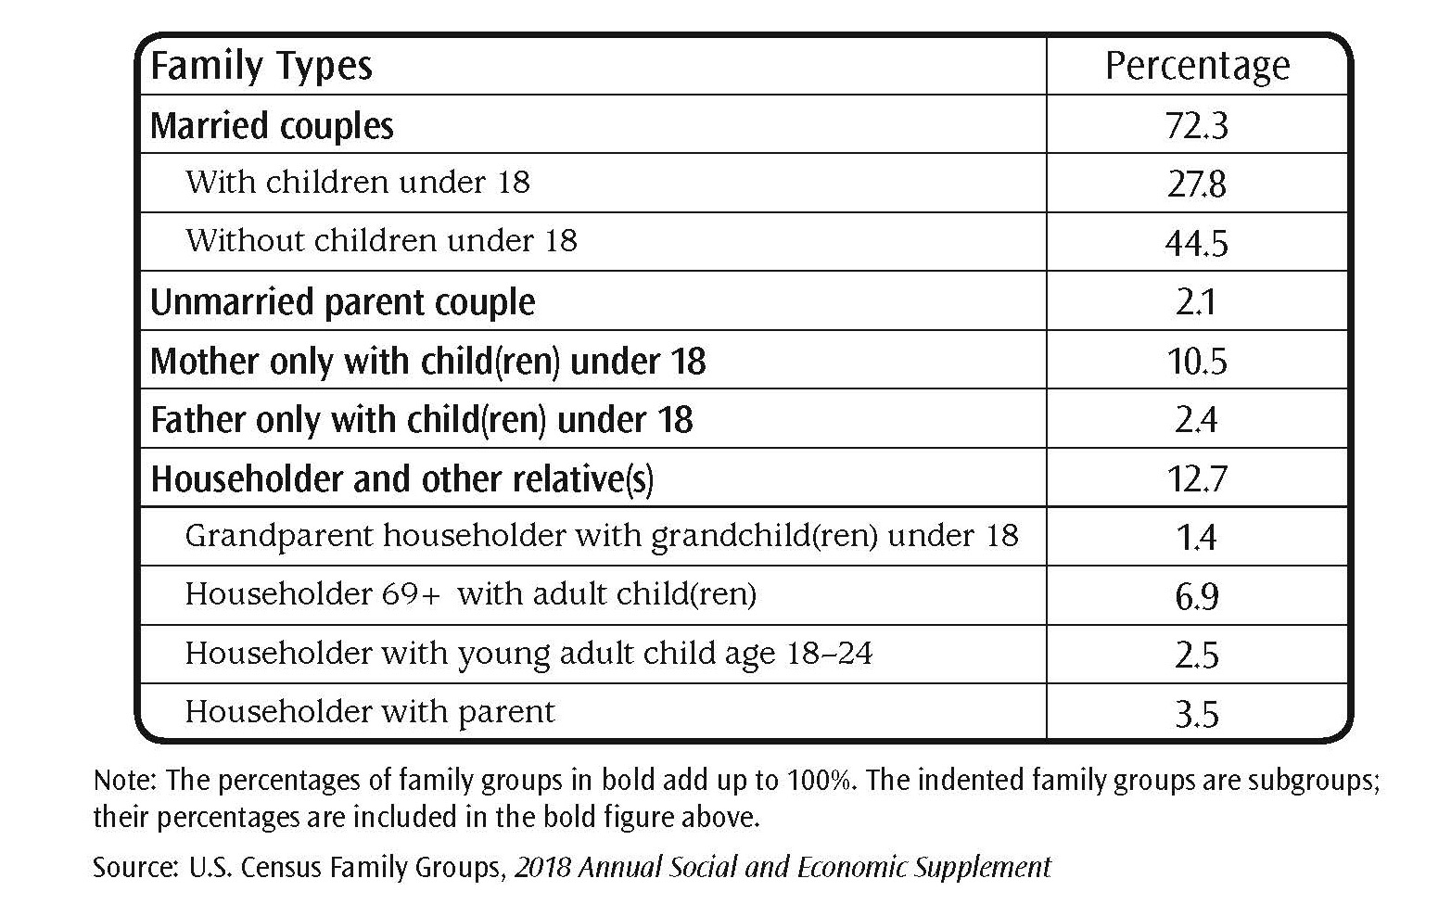
Family Types
Page 84

Slide 42
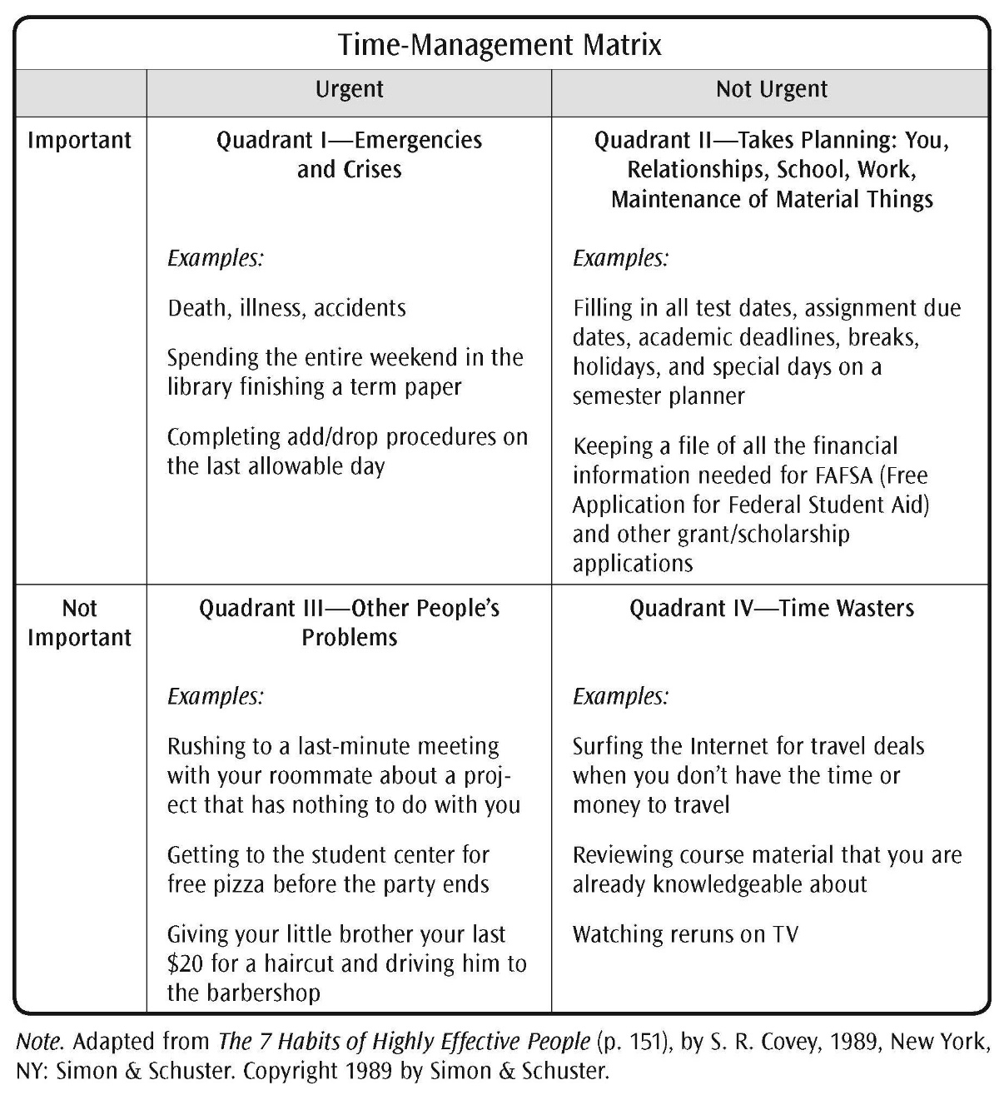
Time-Management Matrix
Page 86

Slide 43
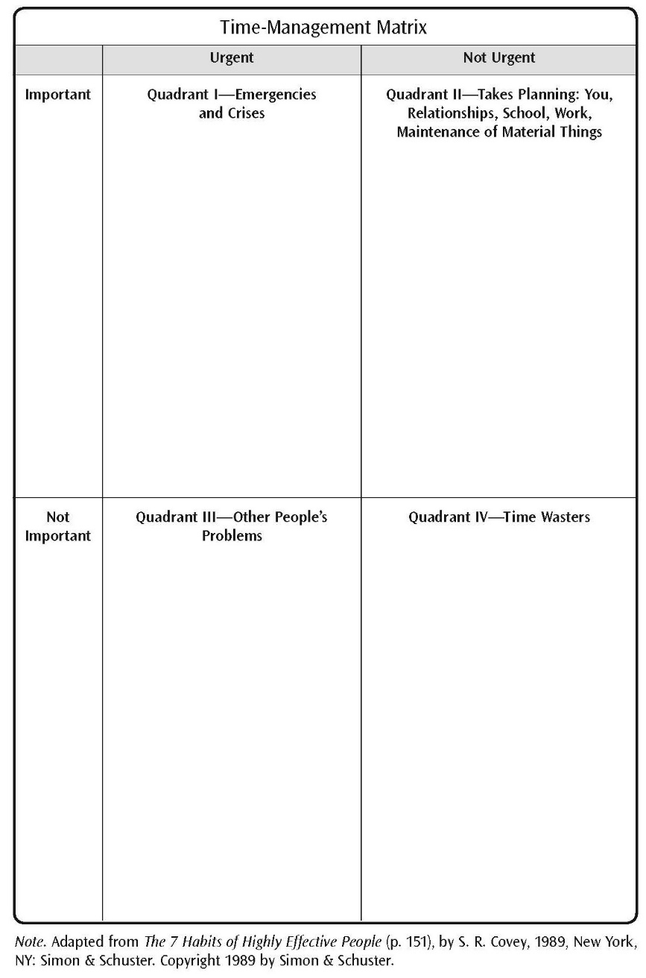
Time-Management Form
Page 87

Slide 44
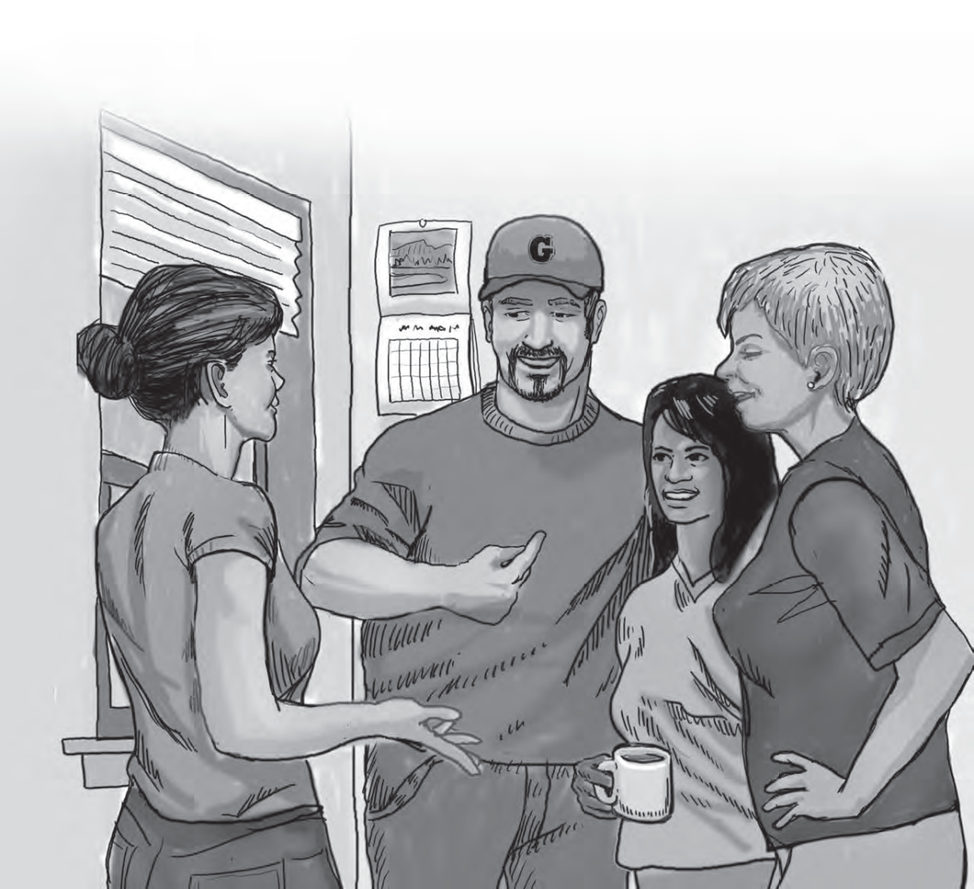
Module 5: The Importance of Language
Page 91

Slide 45
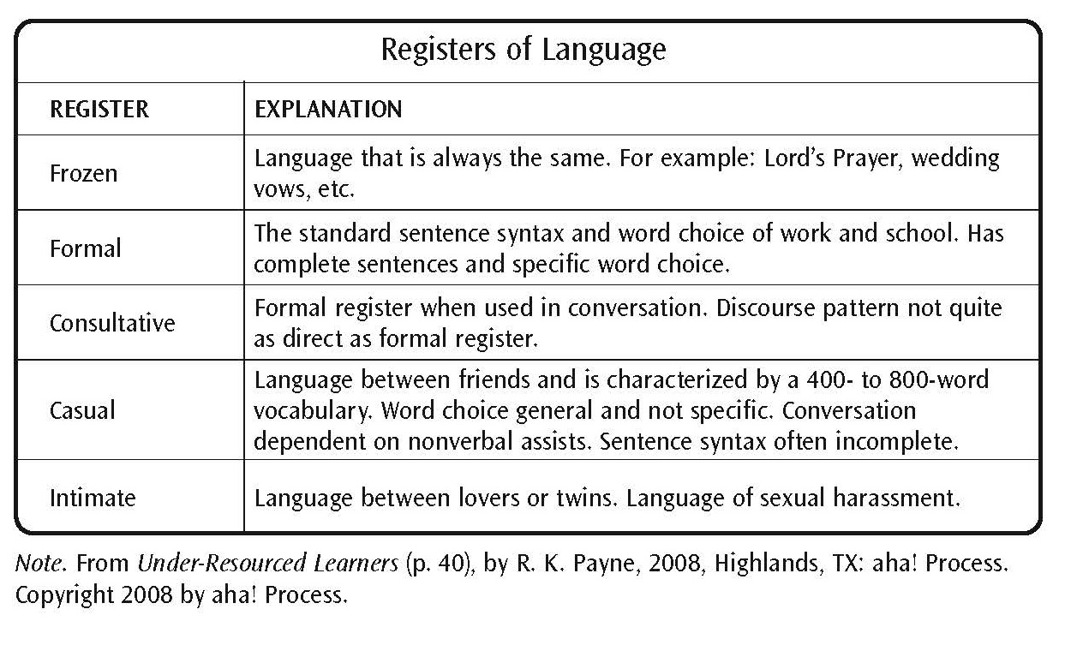
Registers of Language
Page 93

Slide 46
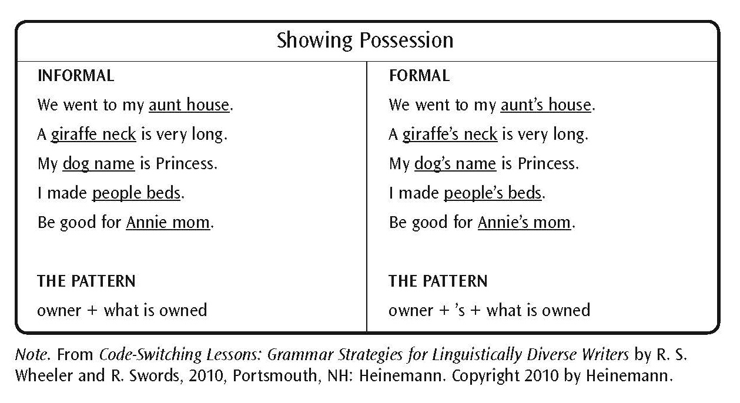
Showing Possession
Page 96

Slide 47
Past Time Patterns
Page 97

Slide 48
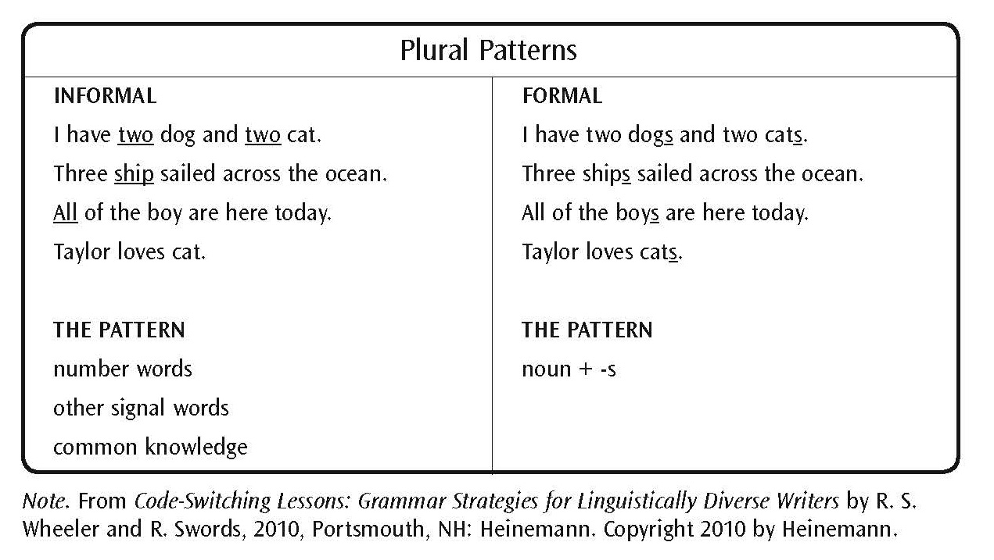
Plural Patterns
Page 97

Slide 49
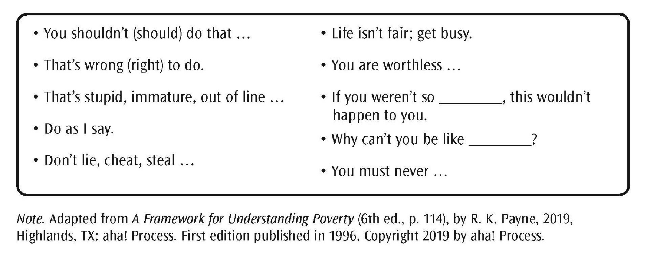
Parent Voice
Page 98

Slide 50
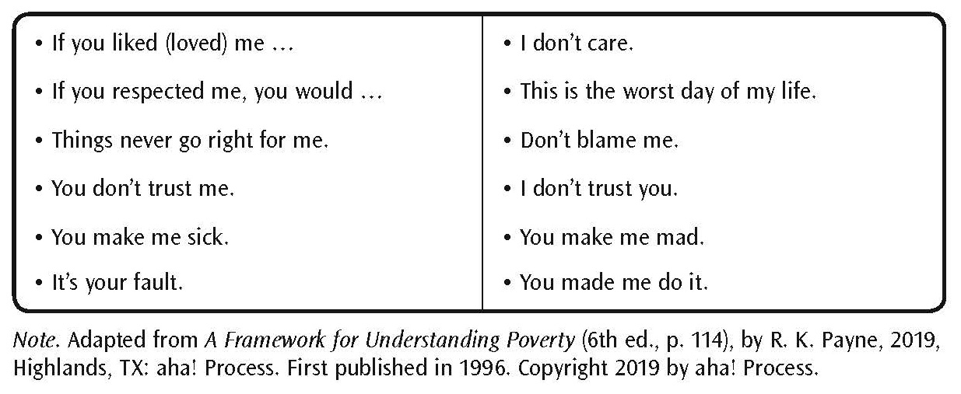
Child Voice
Page 99

Slide 51
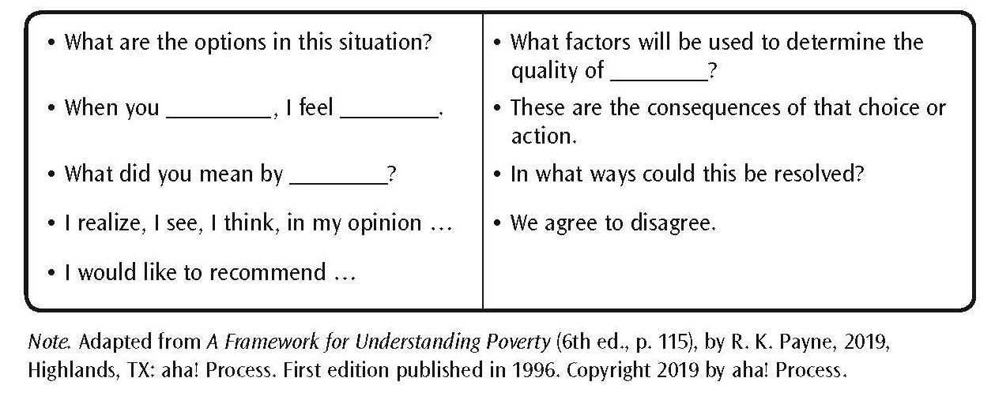
Adult Voice
Page 100

Slide 52
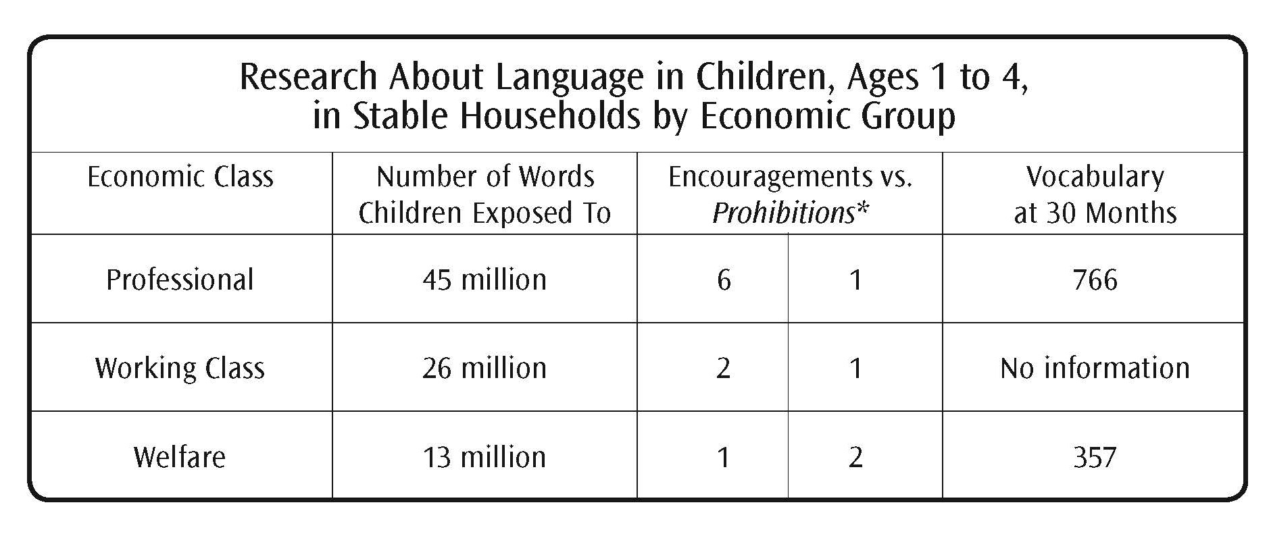
Research About Language in Children, Ages 1 to 4, in Stable Households by Economic Group
Source: Meaningful Differences in the Everyday Experience of Young American Children. Hart & T. Risley. (1995).
Page 104

Slide 53
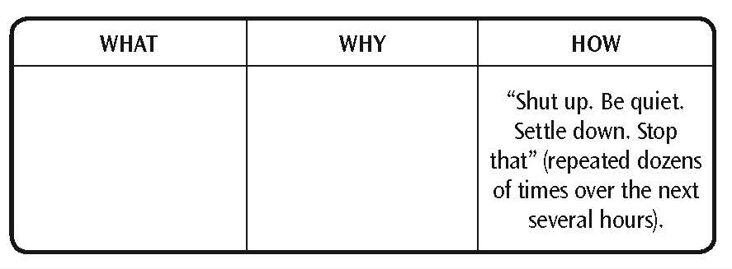
Mediation: the What, the Why, the How
Page 105

Slide 54
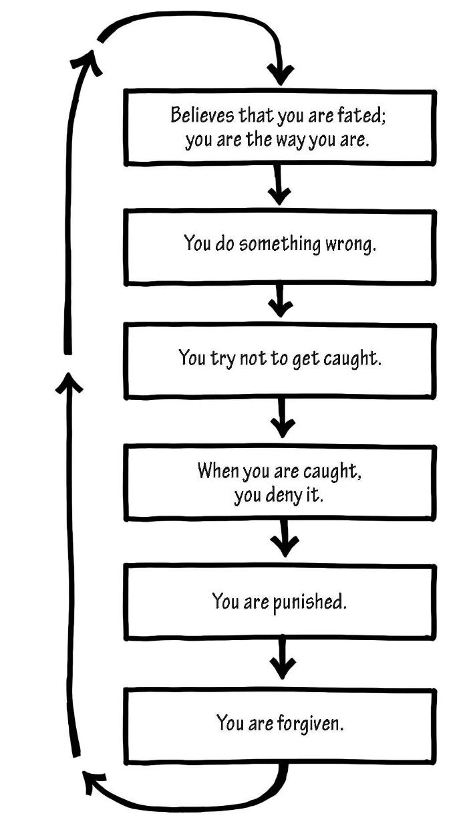
Penance/Forgiveness Cycle
Page 108

Slide 55
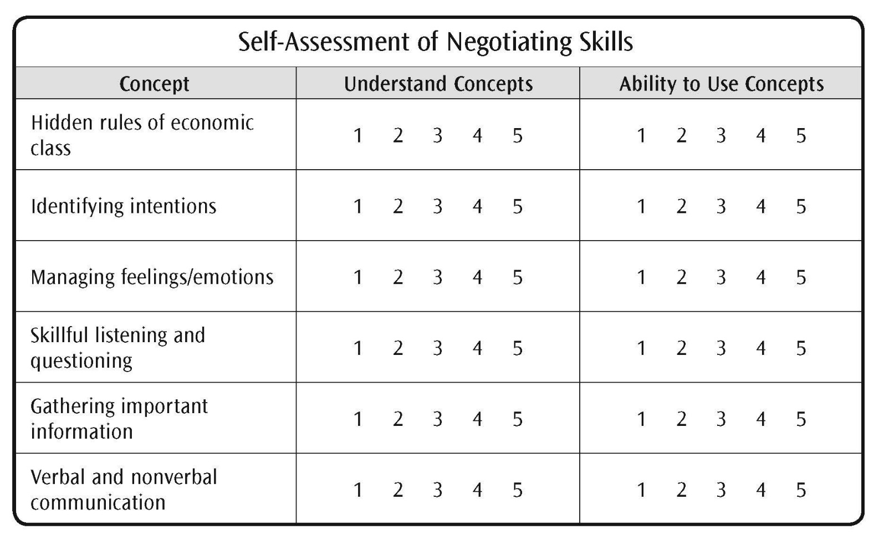
Self-Assessment of Negotiating Skills
Page 114

Slide 56
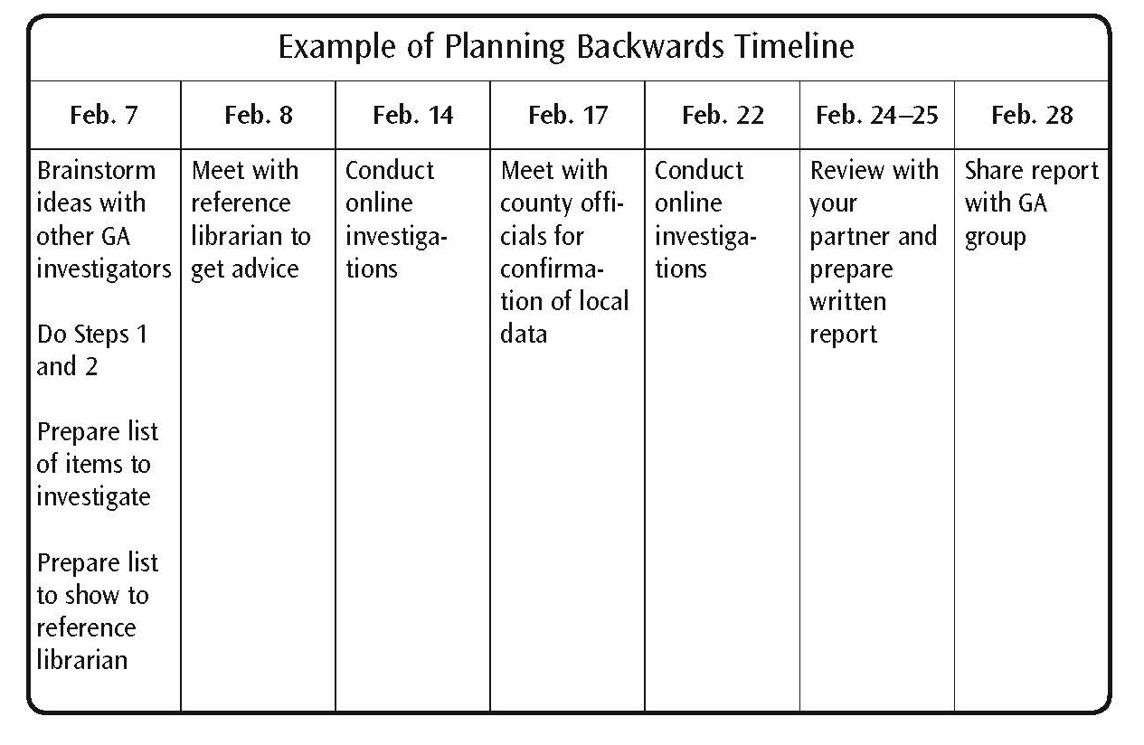
Example of Planning Backwards Timeline
Page 116

Slide 57
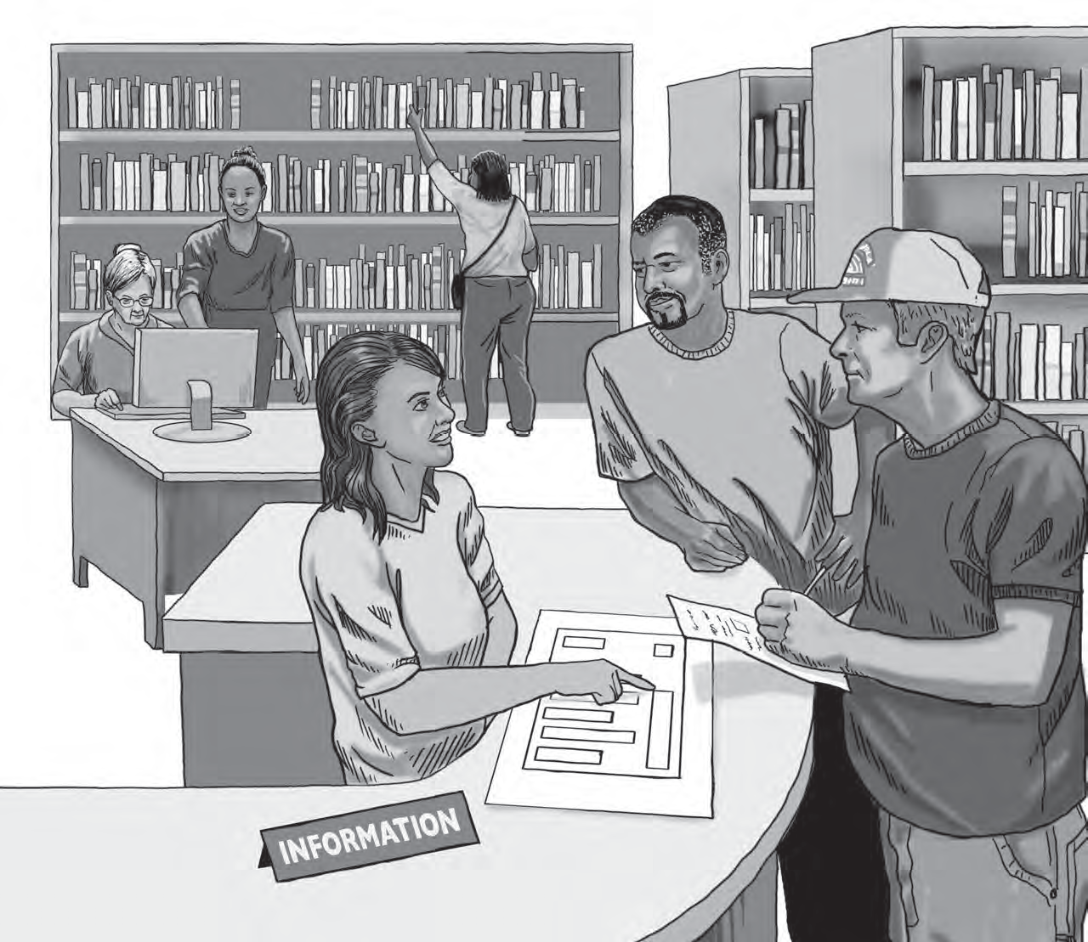
Module 6: Eleven Resources
Page 119

Slide 58
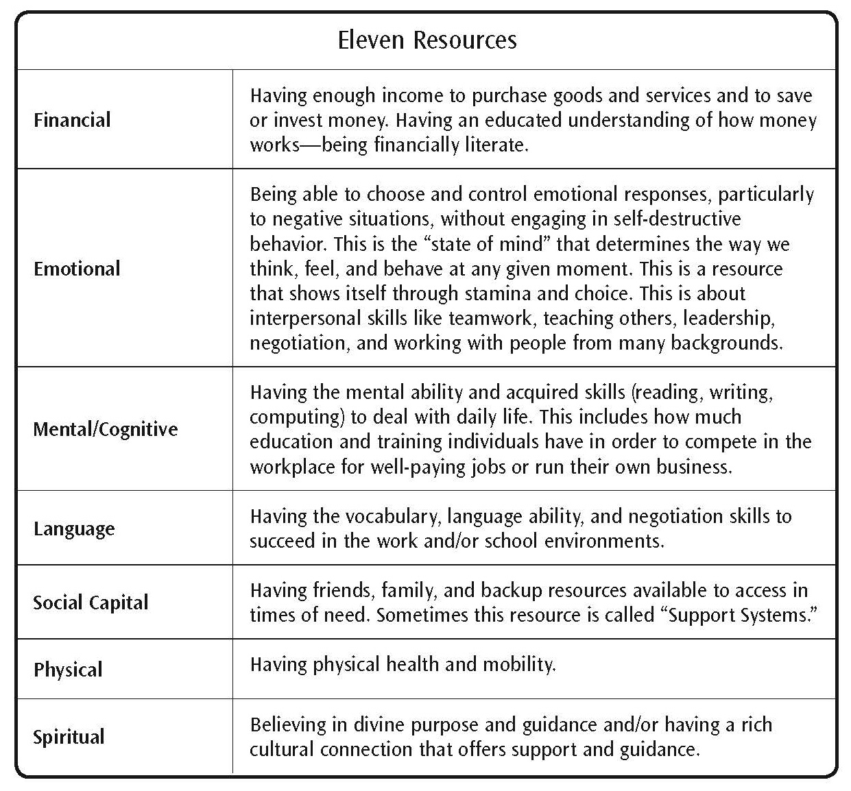
Defining Resources
Page 121

Slide 59
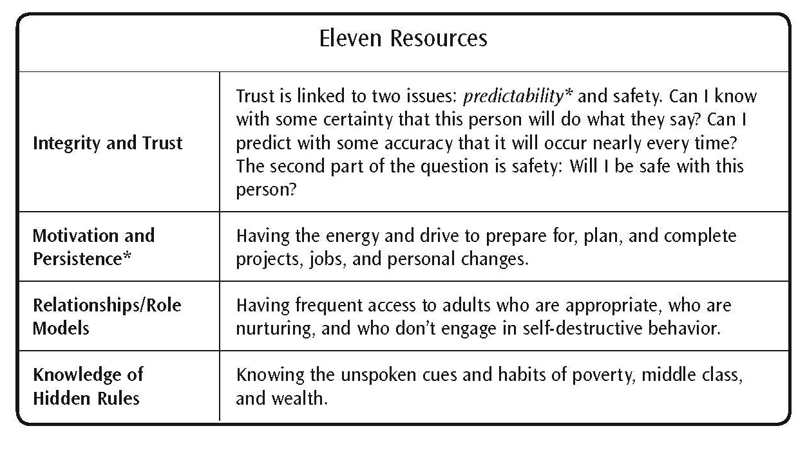
Defining Resources (continued)
Page 122

Slide 60
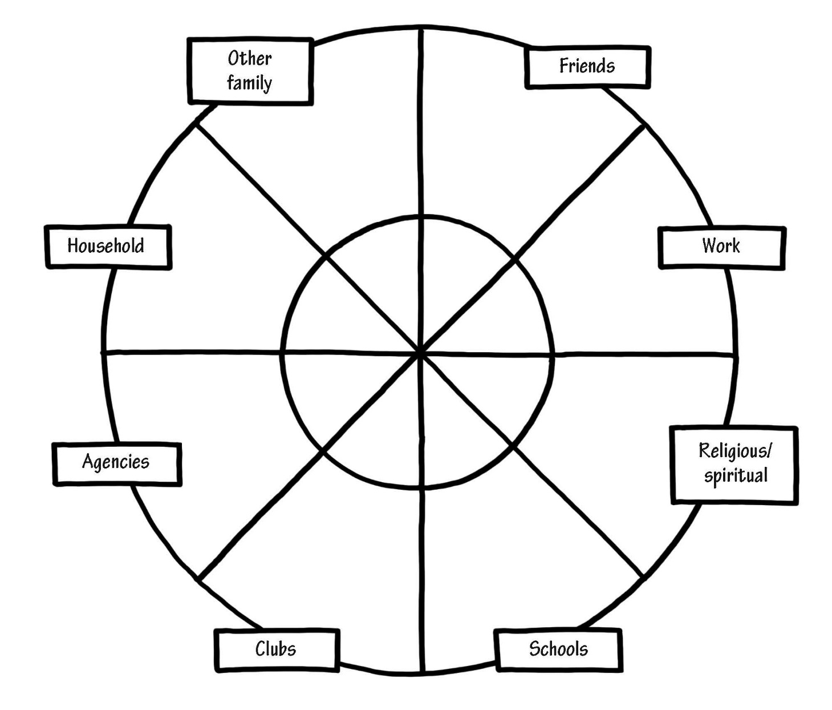
Mental Model of Personal Social Capital
Page 125

Slide 61
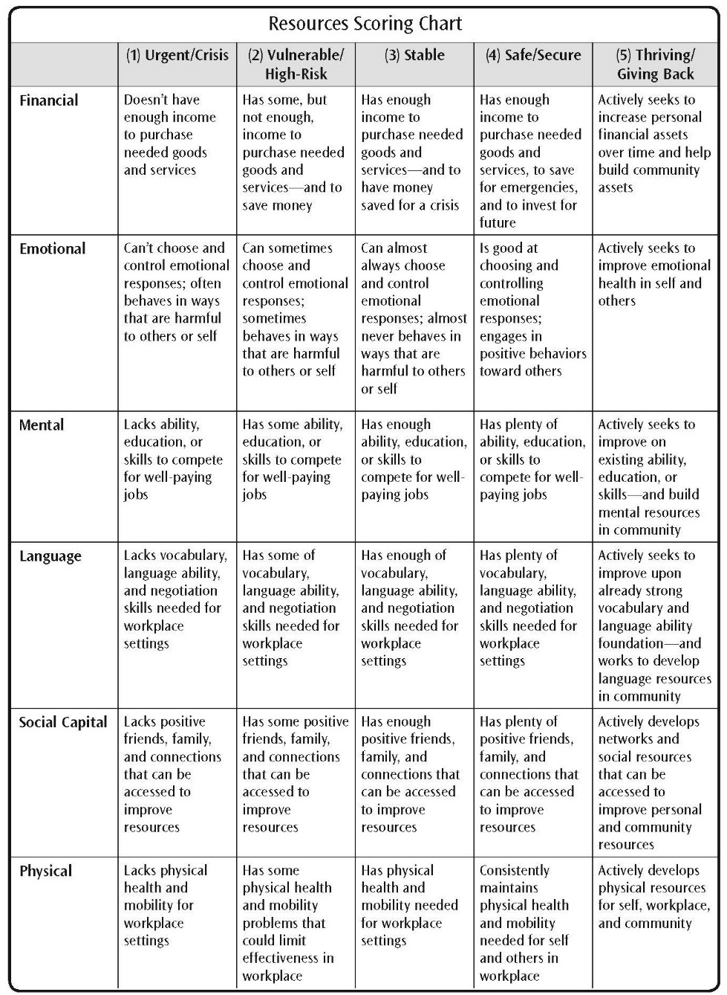
Resources Scoring Chart
Page 133

Slide 62
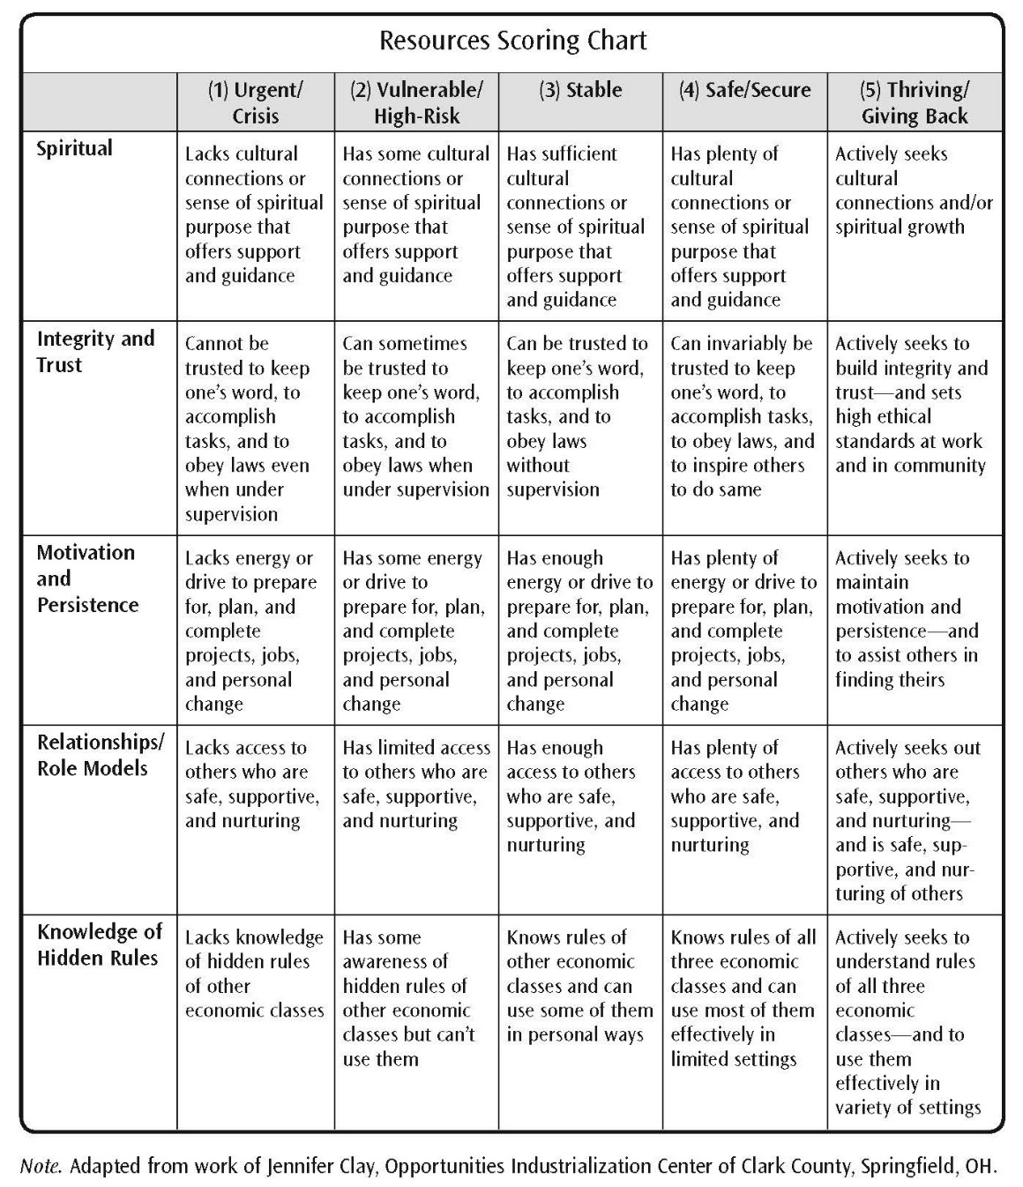
Resources Scoring Chart
Page 134

Slide 63
Module 7: Self-Assessment of Resources
Page 139

Slide 64
Self Assessment of Resources Activity
https://fs27.formsite.com/a34qO0/32xfkh5fdp/index.html
Link to Demographics:
https://fs27.formsite.com/a34qO0/mu99yrrncv/index.html
Link to ROI questions:
https://fs27.formsite.com/a34qO0/jhvz28mpjq/index.html
Page 142

Slide 65
Self Assessment of Resources
Page 142

Slide 66
Self Assessment of Resources
Page 143

Slide 67
Self Assessment of Resources
Page 144

Slide 68
Self Assessment of Resources
Page 145

Slide 69
Self Assessment of Resources
Page 146

Slide 70
Self Assessment of Resources
Page 147

Slide 71
Self Assessment of Resources
Page 148

Slide 72
Self Assessment of Resources
Page 149

Slide 73
Self Assessment of Resources
Page 150

Slide 74
Self Assessment of Resources
Page 151

Slide 75
Self Assessment of Resources
Page 152

Slide 76
Self Assessment of Resources
Page 153

Slide 77
Self Assessment of Resources
Page 154

Slide 78
Self Assessment of Resources
Page 155

Slide 79
Self Assessment of Resources
Page 156

Slide 80
Self Assessment of Resources
Page 157

Slide 81
Self Assessment of Resources
Page 158

Slide 82
Self Assessment of Resources
Page 159

Slide 83
Self Assessment of Resources
Page 160

Slide 84
Self Assessment of Resources
Page 161

Slide 85
Self Assessment of Resources
Page 162

Slide 86
Self Assessment of Resources
Page 163

Slide 87
Mental Model of Resources
Page 164

Slide 88
Module 8: Community Assessment
Page 167

Slide 89
Community Assessment Activity
https://fs27.formsite.com/a34qO0/lqjau6rea8/index.html
Page 170

Slide 90
Community Assessment
Page 170

Slide 91
Community Assessment
Page 171

Slide 92
Community Assessment
Page 172

Slide 93
Community Assessment
Page 173

Slide 94
Community Assessment
Page 174

Slide 95
Community Assessment
Page 175

Slide 96
Community Assessment
Page 176

Slide 97
Community Assessment
Page 177

Slide 98
Community Assessment
Page 178

Slide 99
Community Assessment Mental Model
Page 179

Slide 100
Community Assets Map
Page 181

Slide 101
One-on-One Relationships
Page 182

Slide 102
Sample Community Map
Page 184

Slide 103
Module 9: Building Resources
Page 187

Slide 104
Analyzing the Differences Between Getting-By and Getting-Ahead Resources
Page 190

Slide 105
Example: Tic-Tac-Toe Diagram
Page 193

Slide 106
Video: Tic-Tac-Toe Activity
https://spaces.hightail.com/receive/JAjfdjCZ47
Page 193

Slide 107
Example: Resource Development Worksheet for Building Emotional Resources
Page 194

Slide 108
Example: Resource Development Worksheet for Building Emotional Resources (continued)
Page 195

Slide 109
Module 10: Personal and Community Plans
Page 199

Slide 110
Decide what to work on.
Page 202

Slide 111
Define why you want to work on these resources.
Page 202

Slide 112
Example: Procedural Steps
Page 204

Slide 113
Where to Go to Get Help
Page 205

Slide 114
Example: Plan for First Week
Page 205

Slide 115
Example: Example: Closing ‘Back Doors’
Page 206

Slide 116
Example: Support for Change Mental Model
Page 208

Slide 117
For Facilitators Only
Model Fidelity Scale:
https://fs27.formsite.com/a34qO0/9cuc2cnsic/index.html

