Slide 1
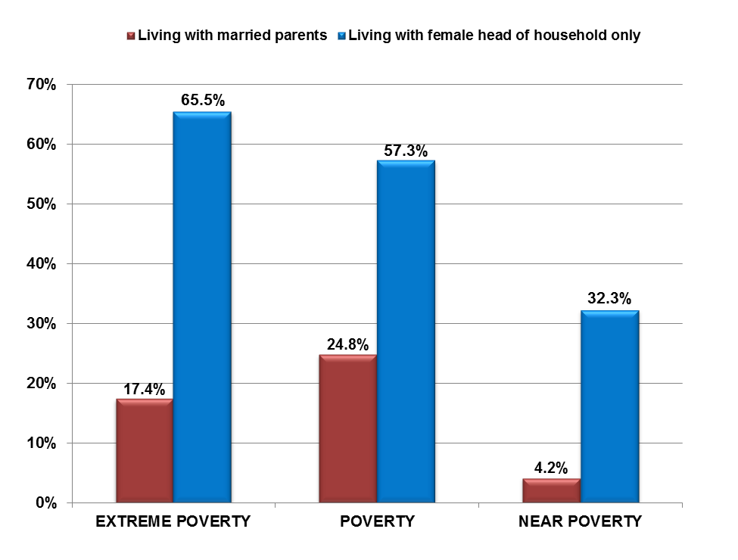
Extreme Poverty, Poverty, and Near Poverty Rates for Children Under Age 5, by Living Arrangement: 2012
The data for Extreme Poverty, Poverty, and Near Poverty Rates for Children Under Age 5, by Living Arrangement are from table POV03 (50% of poverty, 100% of poverty, and 125% of poverty) People in Families by Family Structure, Iterated by Income-to-Poverty-Ratio, U.S. Census Bureau, Current Population Survey, 2012 Annual Social and Economic Supplement.
Extreme poverty: Below 50% of poverty
Poverty: Below 100% of poverty
Near poverty: Below 125% of poverty
Source: U.S. Census Bureau, Current Population Survey, 2013 Annual Social and Economic Supplement.

Slide 2
2013 Poverty Guidelines for the
48 Contiguous States and Washington D.C.
Family Size | Annual Income
1 | $11,490
2 | $15,510
3 | $19,530
4 | $23,550
Source: U.S. Department of Health and Human Services (January 2013). Federal Register, Vol. 78, No. 16, January 24, 2013, pp. 5182-5183

Slide 3
Household Income in 20% Increments of Total: 2012
Group | Average Household Income Ranges: 2012
LOWEST 20% | $0–$20,593
SECOND 20% | $20,594–$39,736
THIRD 20% | $39,737–$64,554
FOURTH 20% | $64,555–$104,086
HIGHEST 20% | $104,087+
TOP 5% (part of highest 20%) | $191,150+
Source: U.S. Census Bureau, Current Population Survey, 2013 Annual Social and Economic Supplement (households as of March of the following year).

Slide 4
Breakdown of U.S. Households, by Total Money Income: 2012
Income | # of U.S. Households (in millions) | % of All U.S. Households
Less than $10,000 | 8,929,655 | 7.7%
$10,000 to $14,999 | 6,494,294 | 5.6%
$15,000 to $24,999 | 12,872,619 | 11.1%
$25,000 to $34,999 | 12,060,832 | 10.4%
$35,000 to $49,999 | 16,003,797 | 13.8%
$50,000 to $74,999 | 20,874,517 | 18.0%
$75,000 to $99,999 | 13,800,375 | 11.9%
$100,000 to $149,999 | 14,380,223 | 12.4%
$150,000 to $199,999 | 5,334,599 | 4.6%
$200,000 or more | 5,334,599 | 4.6%
Source: U.S. Census Bureau, Current Population Survey, 2013 Annual Social and Economic Supplement (households as of March of the following year).
Estimated median household income: $51,371
Source: U. S. Census Bureau, 2012 American Community Survey 1-Year Estimates.

Slide 5
Number and Percentage of Children in Poverty, by Race: 2012
 | NUMBER OF CHILDREN IN POVERTY | PERCENTAGE OF CHILDREN IN POVERTY
ALL RACES | 20,229,811 | 21.8%
WHITE | 9,562,000 | 18.0%
AFRICAN-AMERICAN | 4,101,000 | 37.5%
HISPANIC * | 5,788,000 | 33.3%
ASIAN-AMERICAN | 477,000 | 13.4%
AMERICAN INDIAN AND ALASKA NATIVE ** | 259,127 | 58.2%
NATIVE HAWAIIAN AND OTHER PACIFIC ISLANDER ** | 42,684 | 39.5%
* Hispanics may be of any race.
** Data from U.S. Census Bureau, 2012 American Community Survey 1-Year Estimates.
Source: U.S. Census Bureau, Current Population Survey, 2013 Annual Social and Economic Supplement.

Slide 6
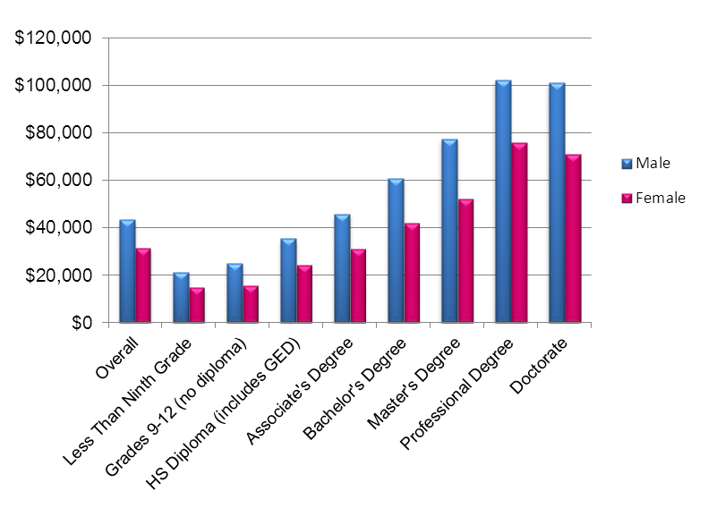
U.S. Median Income for Persons Age 25 and Older,
by Sex and Educational Attainment: 2012
 | Overall | Less Than Ninth Grade | Grades 9–12 (no diploma) | HS Diploma (includes GED) | Associate's Degree | Bachelor's Degree | Master's Degree | Professional Degree | Doctorate
 |  |  |  | Numbers of persons with earnings (in thousands)
Male | 66,863 | 2,503 | 3,871 | 19,214 | 6,497 | 15,027 | 5,595 | 1,321 | 1,424
Female | 59,634 | 1,276 | 2,366 | 14,527 | 7696 | 14,863 | 6,732 | 868 | 910
 |  |  | Median earnings, in 2012 dollars
Male | $43,299 | $21,339 | $25,058 | $35,373 | $45,834 | $60,758 | $77,505 | $102,240 | $100,968
Female | $31,482 | $15,015 | $15,664 | $24,385 | $31,110 | $41,927 | $52,217 | $76,038 | $70,939
Source: U.S. Census Bureau, Current Population Survey, 2013 Annual Social and Economic Supplement.

Slide 7
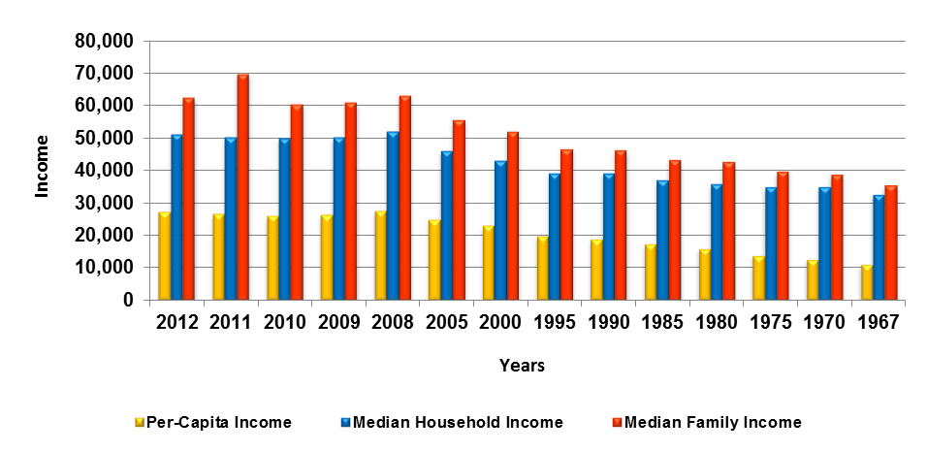
U.S. Per-Capita Income, Median Household Income,
and Median Family Income: 1967 to 2012
Year | Per-Capita Income | Median Household Income | Median Family Income
2012 | 27,319 | 51,371 | 62,527
2011 | 26,708 | 50,502 | 69,821
2010 | 26,059 | 50,046 | 60,609
2009 | 26,409 | 50,221 | 61,082
2008 | 27,589 | 52,029 | 63,366
2005 | 25,035 | 46,242 | 55,832
2000 | 22,970 | 43,162 | 52,148
1995 | 19,871 | 39,306 | 46,843
1990 | 18,894 | 39,324 | 46,429
1985 | 17,280 | 37,059 | 43,518
1980 | 15,844 | 36,035 | 42,776
1975 | 13,972 | 34,980 | 39,784
1970 | 12,543 | 35,232 | 38,954
1967 | 11,067 | 32,783 | 35,629
Source: U.S. Census Bureau, 2012 American Community Survey 1-Year Estimates.

Slide 8
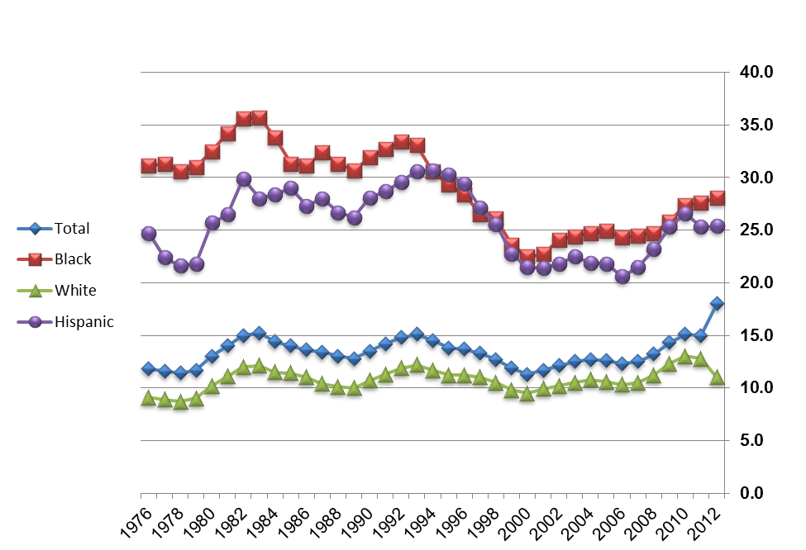
Percentage of
U.S. Persons Below Poverty Level, by Race
and Ethnicity:
1976 to 2012
Source: U.S. Census Bureau, Current Population Survey, 2013 Annual Social and Economic Supplement.

